Slide 2
NORTH AUGUSTA MIDDLE SCHOOL
SCHEMATIC DESIGN SUMMARY
AIKEN COUNTY PUBLIC SCHOOL DISTRICT June 10, 2025
Notes:
**It’s not really this complicated, just erase all but one letter and enter your own info (then erase that first letter). But if you’re curious and want to play around with the presentation, the below is the guide:
TITLE:
font: Calibri Light Headings (all caps); Bold
font size: lg. depending on length 50/60 pt.
color: Black & Gray (Black, Text 1 Lighter 35%)
Subheading:
Part 1 (ACPSD): Font: Calibri Light (Headings) All Caps, Light Green, 24 pt.
Part 2 (DATE): Font: Calibri Light (Headings) Small Caps, Gray (Black, Text 1 Lighter 35%)

Slide 3
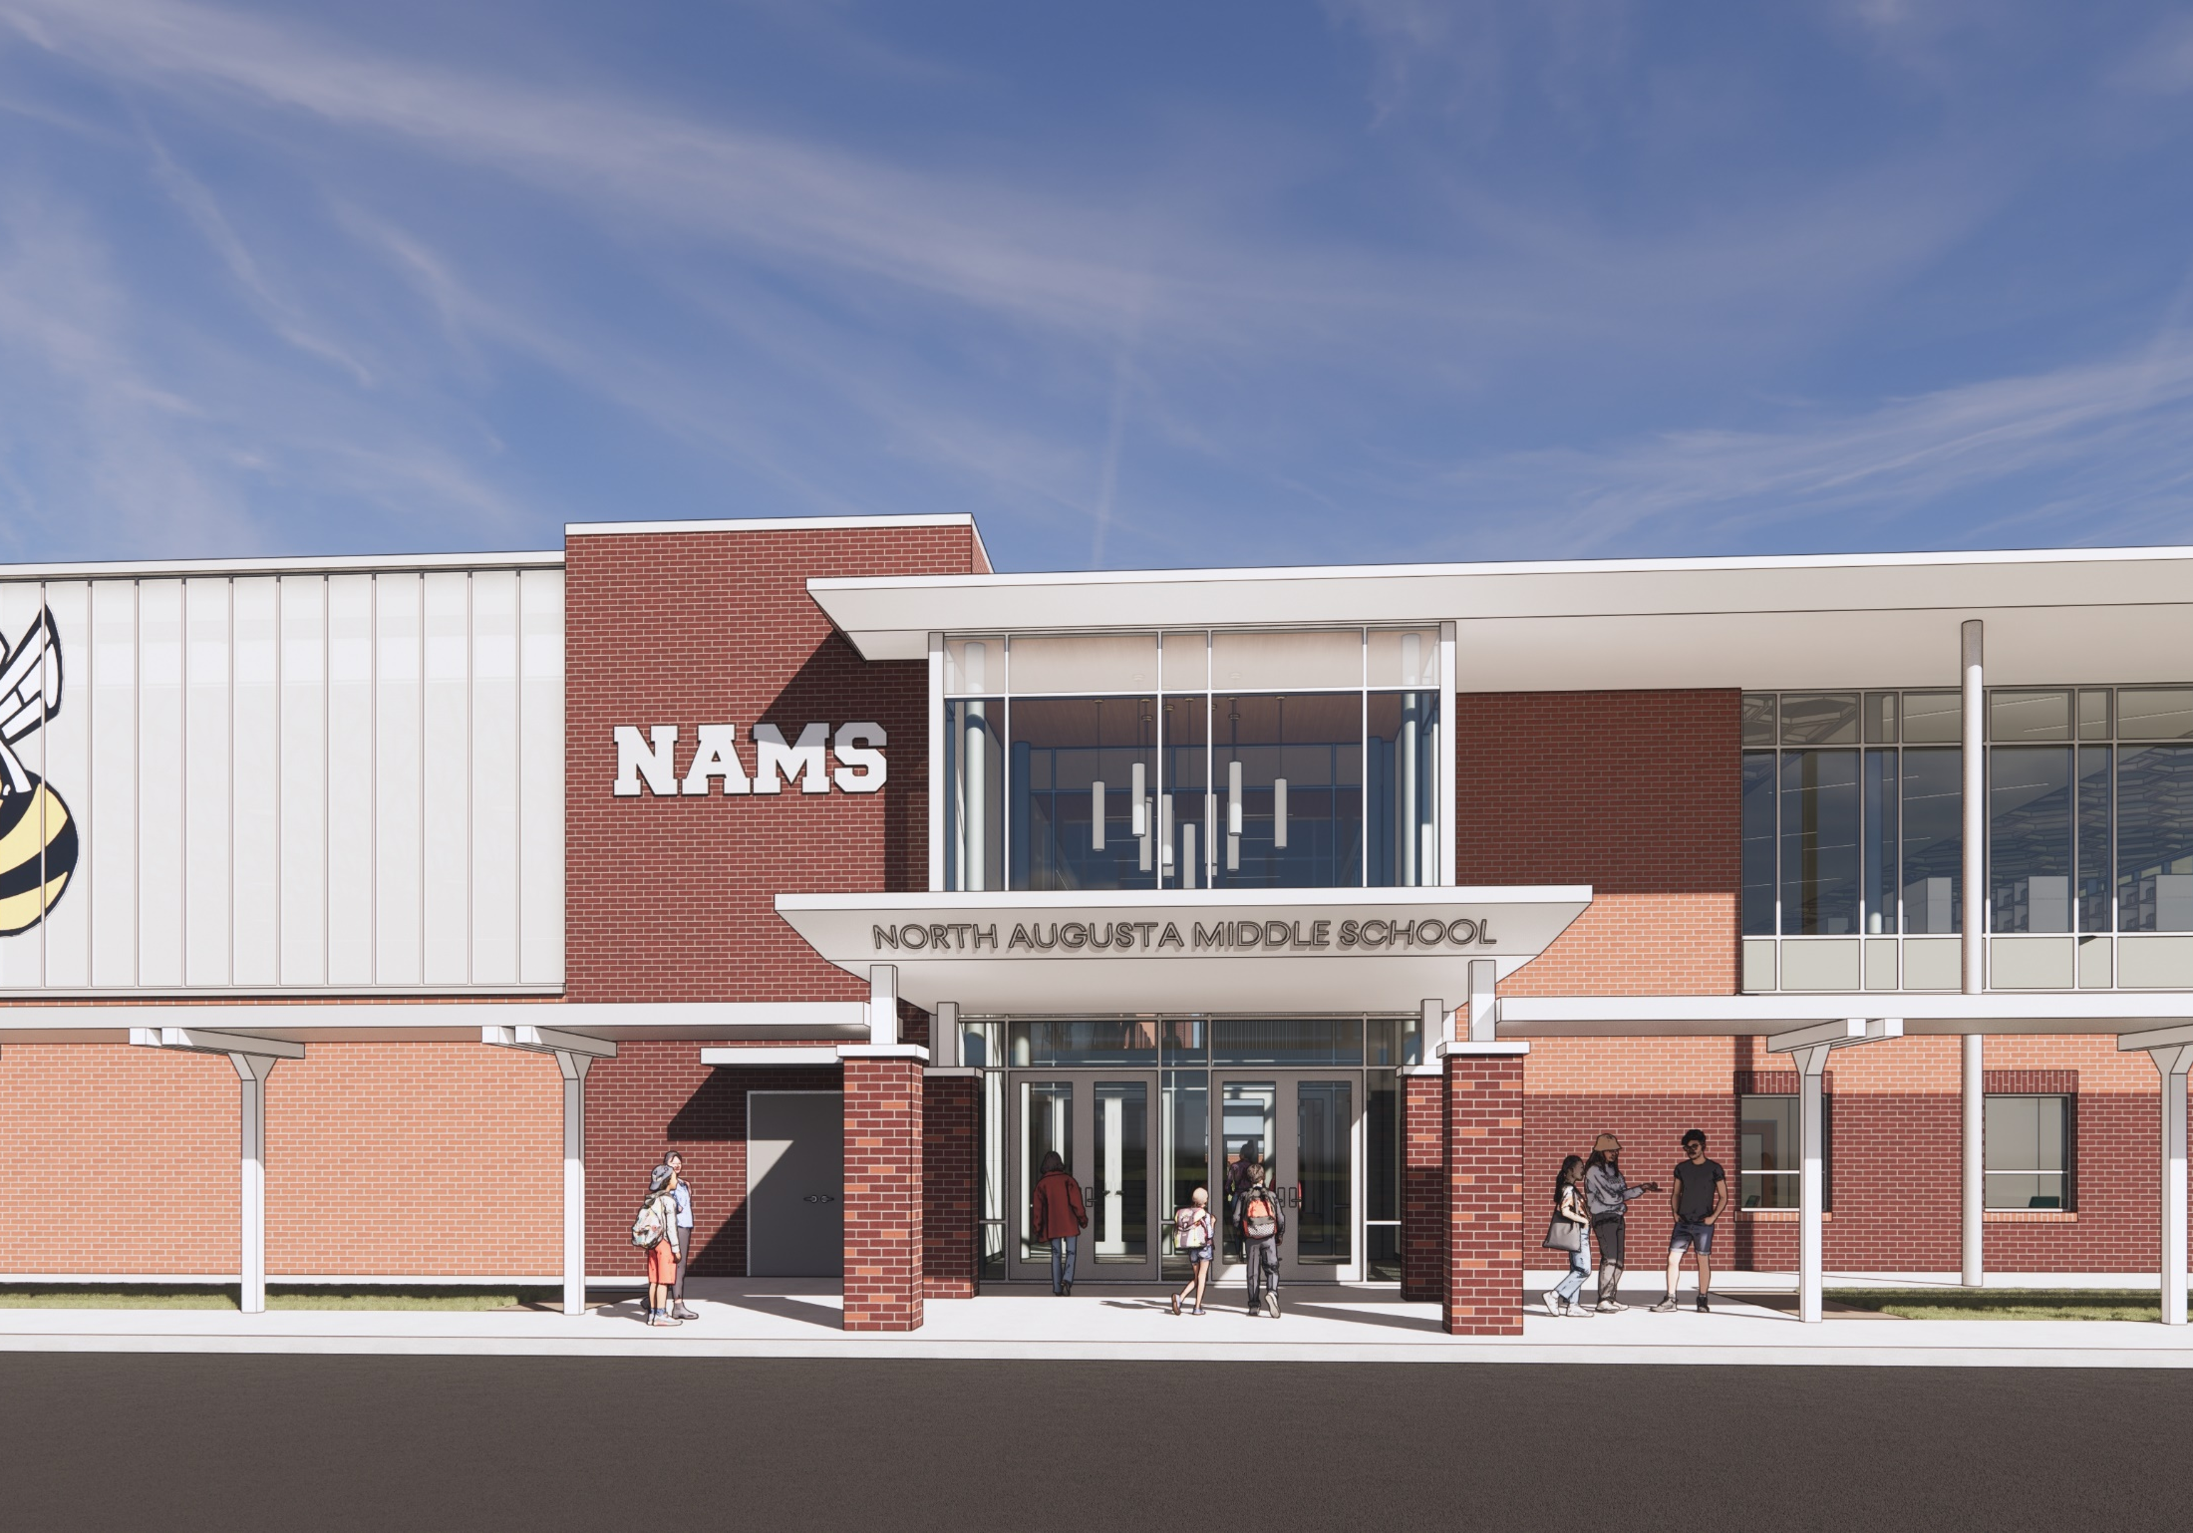
AIKEN COUNTY PUBLIC SCHOOL DISTRICT NAMS| June 10, 2025

Slide 4
VISION STATEMENT
The North Augusta Middle School Addition will have a clearly defined front entry while providing modern, secure, and inspiring educational environments / outdoor learning spaces that embody Jacket pride and support the diverse needs of students and staff.
The new facility will feature flexible, well-lit classrooms with adaptable furniture, strategically placed common areas —including centralized administrative and collaborative hubs —and improved circulation that ensures ease of movement and clear wayfinding. It will also provide all academic spaces, including specialized areas for indoor athletics, performing arts, exploratory courses, and student support services.
Additionally, the design will integrate modern mechanical / electrical systems and be forward-thinking to accommodate future growth. The new building will be delivered on time and within budget to set a new standard of excellence for NAMS.
AIKEN COUNTY PUBLIC SCHOOL DISTRICT NAMS | June 10, 2025
Notes:
Title:
Font: Calibri Light (Headings)
Size: about 54+ pt., depending on length
I use “AV” to increase the space between letters to as loose as possible.
Section Content:
Font: Californian 20+ size, black
Color: Light green/black/gray bullets (your preference)
Info Bar at Bottom:
Enter the title of your presentation (Font: Calibri; Size: 18 pt, all lower case; Color: white) and Date (Font: Calibri; Size: 18 pt., small caps; Color: gray)
Copy and paste on each slide, with the exception of slide 1.

Slide 5
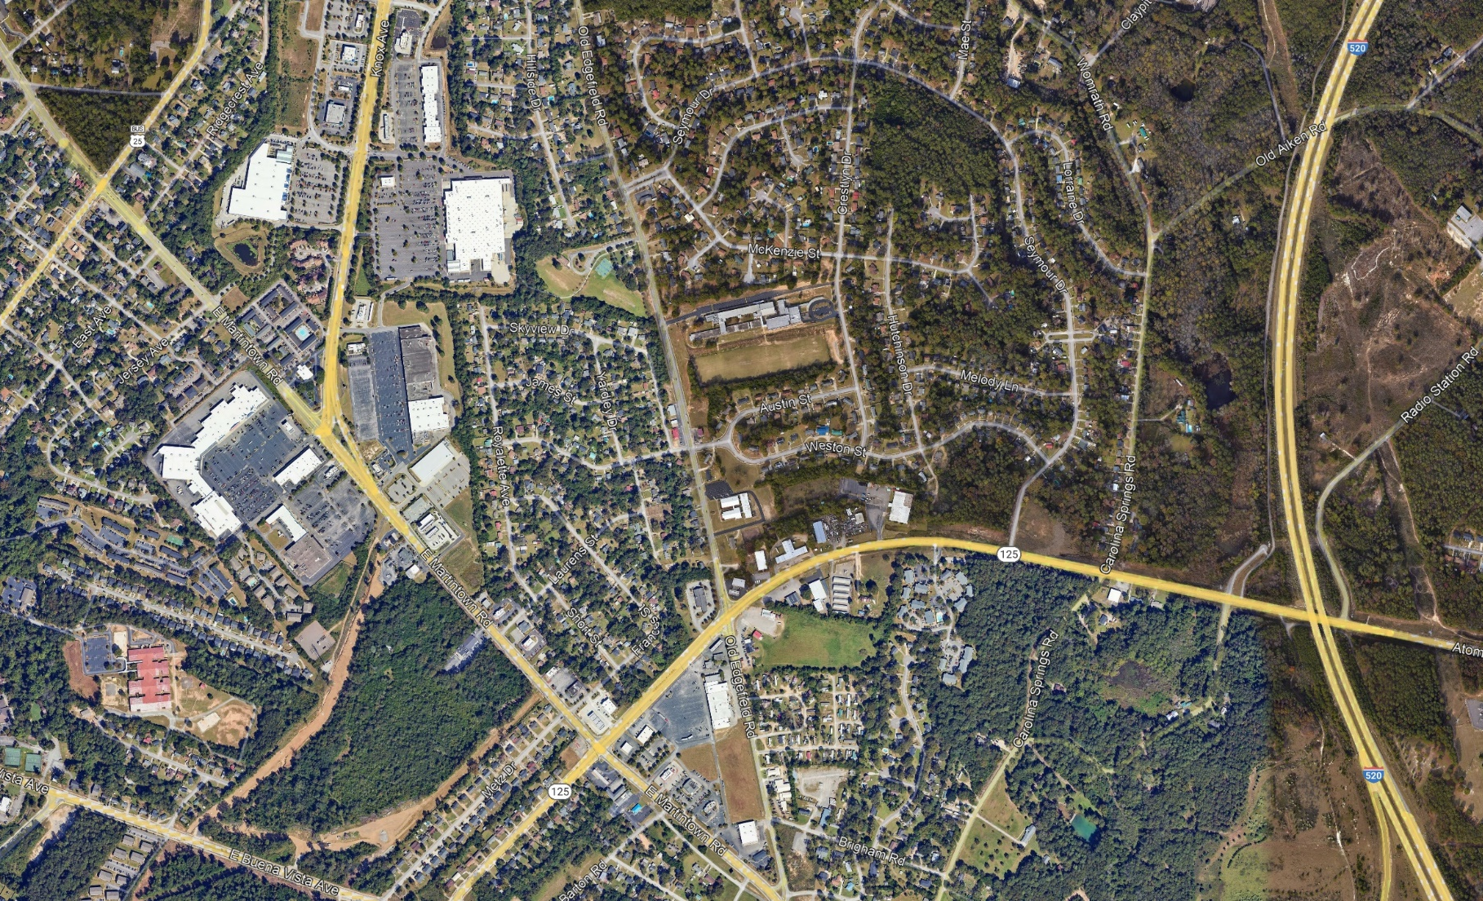
PROJECT SITE
AIKEN COUNTY PUBLIC SCHOOL DISTRICT NAMS | June 10, 2025
Notes:
Title:
Font: Calibri Light (Headings)
Size: about 54+ pt., depending on length
I use “AV” to increase the space between letters to as loose as possible.
Section Content:
Font: Californian 20+ size, black
Color: Light green/black/gray bullets (your preference)
Info Bar at Bottom:
Enter the title of your presentation (Font: Calibri; Size: 18 pt, all lower case; Color: white) and Date (Font: Calibri; Size: 18 pt., small caps; Color: gray)
Copy and paste on each slide, with the exception of slide 1.

Slide 6
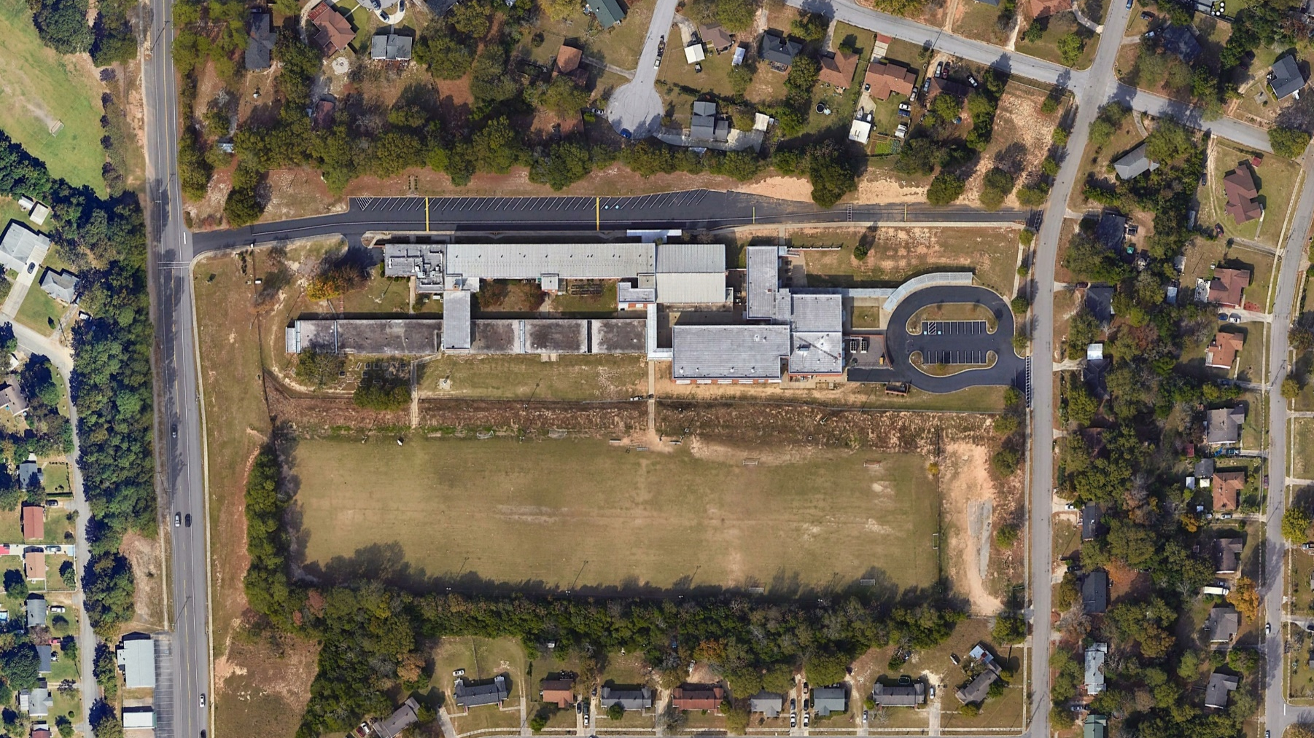
PROJECT SITE
AIKEN COUNTY PUBLIC SCHOOL DISTRICT NAMS | June 10, 2025
Notes:
Title:
Font: Calibri Light (Headings)
Size: about 54+ pt., depending on length
I use “AV” to increase the space between letters to as loose as possible.
Section Content:
Font: Californian 20+ size, black
Color: Light green/black/gray bullets (your preference)
Info Bar at Bottom:
Enter the title of your presentation (Font: Calibri; Size: 18 pt, all lower case; Color: white) and Date (Font: Calibri; Size: 18 pt., small caps; Color: gray)
Copy and paste on each slide, with the exception of slide 1.

Slide 7
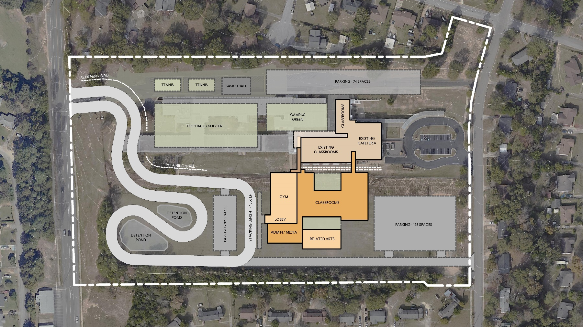
SITE PLAN
AIKEN COUNTY PUBLIC SCHOOL DISTRICT NAMS | June 10, 2025
Notes:
Title:
Font: Calibri Light (Headings)
Size: about 54+ pt., depending on length
I use “AV” to increase the space between letters to as loose as possible.
Section Content:
Font: Californian 20+ size, black
Color: Light green/black/gray bullets (your preference)
Info Bar at Bottom:
Enter the title of your presentation (Font: Calibri; Size: 18 pt, all lower case; Color: white) and Date (Font: Calibri; Size: 18 pt., small caps; Color: gray)
Copy and paste on each slide, with the exception of slide 1.

Slide 8
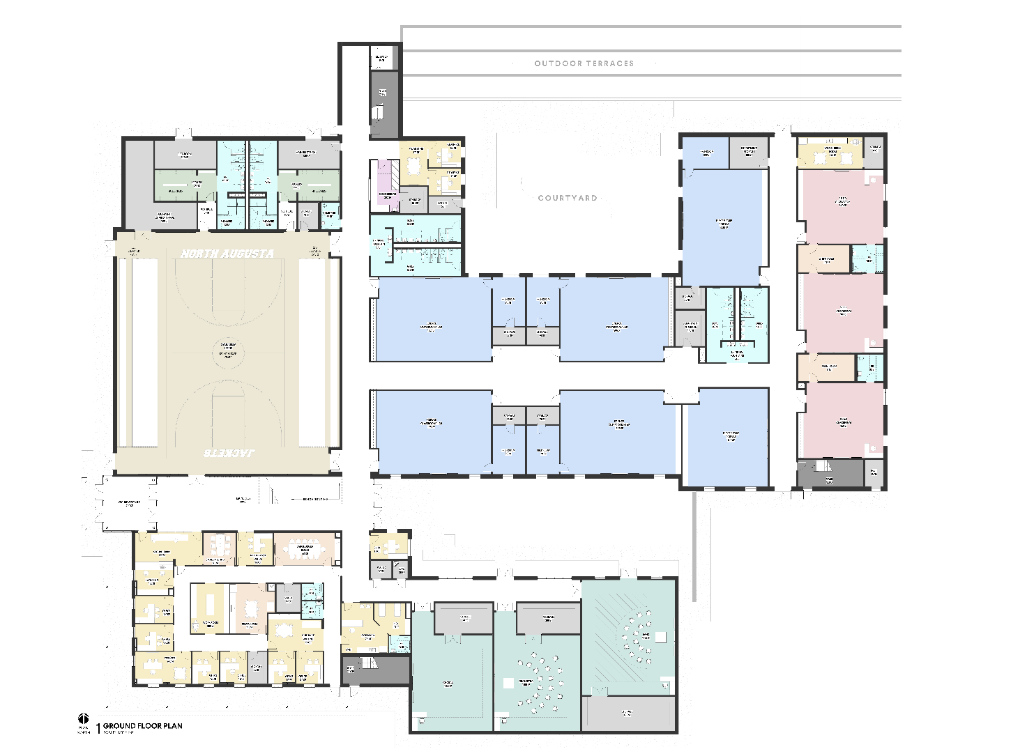
GROUND LEVEL PLAN
AIKEN COUNTY PUBLIC SCHOOL DISTRICT NAMS | June 10, 2025
Notes:
Title:
Font: Calibri Light (Headings)
Size: about 54+ pt., depending on length
I use “AV” to increase the space between letters to as loose as possible.
Section Content:
Font: Californian 20+ size, black
Color: Light green/black/gray bullets (your preference)
Info Bar at Bottom:
Enter the title of your presentation (Font: Calibri; Size: 18 pt, all lower case; Color: white) and Date (Font: Calibri; Size: 18 pt., small caps; Color: gray)
Copy and paste on each slide, with the exception of slide 1.

Slide 9
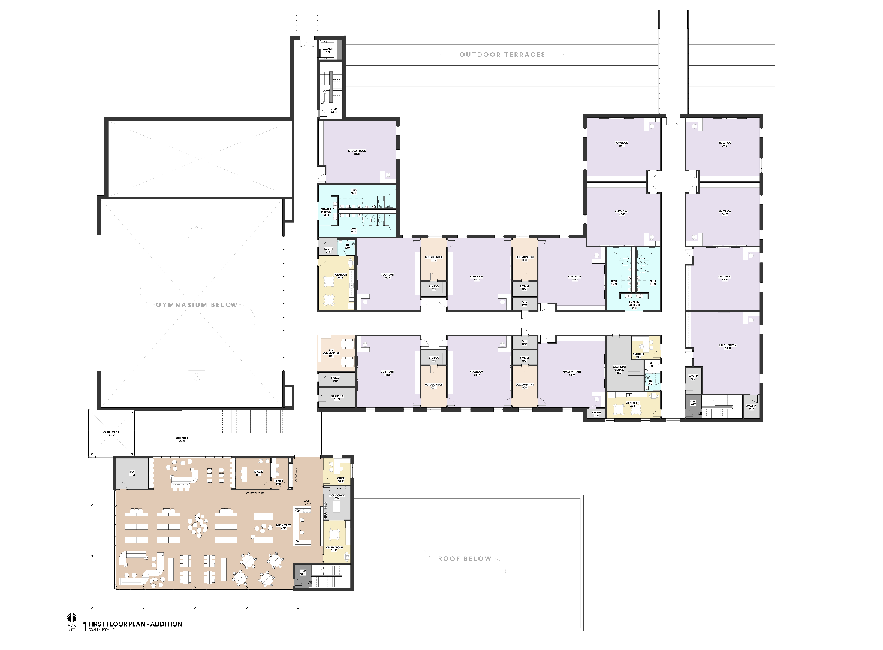
FIRST LEVEL ADDITION PLAN
AIKEN COUNTY PUBLIC SCHOOL DISTRICT NAMS | June 10, 2025
Notes:
Title:
Font: Calibri Light (Headings)
Size: about 54+ pt., depending on length
I use “AV” to increase the space between letters to as loose as possible.
Section Content:
Font: Californian 20+ size, black
Color: Light green/black/gray bullets (your preference)
Info Bar at Bottom:
Enter the title of your presentation (Font: Calibri; Size: 18 pt, all lower case; Color: white) and Date (Font: Calibri; Size: 18 pt., small caps; Color: gray)
Copy and paste on each slide, with the exception of slide 1.

Slide 10
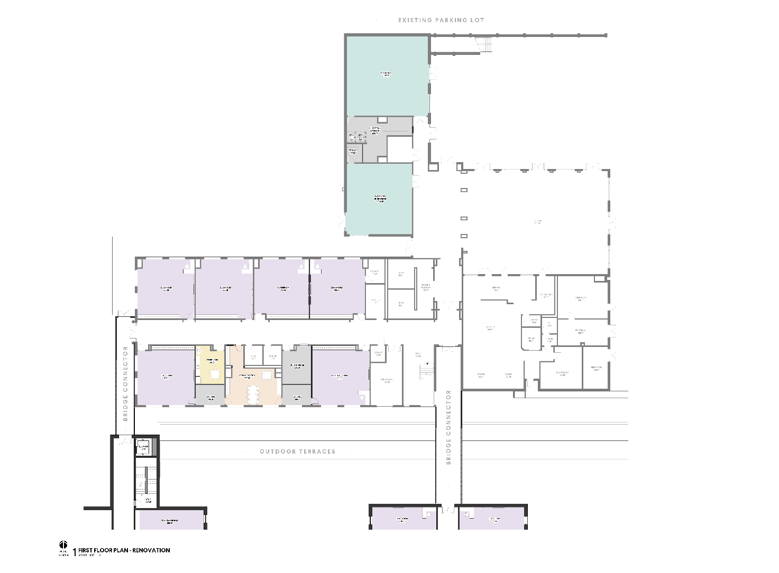
FIRST LEVEL RENOVATION PLAN
AIKEN COUNTY PUBLIC SCHOOL DISTRICT NAMS | June 10, 2025
Notes:
Title:
Font: Calibri Light (Headings)
Size: about 54+ pt., depending on length
I use “AV” to increase the space between letters to as loose as possible.
Section Content:
Font: Californian 20+ size, black
Color: Light green/black/gray bullets (your preference)
Info Bar at Bottom:
Enter the title of your presentation (Font: Calibri; Size: 18 pt, all lower case; Color: white) and Date (Font: Calibri; Size: 18 pt., small caps; Color: gray)
Copy and paste on each slide, with the exception of slide 1.

Slide 11
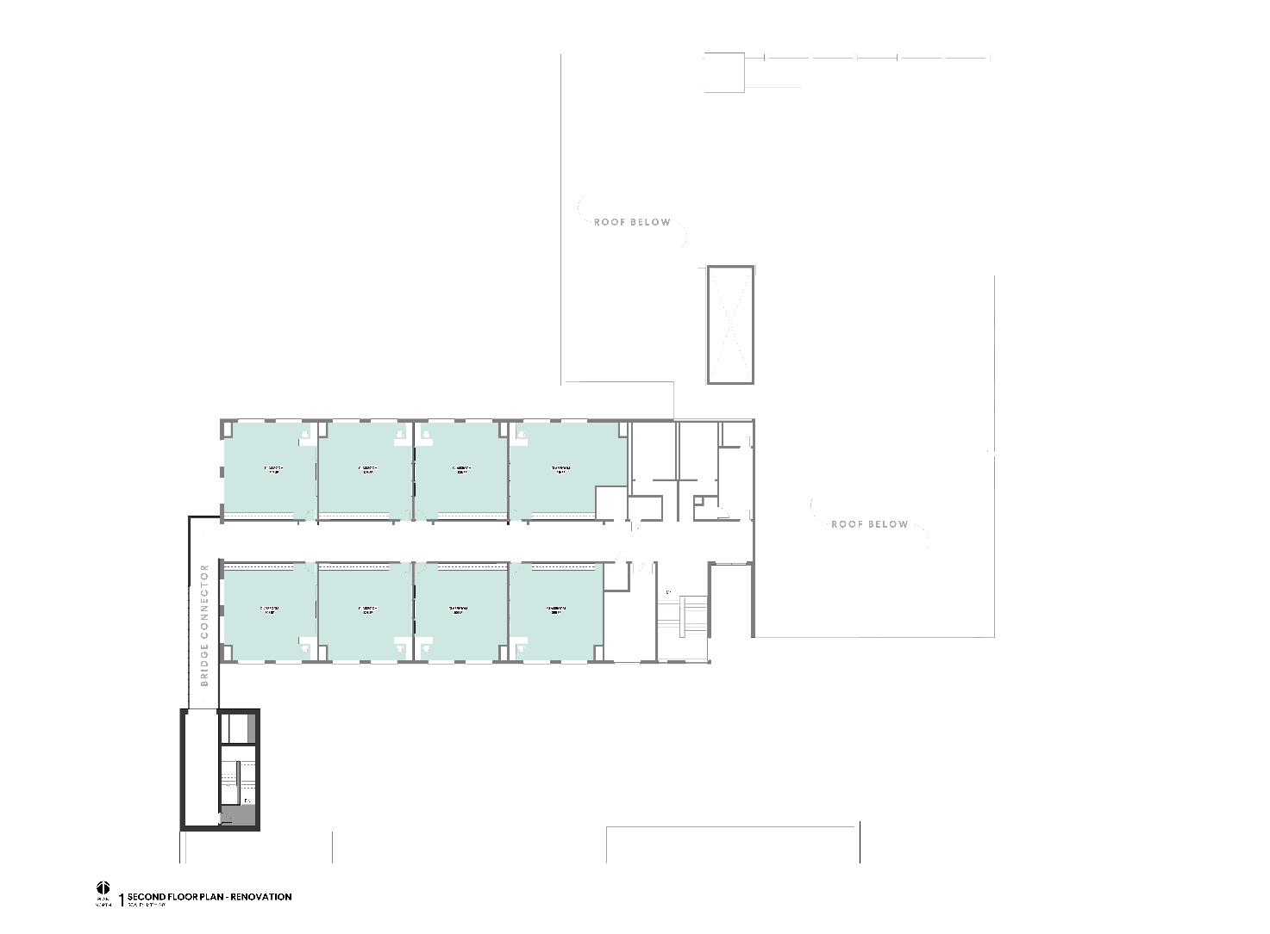
SECOND LEVEL RENOVATION PLAN
AIKEN COUNTY PUBLIC SCHOOL DISTRICT NAMS | June 10, 2025
Notes:
Title:
Font: Calibri Light (Headings)
Size: about 54+ pt., depending on length
I use “AV” to increase the space between letters to as loose as possible.
Section Content:
Font: Californian 20+ size, black
Color: Light green/black/gray bullets (your preference)
Info Bar at Bottom:
Enter the title of your presentation (Font: Calibri; Size: 18 pt, all lower case; Color: white) and Date (Font: Calibri; Size: 18 pt., small caps; Color: gray)
Copy and paste on each slide, with the exception of slide 1.

Slide 12
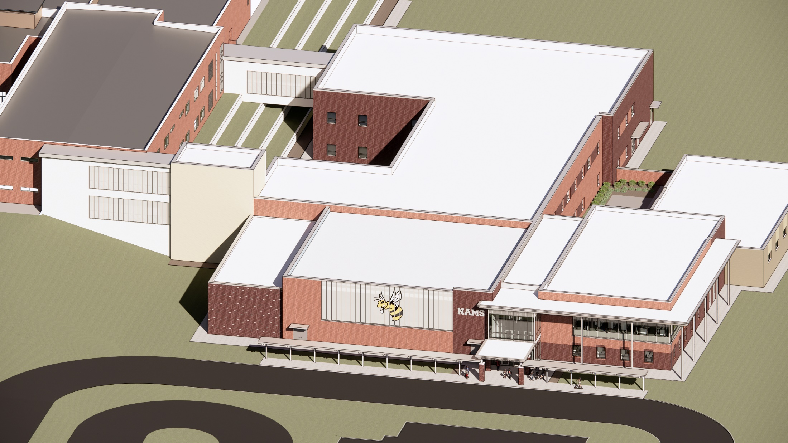
AIKEN COUNTY PUBLIC SCHOOL DISTRICT NAMS | June 10, 2025

Slide 13
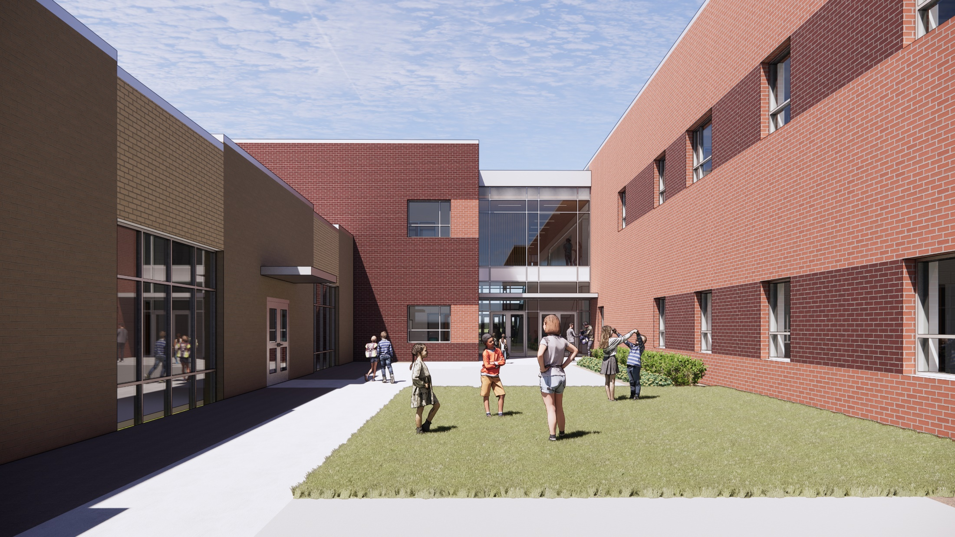
AIKEN COUNTY PUBLIC SCHOOL DISTRICT NAMS | June 10, 2025

Slide 14
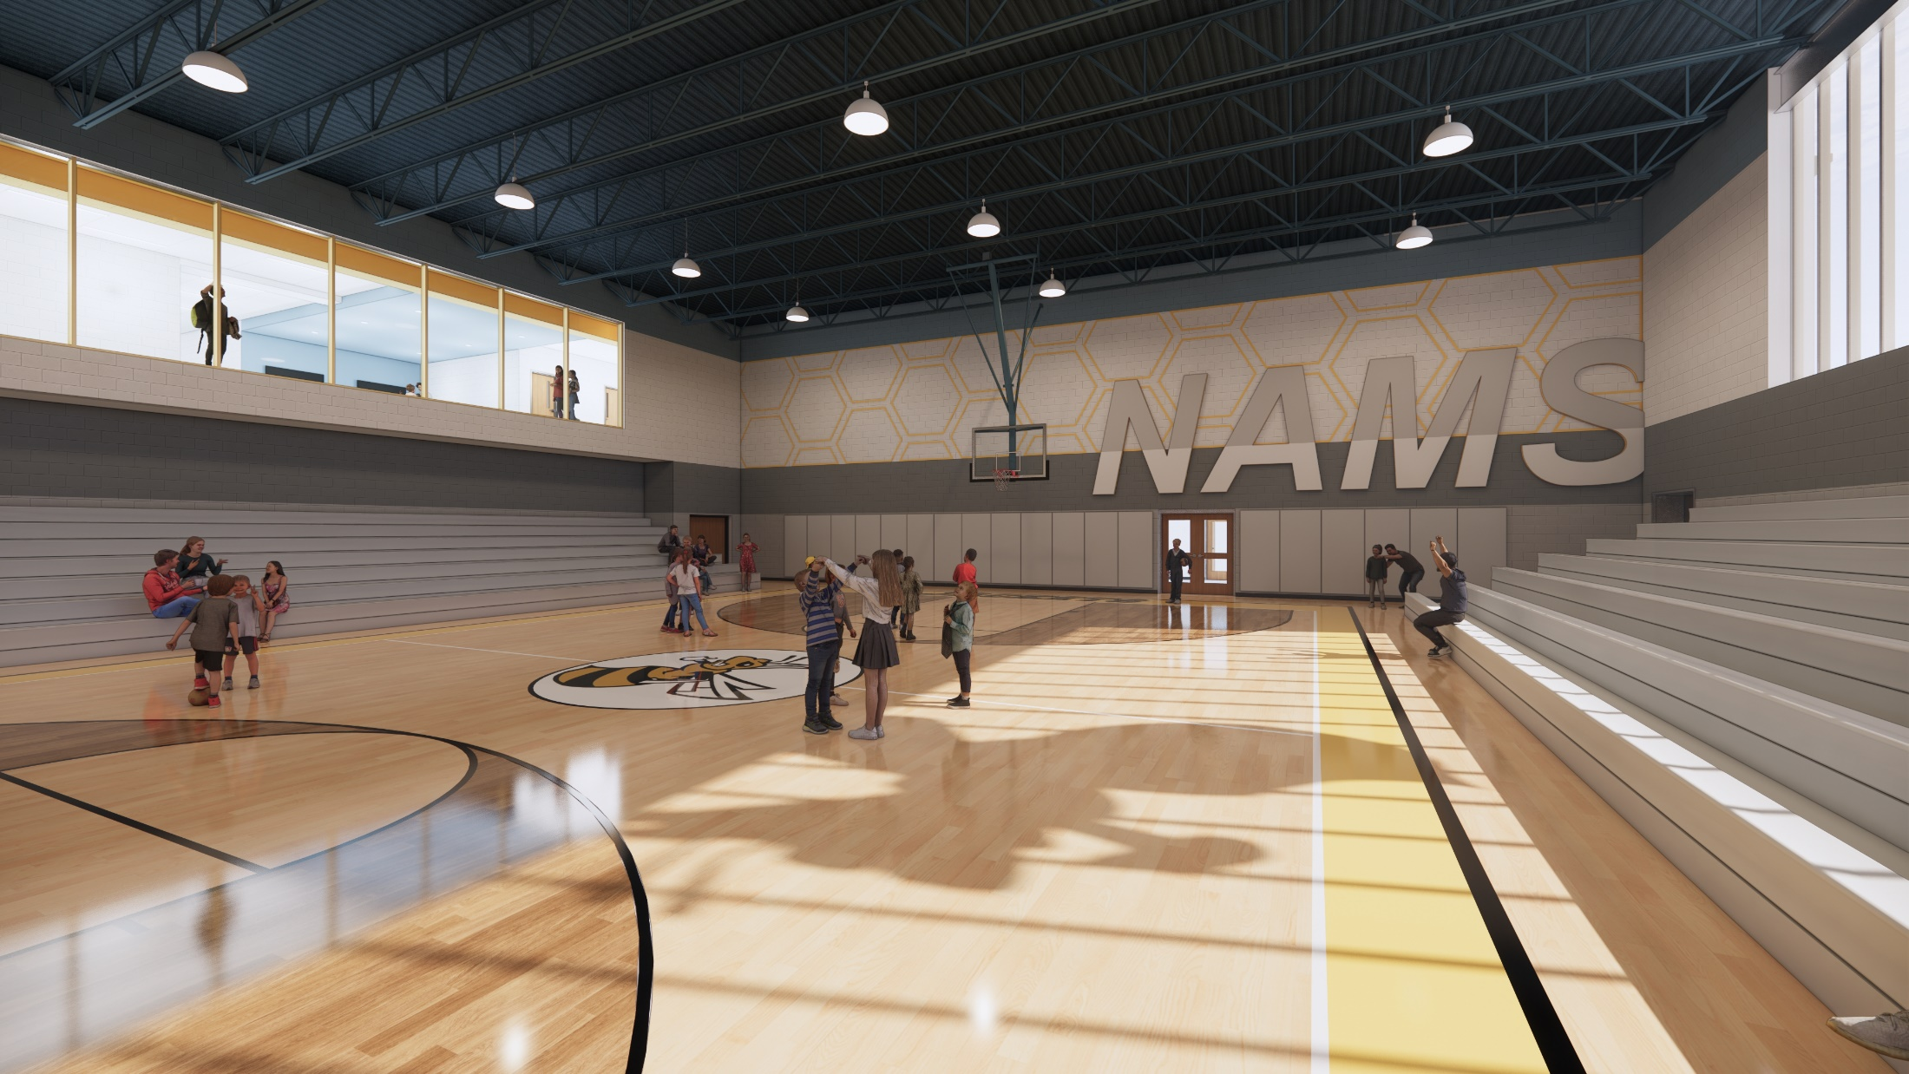
AIKEN COUNTY PUBLIC SCHOOL DISTRICT NAMS | June 10, 2025

Slide 15
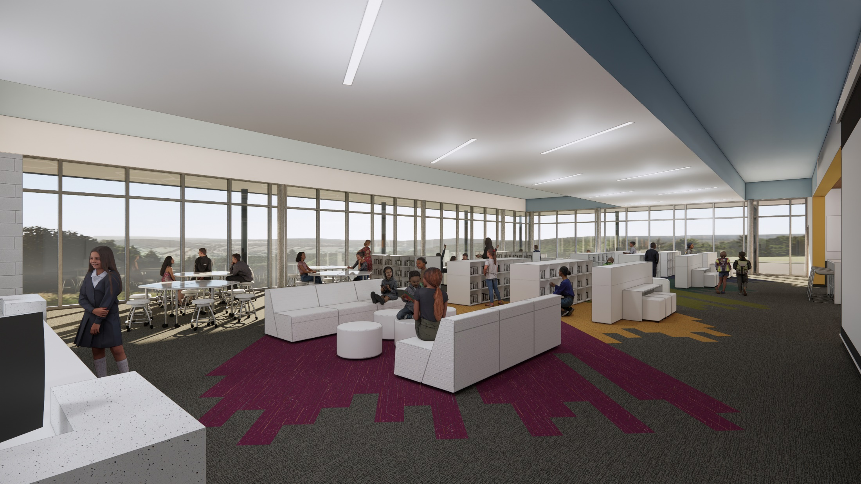
AIKEN COUNTY PUBLIC SCHOOL DISTRICT NAMS | June 10, 2025

Slide 16
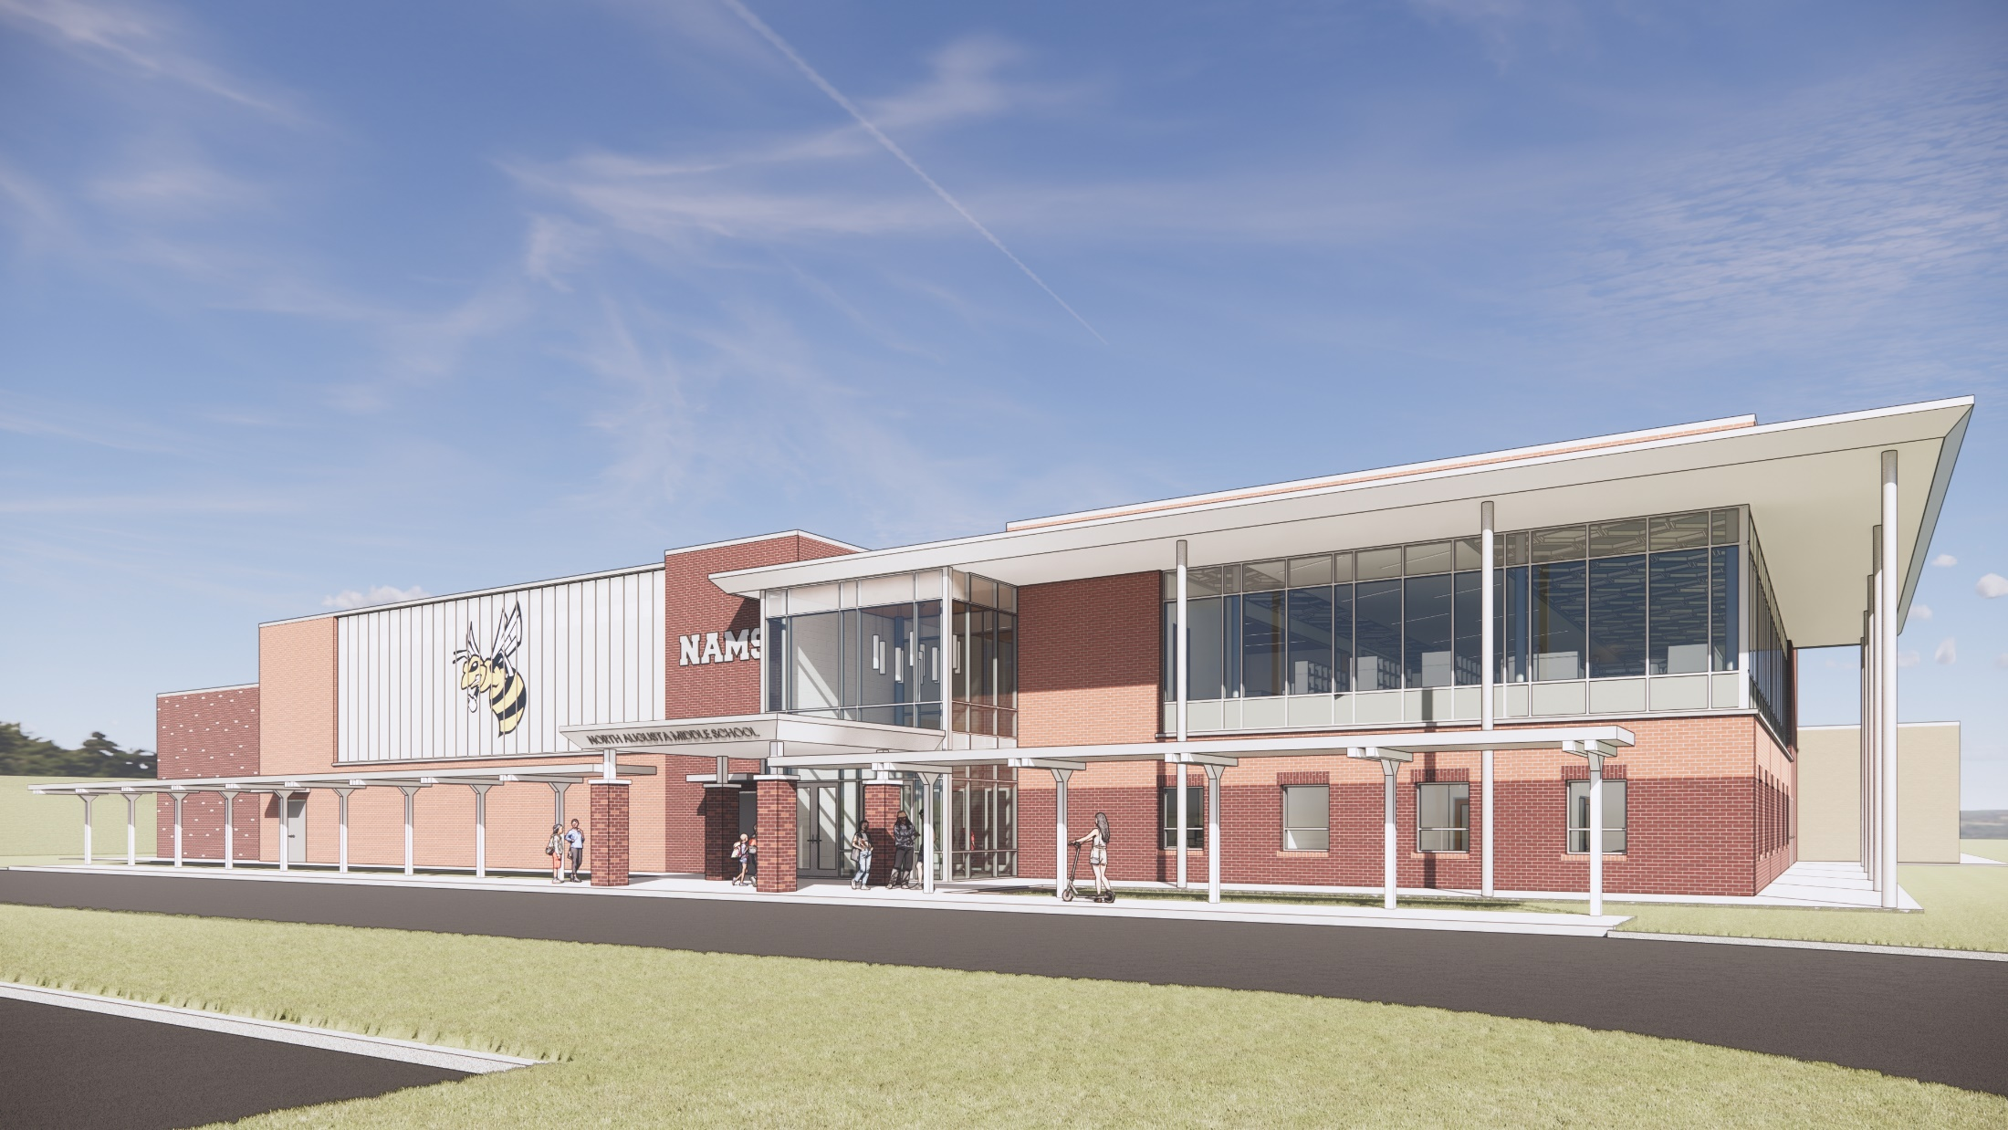
AIKEN COUNTY PUBLIC SCHOOL DISTRICT NAMS | June 10, 2025

Slide 17
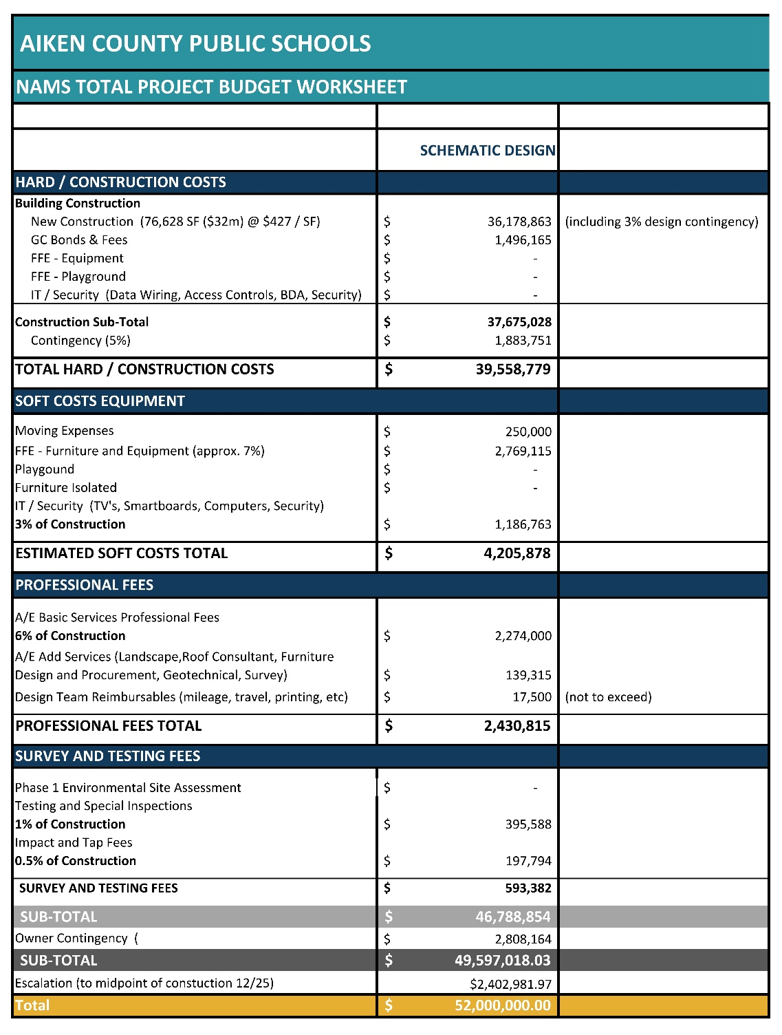
TOTAL PROJECT BUDGET
AIKEN COUNTY PUBLIC SCHOOL DISTRICT NAMS | June 10, 2025

Slide 18
SCHEDULE
AIKEN COUNTY PUBLIC SCHOOL DISTRICT NAMS | June 10, 2025

Slide 19
QUESTIONS & COMMENTS
AIKEN COUNTY PUBLIC SCHOOL DISTRICT NAMS | June 10, 2025
Notes:
Font: Californian FB
Size: 72
Color: gray and black

