Slide 2
WAGENER-SALLEY HIGH SCHOOL NEW CONSTRUCTION
AIKEN COUNTY PUBLIC SCHOOL DISTRICT Construction Status Reports August 13, 2024
Notes:
August 2024 Update:
1. Progress:
All HVAC units running except one.
Recent overheads in B1 and B2 and they are dropping tile in those areas.
Painters out of B2 and have finished the auxiliary gym. They are continuing in B1 to A2. Also working on the three labs.
Lab tops scheduled for next week.
Electrical bringing in additional help for the weekend.
Preparing for asphalt in student parking lot. Proof roll passed.
Scheduling resinous flooring.
Curb and gutter contractor continues to make repairs.
BDA contractor completing system install.
2. Switchgear arrived on site. Power outage scheduled for Monday, July 29th to switch over.
The project is within budget and on schedule.

Slide 3
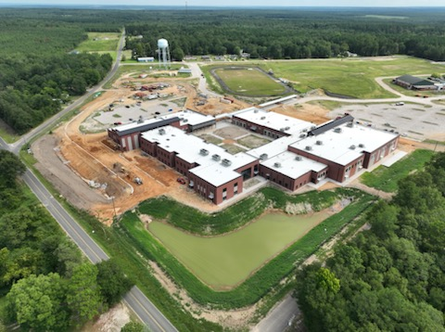
AIKEN COUNTY PUBLIC SCHOOL DISTRICT Construction Status Reports August 13, 2024
Notes:
Aerial view of campus

Slide 4
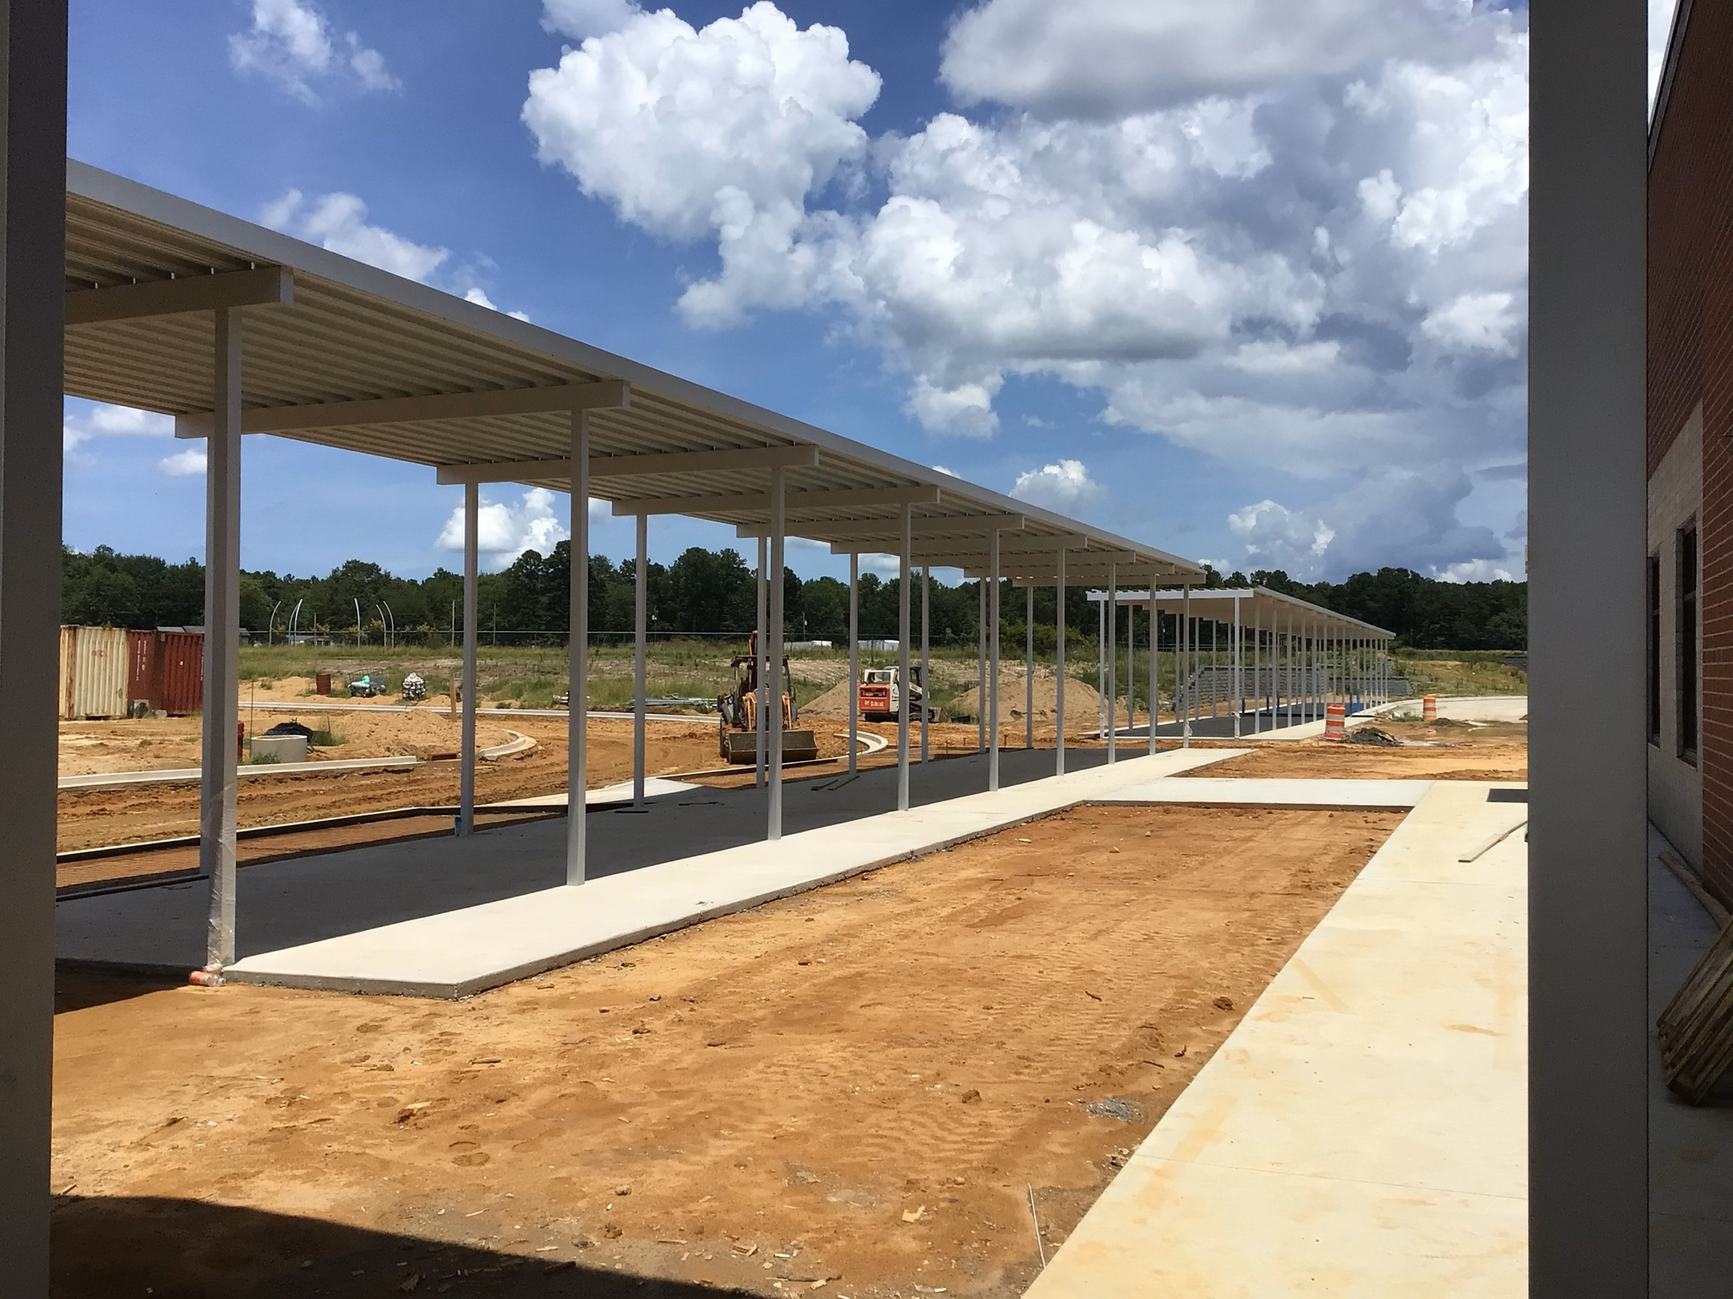
AIKEN COUNTY PUBLIC SCHOOL DISTRICT Construction Status Reports August 13, 2024
Notes:
Covered Walkway

Slide 5
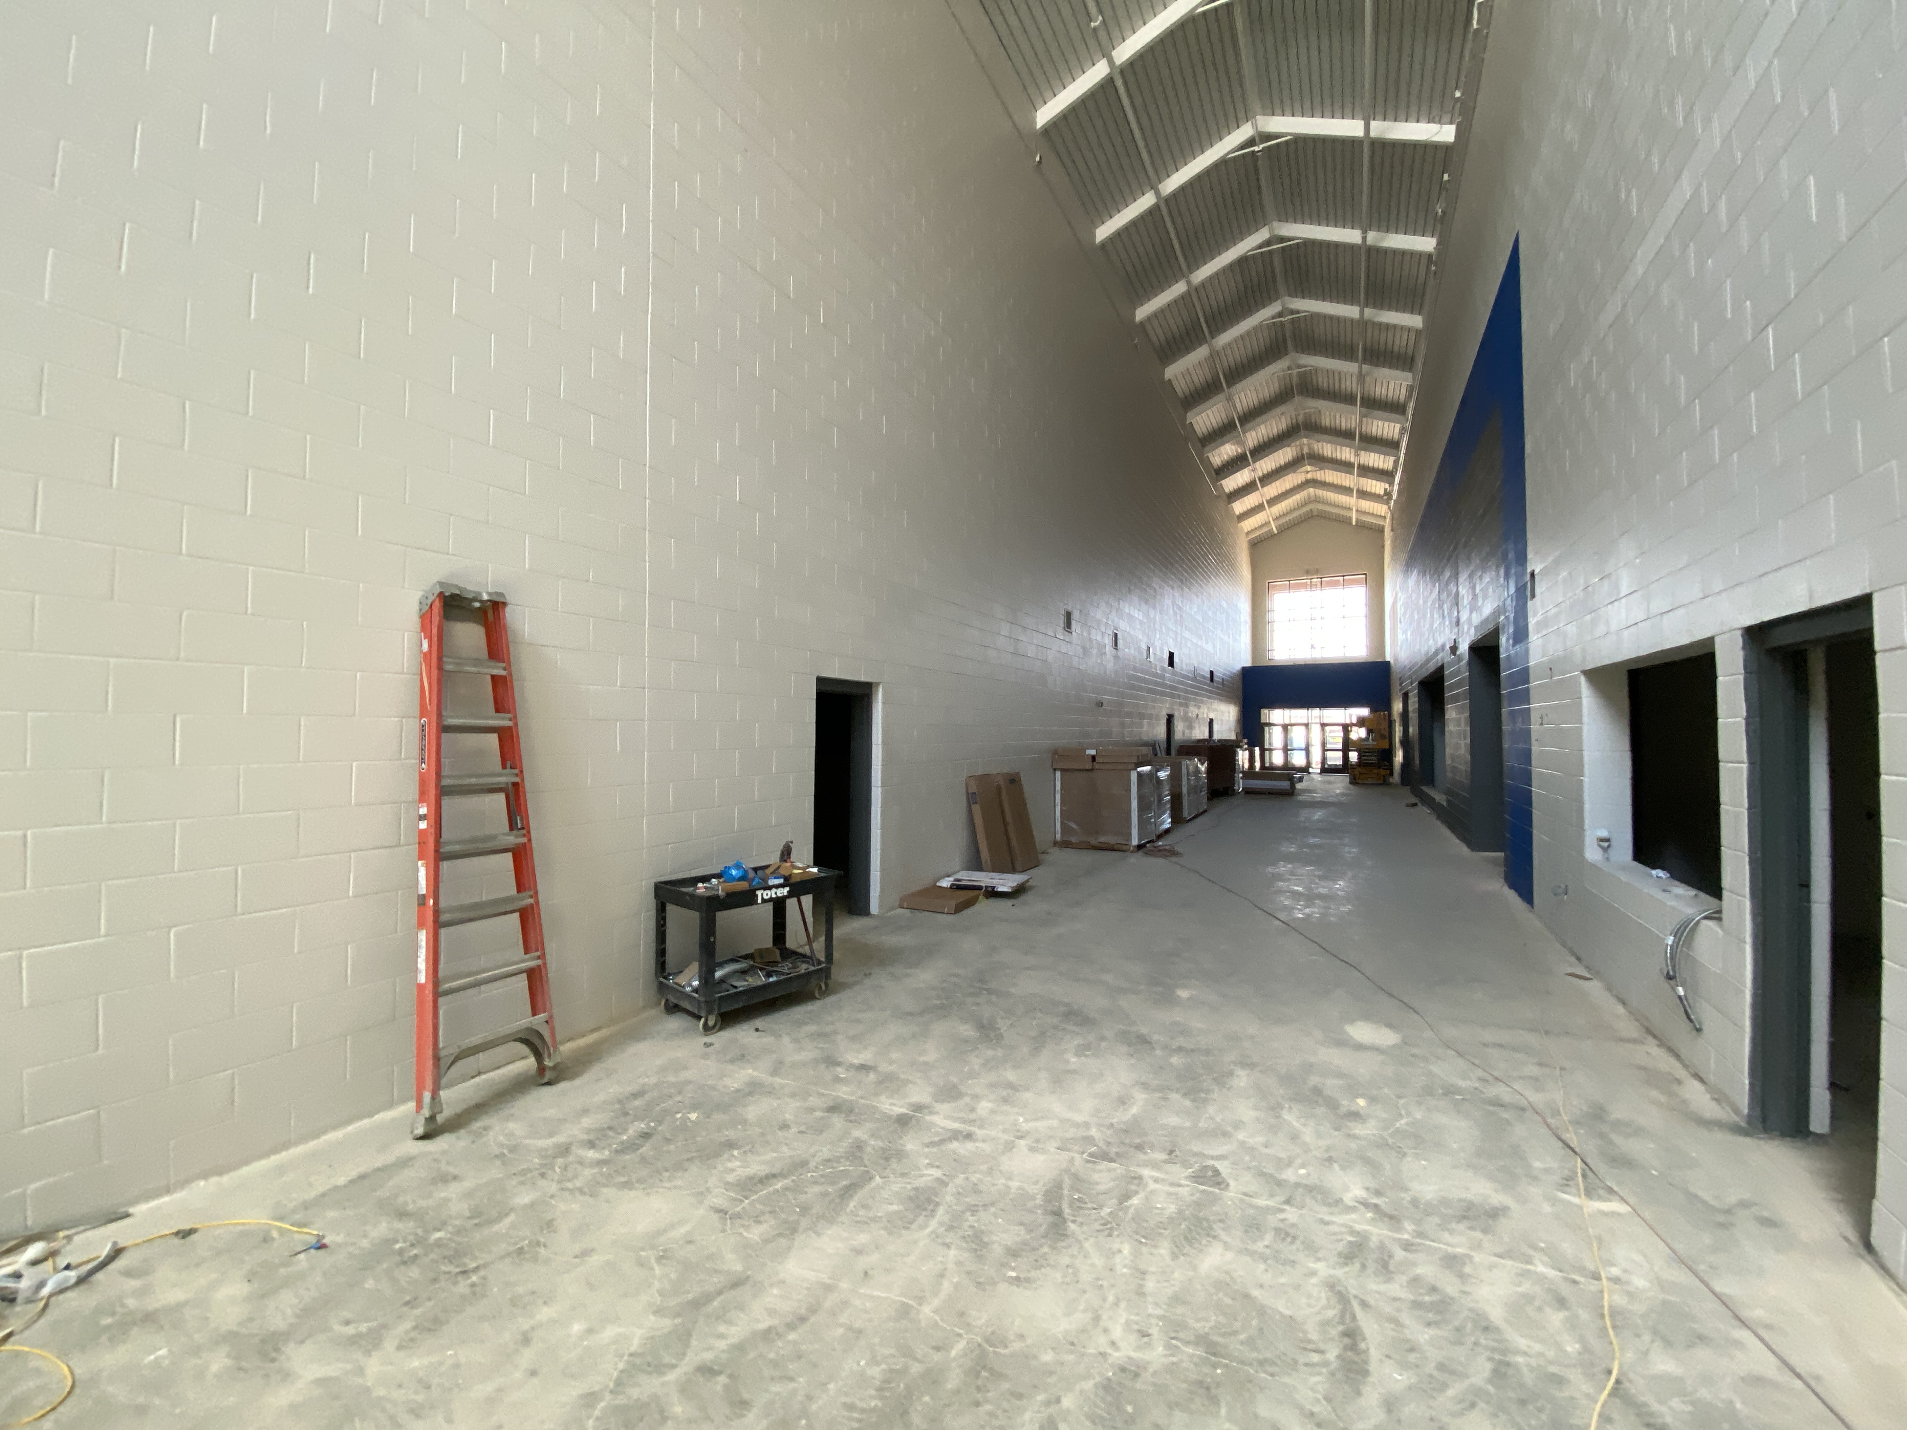
AIKEN COUNTY PUBLIC SCHOOL DISTRICT Construction Status Reports August 13, 2024
Notes:
Athletic Lobby

