Slide 2
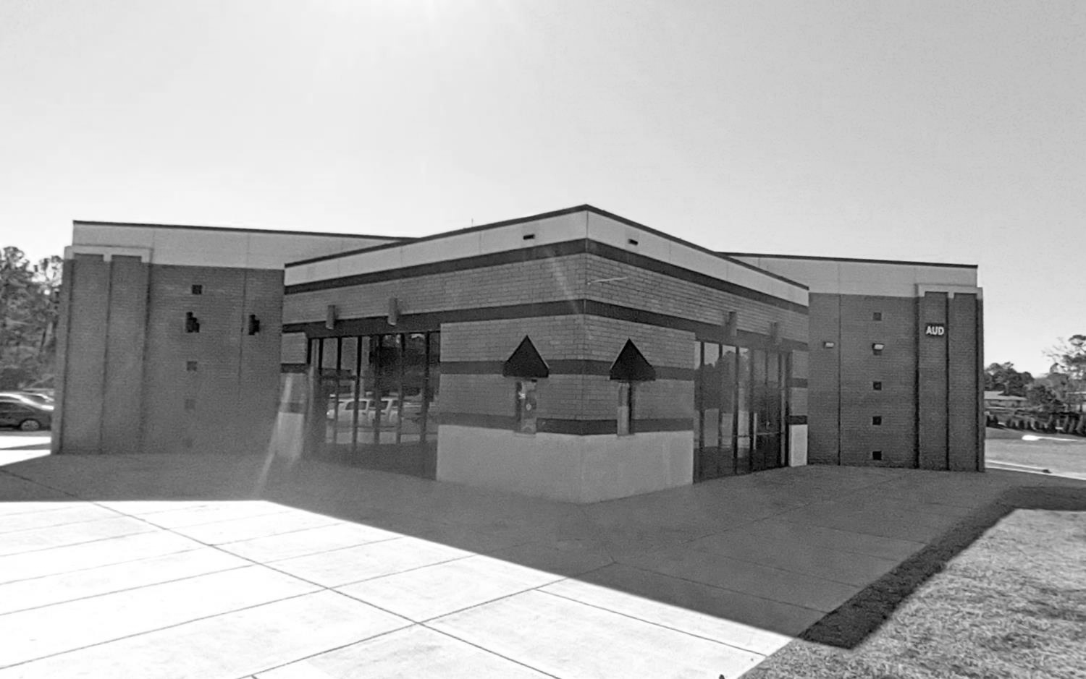
N. Augusta High School
Auditorium Renovation
& Addition
Schematic Design Review

Slide 3
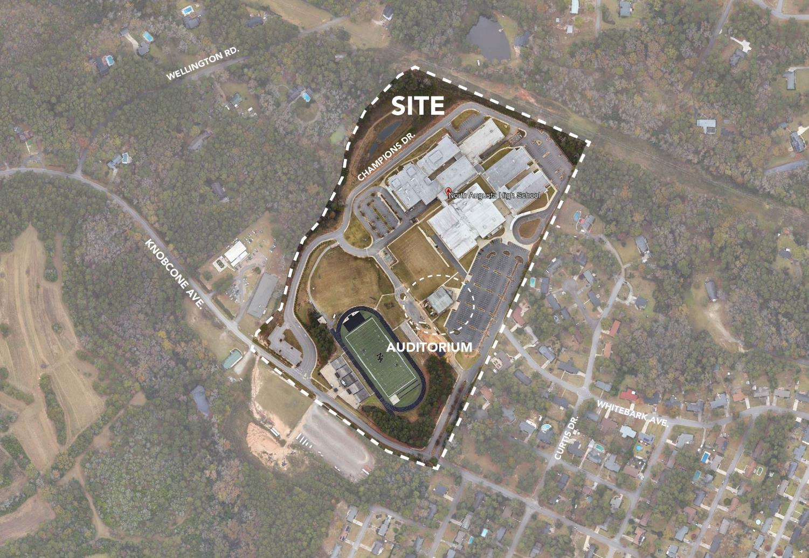
OVERALL CAMPUS PLAN
AIKEN COUNTY PUBLIC SCHOOL DISTRICT
NAHS Auditorium Reno | June 10, 2025

Slide 4
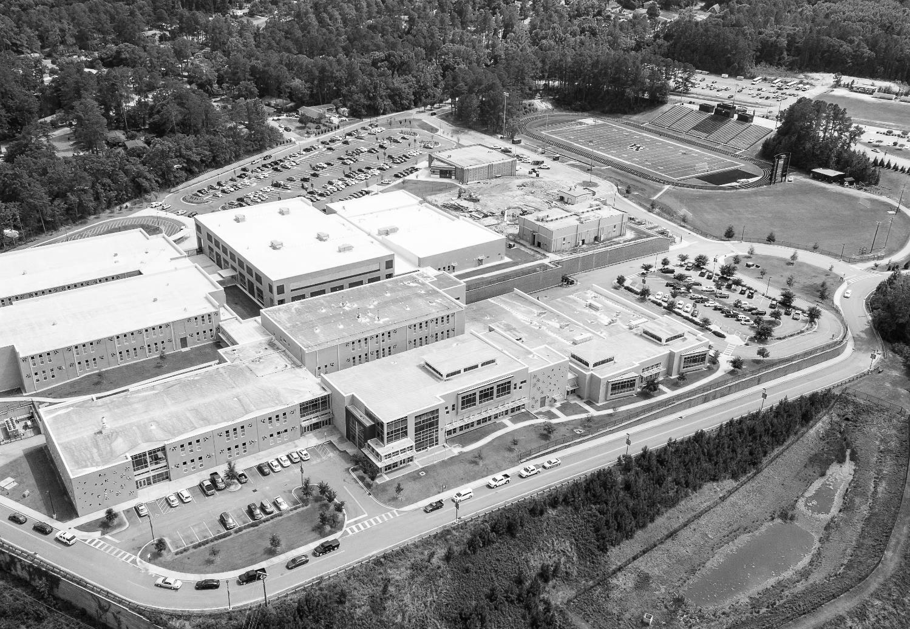
PROJECT BUILDING GOALS
Increase the seating capacity to 500+ seats
Increase the stage area & increase production capabilities
Provide new, enlarged pre-function / lobby space
Provide new monumental entrance befitting a performing arts center
Increase accessible features & routes inside & around the building
Expand & upgrade stage support spaces (i.e. dressing room, control room, scene & prop storage, etc.)
Provide scene shop workroom
Provide band storage room
New restrooms in number and configuration to meet current code requirements
Minimize impact to existing parking and to band practice field
AIKEN COUNTY PUBLIC SCHOOL DISTRICT
NAHS Auditorium Reno | June 10, 2025

Slide 5
PROJECT MILESTONES
02-26-25 | Conceptual Submittal to ACPS
03-07-25 | Schematic Design Complete
03-19-25 | Schematic Design Narratives submitted to CM at Risk for pricing
04-22-25 | Schematic Design Estimate to ACPS
06-02-25 | Design Development Submittal (Owner, CM at Risk, OSF)
06-10-25 | Owner Review – Board Meeting
06-16-25 | Design Development Estimate to ACPS Owner Review – Board Meeting
09-30-25 | Construction Documents Submittal (Owner, CM at Risk, OSF)
10-28-25 | Construction Documents GMP to ACPS
AIKEN COUNTY PUBLIC SCHOOL DISTRICT
NAHS Auditorium Reno | June 10, 2025

Slide 6
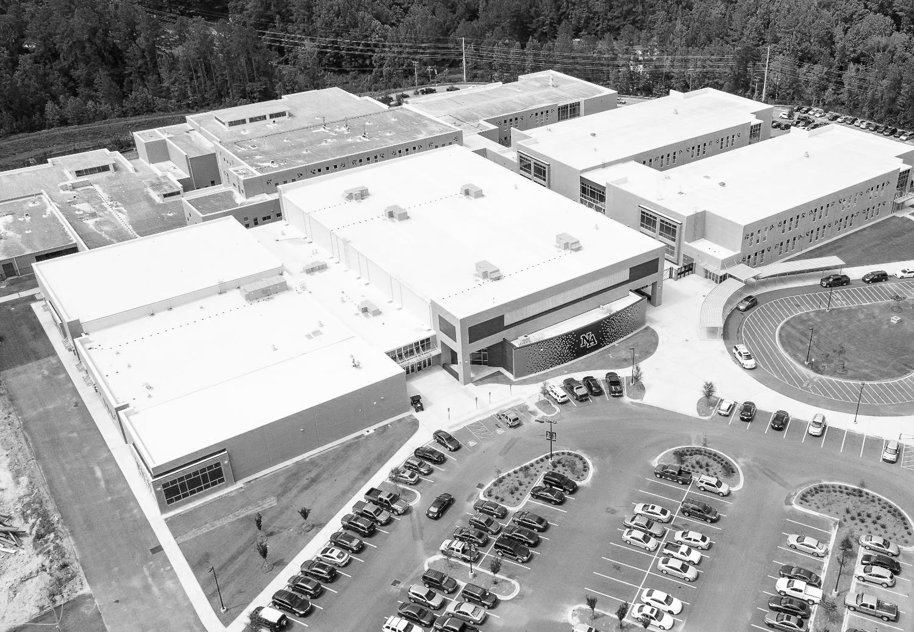
PROGRAM dashboard
EXISTING BUILDING | 10,675 | SF |  | NEW ADDITION & RENOVATION | 21,309 | SF
AUDIENCE | 400 | SEATS |  | AUDIENCE | 517 | SEATS
STAGE | 1,780 | SF |  | STAGE | 2,005 | SF
LOBBY | 1,256 | SF |  | LOBBY | 1,949 | SF
CONCESSIONS | 246 | SF |  | CONCESSIONS | 289 | SF
CONTROL ROOM | 74 | SF |  | CONTROL ROOM | 299 | SF
PUBLIC RESTROOMS | 372 | SF |  | PUBLIC RESTROOMS | 1,036 | SF
DRESSING ROOMS | 429 | SF |  | DRESSING ROOMS | 695 | SF
GEN. STORAGE | 191 | SF |  | GEN. STORAGE | 743 | SF
PROP STORAGE | 541 | SF |  | PROP STORAGE | 166 | SF
 |  |  |  | BAND STORAGE | 1,086 | SF
 |  |  |  | FAMILY RESTROOMS | 65 | SF
 |  |  |  | SCENE SHOP | 1,200 | SF
 |  |  |  | SCENE STORAGE | 439 | SF
 |  |  |  | COSTUME STORAGE | 137 | SF
 |  |  |  | IT / AUDIO EQUIP. RMS. | 110 | SF
 |  |  |  | MANAGER’S OFFICE | 213 | SF
AIKEN COUNTY PUBLIC SCHOOL DISTRICT
NAHS Auditorium Reno | June 10, 2025

Slide 7
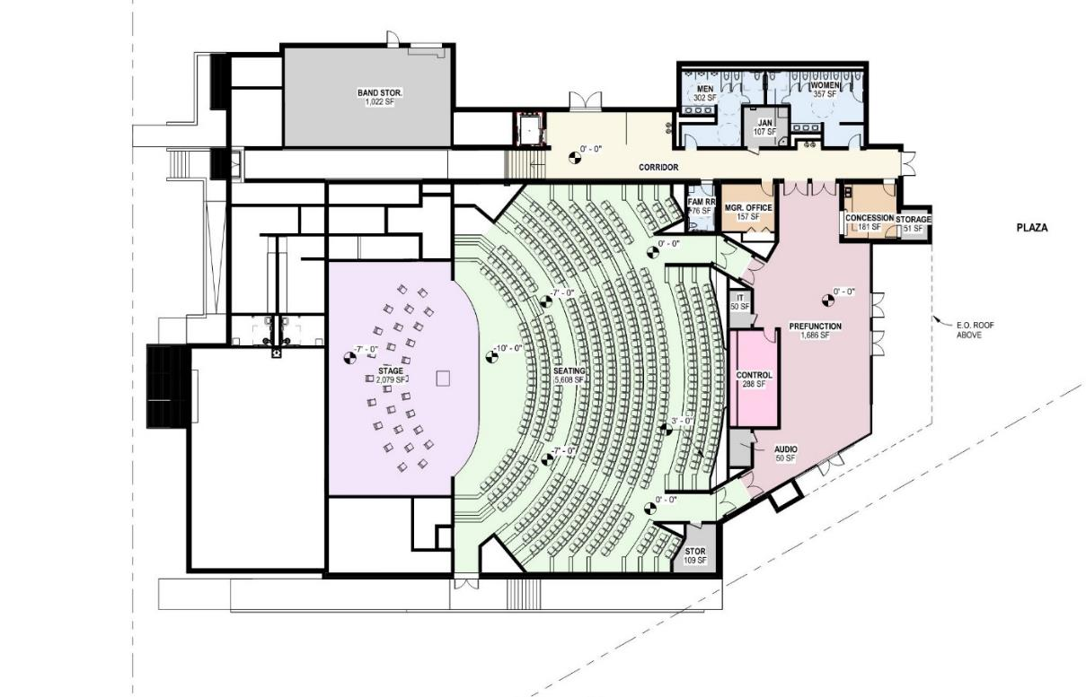
ACCESS LEVEL
AIKEN COUNTY PUBLIC SCHOOL DISTRICT
NAHS Auditorium Reno | June 10, 2025

Slide 8
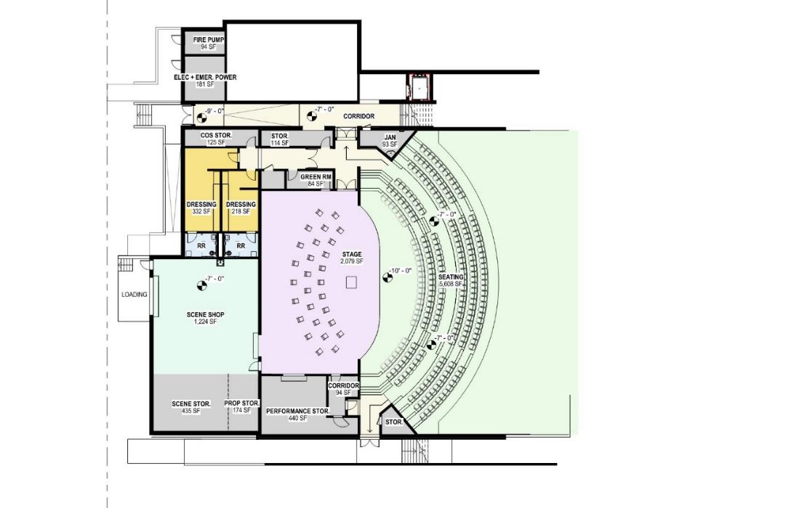
STAGE LEVEL
AIKEN COUNTY PUBLIC SCHOOL DISTRICT
NAHS Auditorium Reno | June 10, 2025

Slide 9
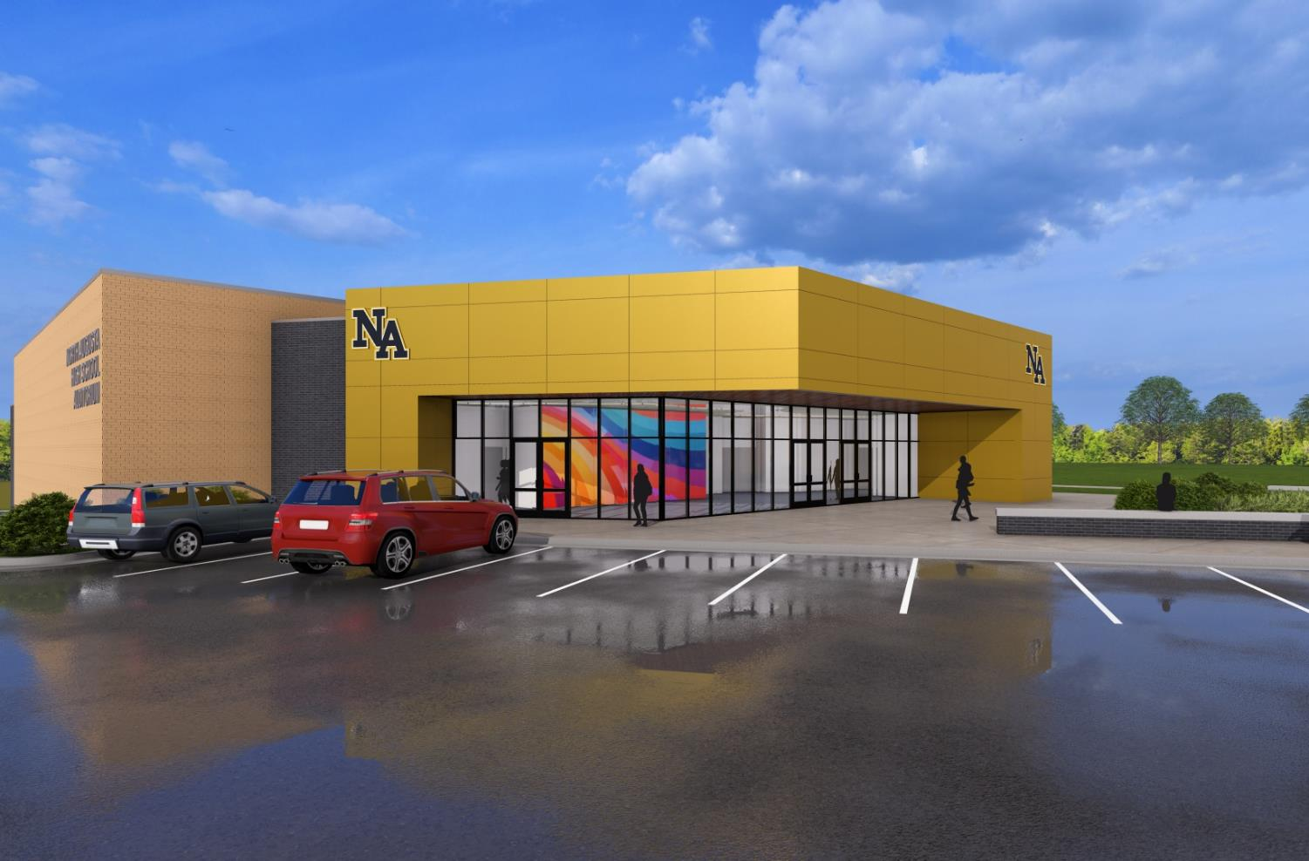
MAIN ENTRY
AIKEN COUNTY PUBLIC SCHOOL DISTRICT
NAHS Auditorium Reno | June 10, 2025

Slide 10
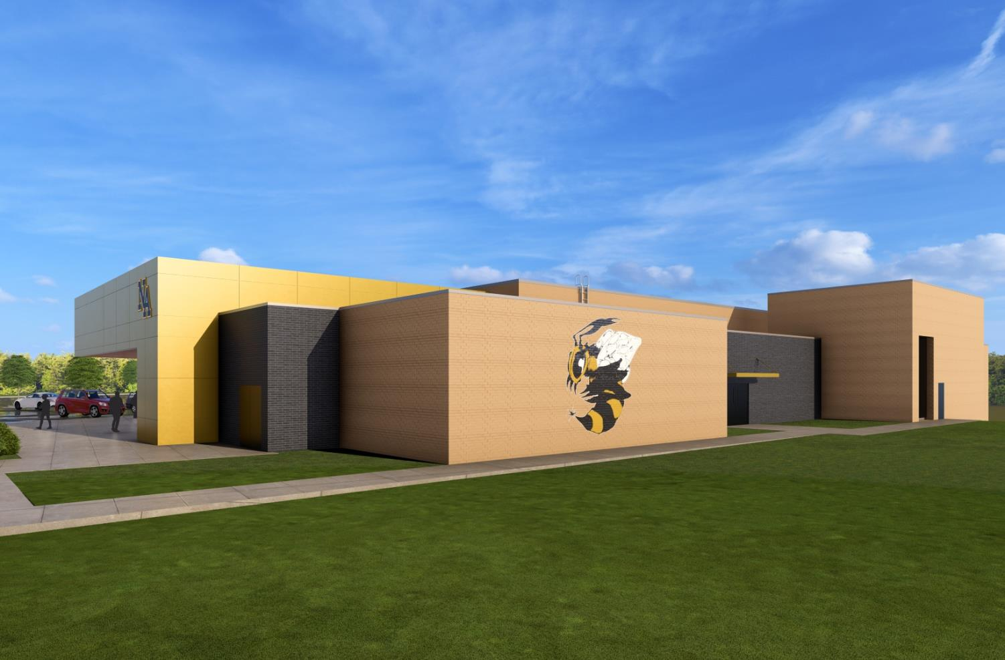
BAND FIELD FACADE
AIKEN COUNTY PUBLIC SCHOOL DISTRICT
NAHS Auditorium Reno | June 10, 2025

Slide 11
PROJECT BUDGET
Construction Costs
Renovation of Exist. Auditorium |  |  | $ 3,000,000
New Additional SF |  |  | $ 5,526,000
Probable Base Bid |  |  | $ 8,526,000
Design Contingency |  | (5% Project Budget) | $ 426,300
Soft Costs
- Geotechnical Engineering | - Impact & Tap Fees | - Data / Security / IT
- Site Surveys | - FFE (Furniture & Equip) | - A/E Prof. Design Fees
- Testing & Inspections
Estimated Soft Costs |  |  | $ 1,131,500
Probable Base Bid + Soft Costs + Design Contingency |  |  | $ 10,083,800
Construction Contingency |  | (5% Project Budget) | $ 504,190
Probable Base + Soft Costs + All Contingencies |  |  | $ 10,587,990
AIKEN COUNTY PUBLIC SCHOOL DISTRICT
NAHS Auditorium Reno | June 10, 2025

Slide 12
Questions? & Comments
AIKEN COUNTY PUBLIC SCHOOL DISTRICT
NAHS Auditorium Reno | June 10, 2025

