Slide 1
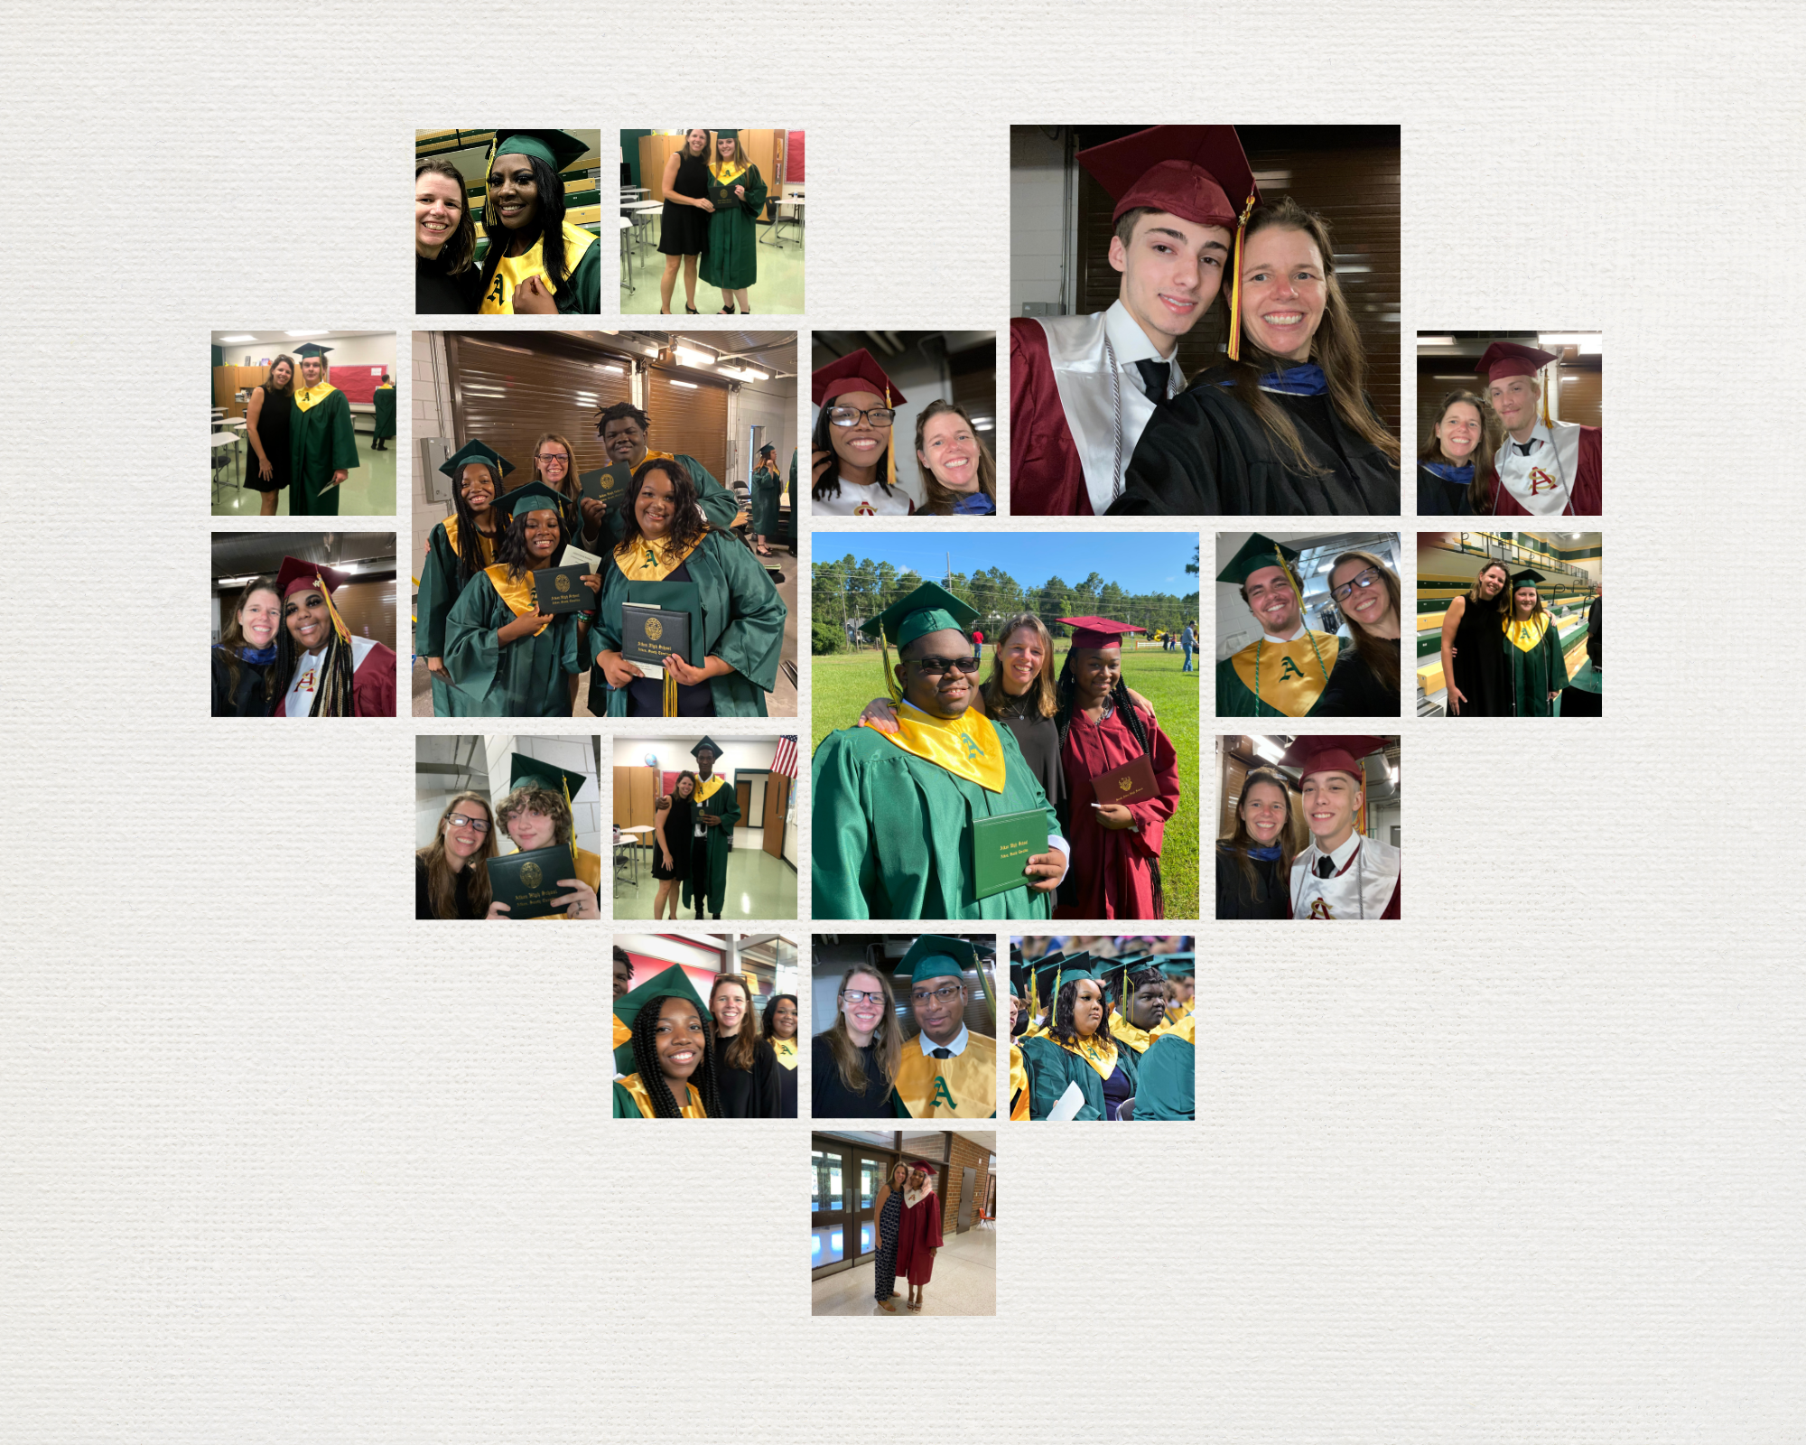

Slide 2
A non-traditional personalized learning opportunity for students to reach their full potential.

Slide 3
WHAT IS SUMMIT?
The Summit program is a non-traditional, personalized learning opportunity for students to reach their full potential. It is designed for students who have attempted at least 1 (one) year of high school by providing them with a personalized and flexible learning opportunity aimed at earning a high school diploma.

Slide 4
Student Success
Personalized Plans
Teacher Support
On-Time Graduation
Students will be enrolled in self-paced web-based courses based on their graduation needs.
Teachers will be available for in-person or virtual support Monday through Thursday at assigned locations.
Students enrolled in Summit will be able to earn more credits in one year than in a traditional high school program. This opportunity provides students with the ability to catch up on credits and graduate on time.

Slide 5
Students who are eligible are those who:
Are off-grade level
Are over age for their grade level
Have lack of interest or motivation in academic work
Have feelings of being disconnected from the school environment
Have family obligations, work obligations, or medical issues outside of the school that impose on their ability to meet mandatory attendance requirements.

Slide 6
Summit
Level One support
Students earn 1-4 credit(s) to get back on track while still enrolled in school full time.
Level Two support
Students attend Summit full-time to earn 8 or more credits to enable the student to graduate on time.

Slide 7
Level One Part Time Support
Students in their 2nd or 3rd year of high school who are off grade level attend one evening a week to earn additional credits throughout the school year to get back on grade level and on track while the student still attends their home school during the school day.
Students would be monitored on both their progress in their Summit course(s) as well as day courses.
Students would be required to have check-ins and complete goal setting workshops.
Students ideally would earn 1-4 credits.

Slide 8
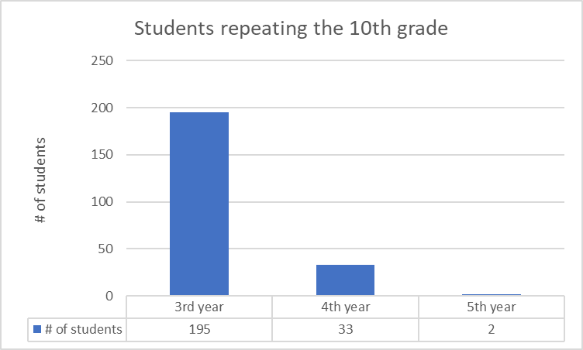
Level One – Potential Students

Slide 9
Level 2 Full time Support
Students who are in their 3rd or 4th year of high school who are off grade level. Students would attend Summit full time. Students have educational contracts that outline the graduation credits necessary so that the students only focus on one or two courses at a time. Based on individual needs, students are assigned in-class hours. Students’ assigned hours fluctuate depending on the student’s needs and progress at the time.
Students are monitored weekly based on their progress in courses, their attendance and any other identified issues.
Students and parents are communicated with weekly on student progress and any/all concerns.
Counselors are available throughout the week to assist students with goal setting based on academic, career, and social/emotional data. Counselors also assist with conducting the students’ IGP meetings and completing work-based learning paperwork.

Slide 10
Level Two – Potential Students
It is important to note that between Aug 15, 2022 – Jan 23, 2023 that 60 students who would have been eligible for Summit transferred out – 16 Adult Ed and 44 Drop out/homeschool letter.

Slide 11
Overall Potential Students at the beginning of 2022-23 school year
Level One – 577 students
Level Two – 163 students
Overall – 740 data identified students (more students could be potentially identified through counselors who are having life hardships)

Slide 12
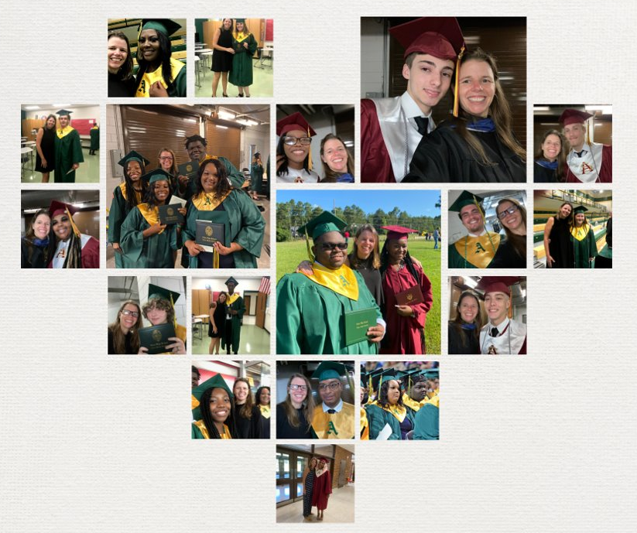
Impacts of the Summit Program
Student success

Slide 13
Impacts of the Summit Program
Increases the district graduation rate
Summit has shown an increase in graduation rate with participating schools.
In 2021, 3.7% of Aiken High and 3.7% of South Aiken High's graduation rate were Summit students.
In 2022, 2.6% of Aiken High and 2.6% of South Aiken High's graduation rate were Summit students.
Changes in homeschool withdrawals will have a negative impact on the district graduation rate

Slide 14
Additional Impacts of the Summit Program
Provides schools a program that can assist them with getting students back on track quickly
End of 1st year – 6 total credits (1 Eng / 1 Math) - 70 10th graders would be considered off track – Summit Level One
End of 2nd year – 12 total credits (2 Eng / 2 Math) 75 11th graders would be considered off track – Summit Level One
End of 3rd year – 18 total credits (3 Eng / 3 Math) - Summit Level One
Starting the 23-24 school year, the program would have one year to get in place prior to the first cohort of students who would be scored.
SY 2023-24: 9GR= 24 1st year On-track graduate will be reported and scored.

Slide 15
Program Design
Director
School counselor
4 full time teachers – one for each core subject – 2 teachers would serve as lead teachers at sites
Extra duty pay for additional teachers
Need to split with another program: bookkeeper, admin assistant
Location: one central site, up to two remote sites on school and district needs

Slide 16
Program Design
One main location for level one and two students to attend.
Lead Summit teachers would travel to different school locations Monday – Thursday from 4 to 7. Locations would be based on high schools that have the most need for Summit level one support.
Summit teachers would be available 12 to 7.
Level one students would attend 4 to 7 on assigned days.
Level two students would be able to attend their assigned hours Monday – Thursday from 12 to 7 and Fridays from 12 – 3.
The ideal location would allow the program to use existing transportation routes.

Slide 17
