Slide 1


Slide 2
North Augusta High School
Athletics Complex
AIKEN COUNTY PUBLIC SCHOOL DISTRICT Construction Status Reports August 13, 2024
Notes:
August 2024 Update:
Progress:
Slab prep with pour.
Installing Storm Drain along back retaining wall.
Visitor dugout footings poured and foundation block complete.
Under slab rough in complete.
Existing fence in neighbors’ yard a conflict to be discussed with ACPSD.
Still reviewing options on softball field and balls into the street.
The project is within budget and on schedule.

Slide 3
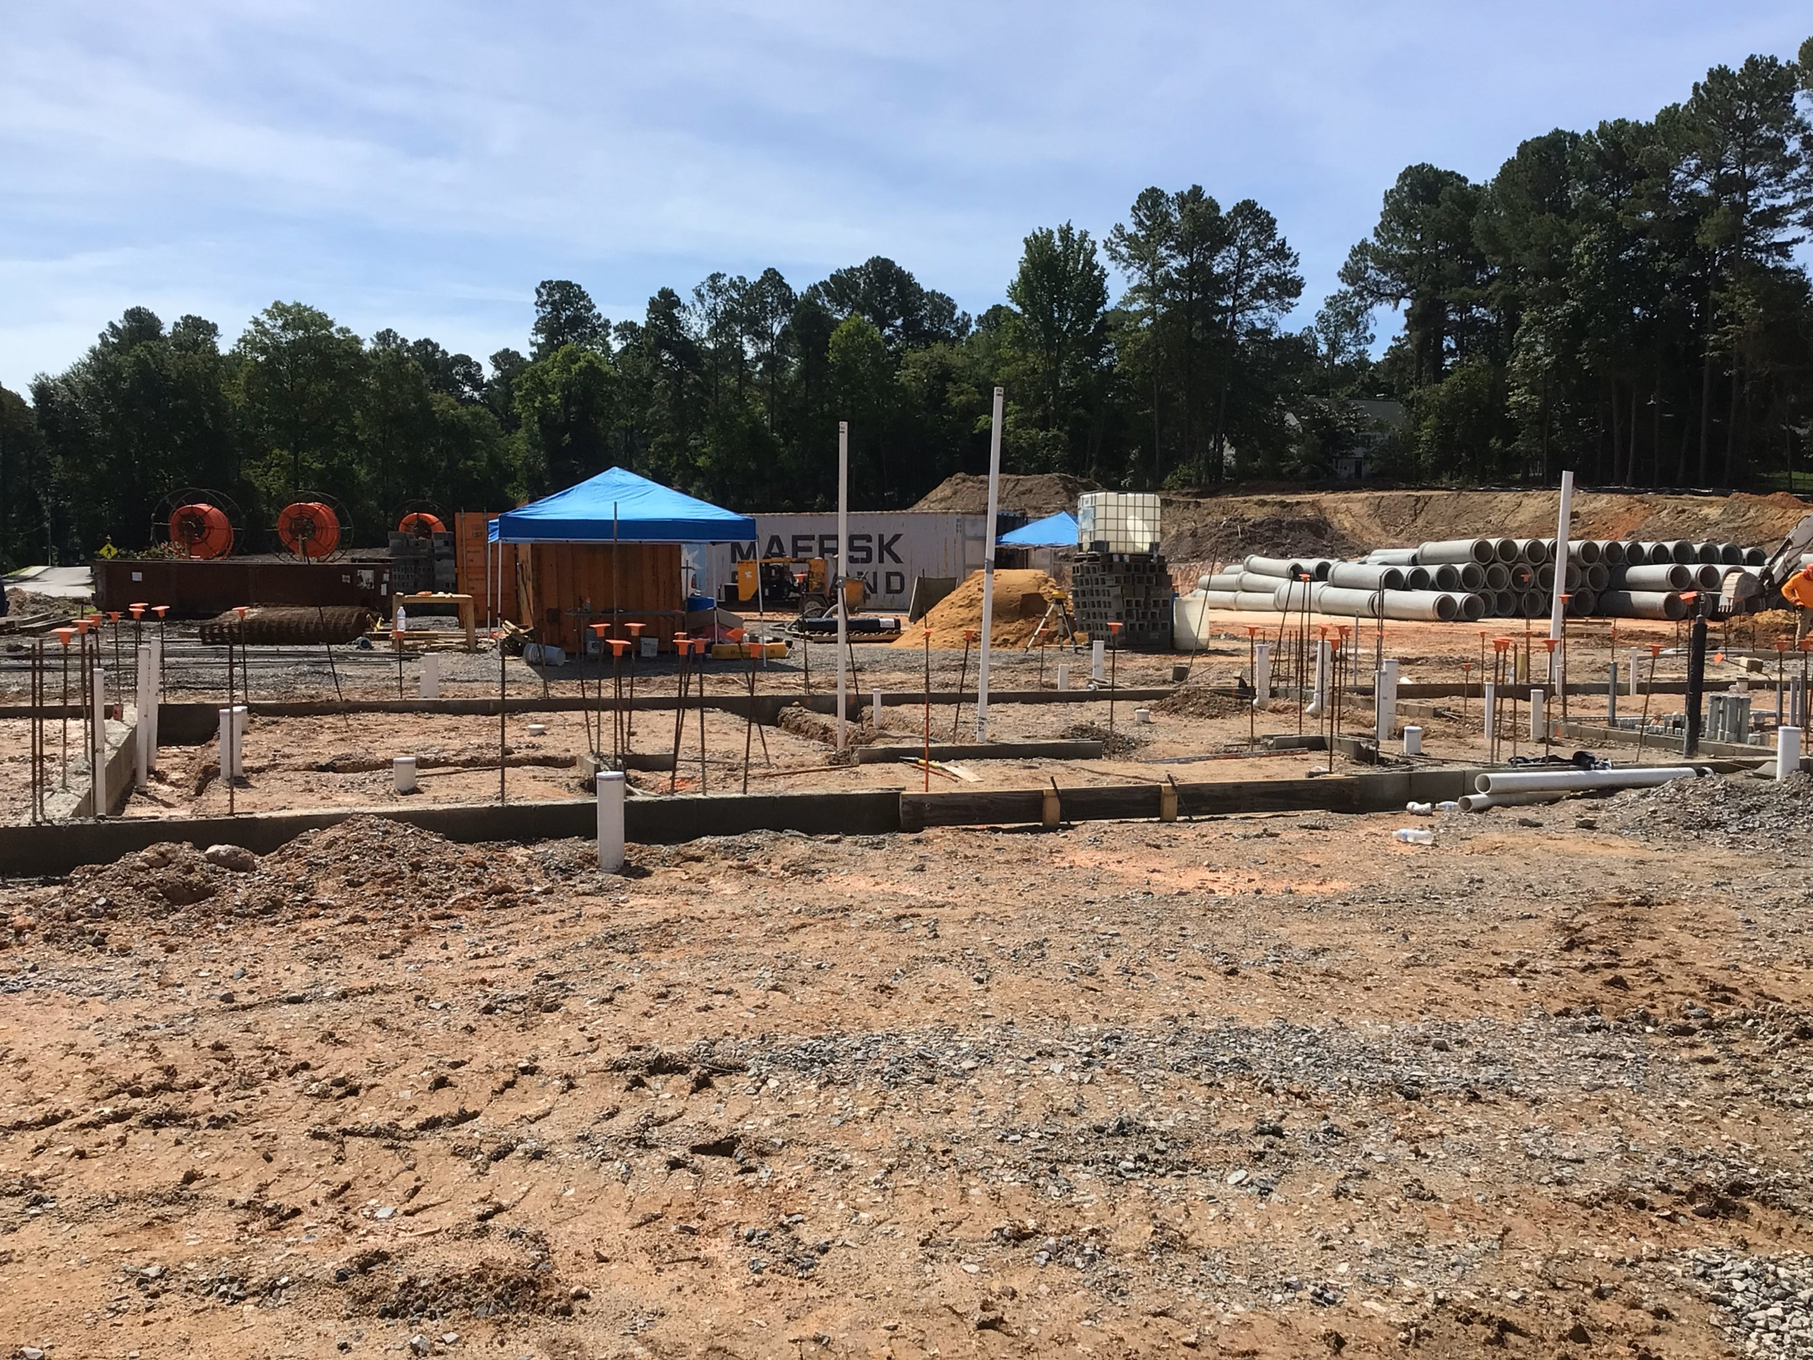
AIKEN COUNTY PUBLIC SCHOOL DISTRICT Construction Status Reports August 13, 2024
Notes:
Dugout Rough-In

Slide 4
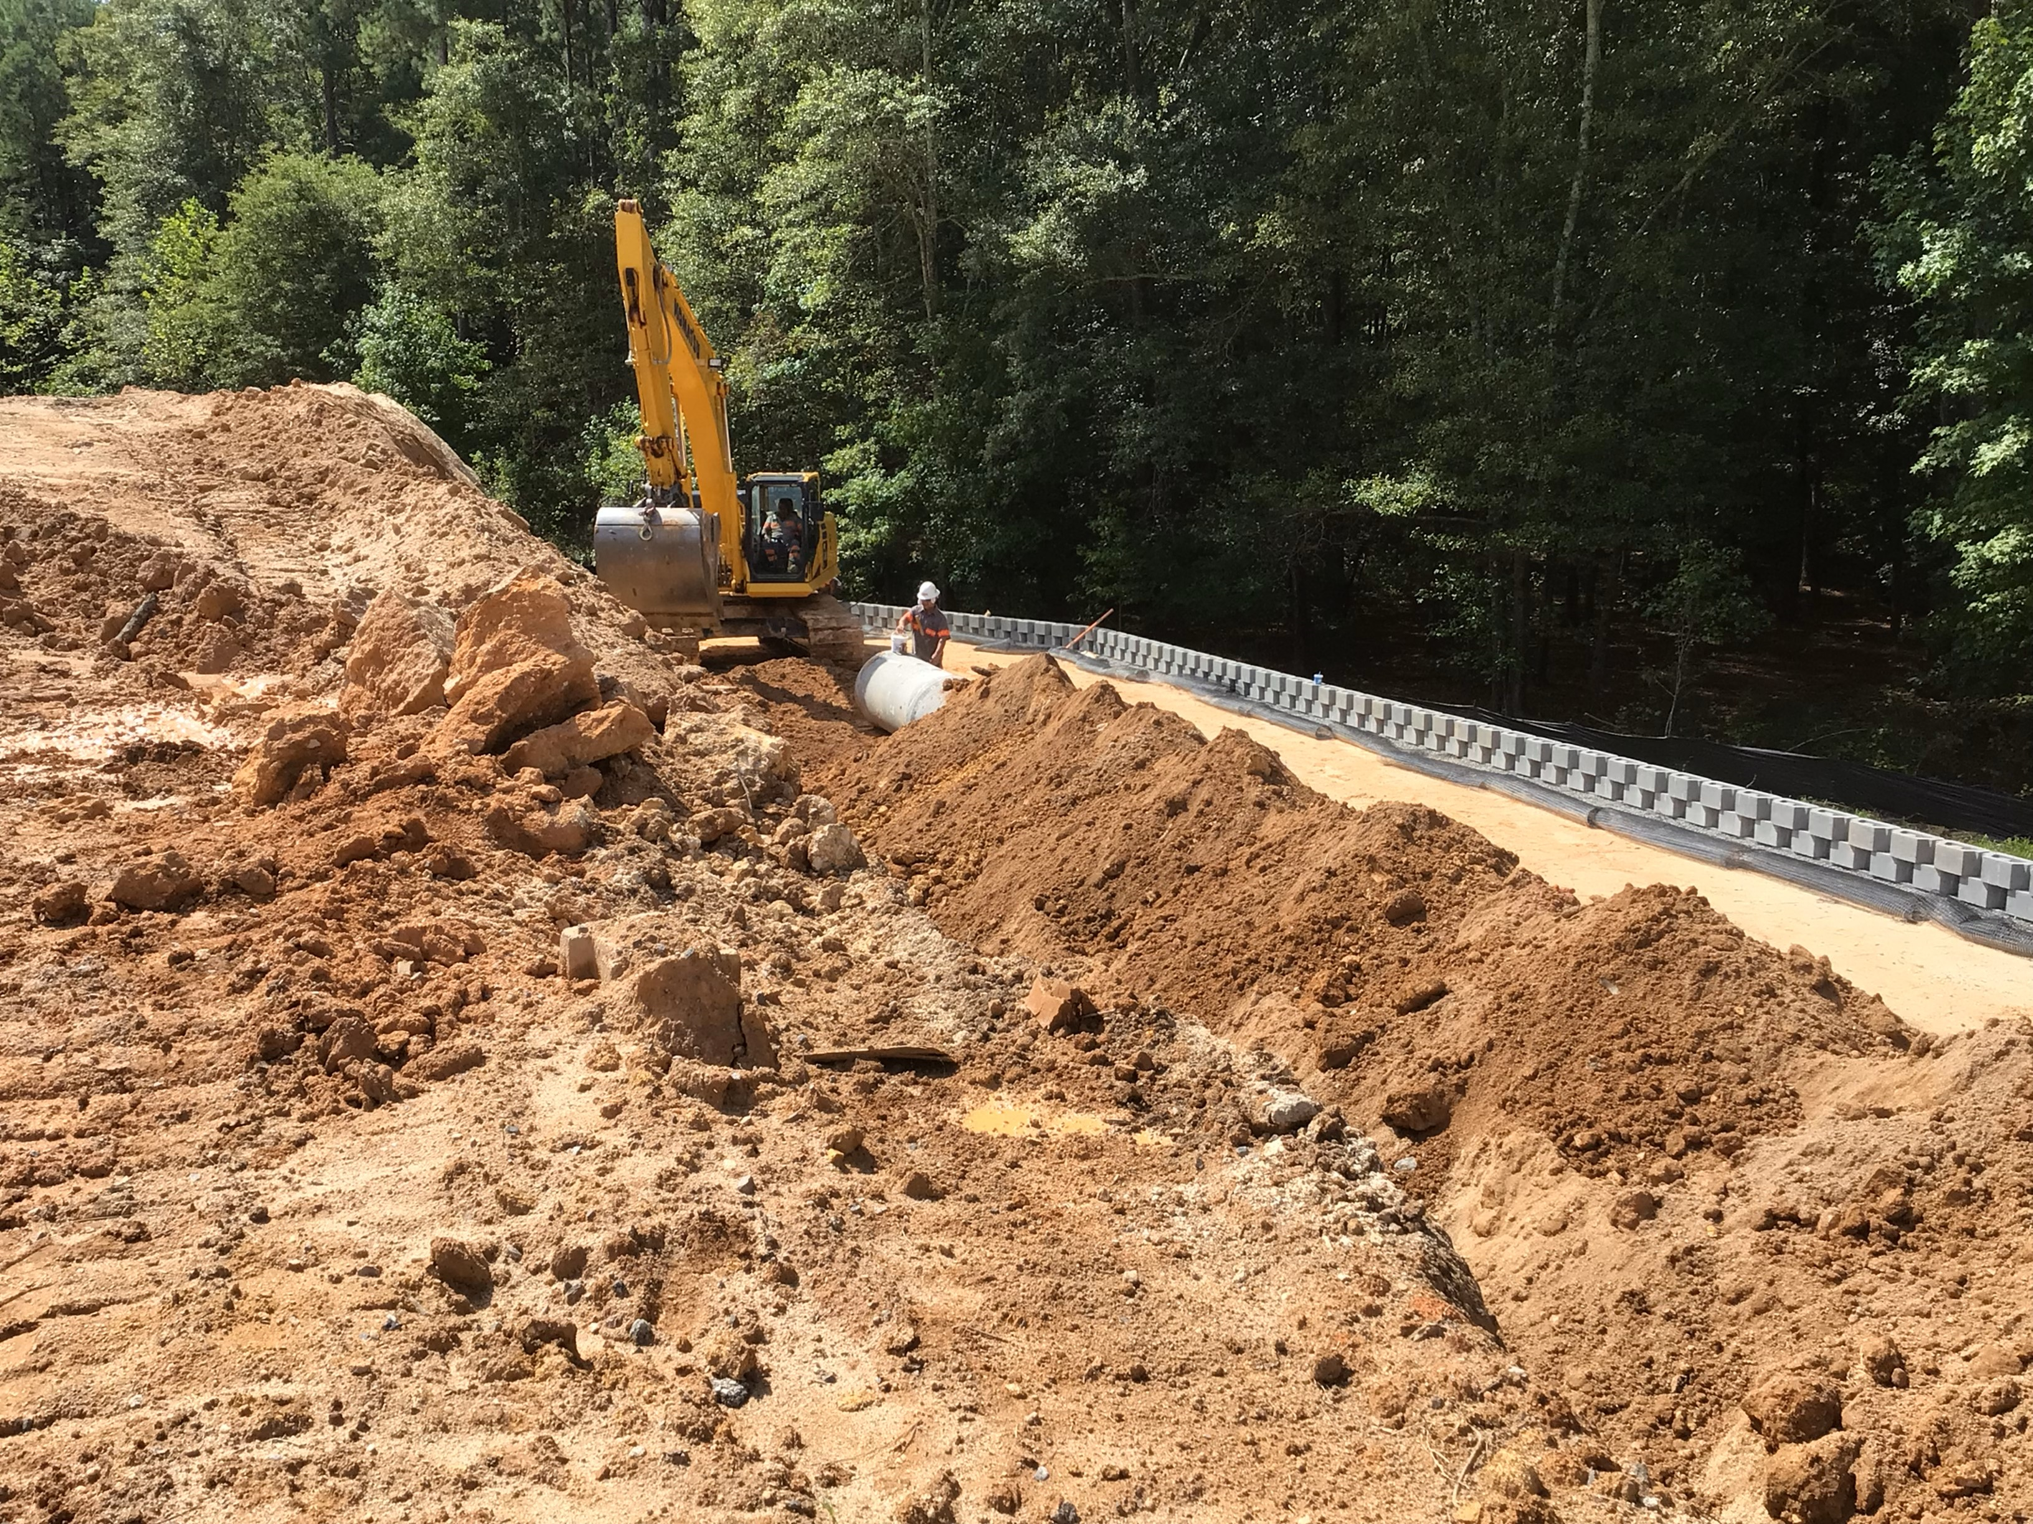
AIKEN COUNTY PUBLIC SCHOOL DISTRICT Construction Status Reports August 13, 2024
Notes:
Retaining Wall

Slide 5


