Slide 1
Operations and Student Services Overview
AIKEN COUNTY PUBLIC SCHOOL DISTRICT March 11, 2025

Slide 2
Division Overview
AIKEN COUNTY PUBLIC SCHOOL DISTRICT
Notes:
3 departments

Slide 3
Operations and Student Services Mission Statement
To design, create, and maintain optimal learning environments that feature physical security, 21st century technology, support for students and employees, and professional, reliable transportation to and from schools.
AIKEN COUNTY PUBLIC SCHOOL DISTRICT

Slide 4
Operations and Student Services Functions
Security and Emergency Management
Facilities Construction
Transportation
Technology
Student Services
Maintenance and Operations
AIKEN COUNTY PUBLIC SCHOOL DISTRICT

Slide 5
Department of Facilities Construction
AIKEN COUNTY PUBLIC SCHOOL DISTRICT

Slide 6
Department of Facilities Construction
A department of four people is responsible for managing:
$20,000,000 annually of cyclic maintenance
$285,000,000 of One Cent Sales Tax Projects
$56,000,000 Aiken County Career and Technology Center Project
Athletics Projects
Security Projects
Capital Outlay Projects
Total - $400,000,000
AIKEN COUNTY PUBLIC SCHOOL DISTRICT

Slide 7
Department of Transportation
Total Bus Driver Positions: 184
AIKEN COUNTY PUBLIC SCHOOL DISTRICT

Slide 8
Department of Technology
AIKEN COUNTY PUBLIC SCHOOL DISTRICT

Slide 9
Department of Student Services
AIKEN COUNTY PUBLIC SCHOOL DISTRICT

Slide 10
Department of Maintenance and Operations
AIKEN COUNTY PUBLIC SCHOOL DISTRICT

Slide 11
Department of Maintenance and Operations
Maintenance Shop 1
AIKEN COUNTY PUBLIC SCHOOL DISTRICT

Slide 12
Department of Maintenance and Operations
Maintenance Shop 2
AIKEN COUNTY PUBLIC SCHOOL DISTRICT

Slide 13
Department of Maintenance and Operations
Maintenance Shop 3
AIKEN COUNTY PUBLIC SCHOOL DISTRICT

Slide 14
Department of Maintenance and Operations
Maintenance Shop 4
AIKEN COUNTY PUBLIC SCHOOL DISTRICT

Slide 15
Department of Maintenance and Operations
Maintenance Shop 5
AIKEN COUNTY PUBLIC SCHOOL DISTRICT

Slide 16
Department of Maintenance and Operations
Maintenance Shop 6
AIKEN COUNTY PUBLIC SCHOOL DISTRICT

Slide 17
Department of Maintenance and Operations
Maintenance Services
AIKEN COUNTY PUBLIC SCHOOL DISTRICT

Slide 18
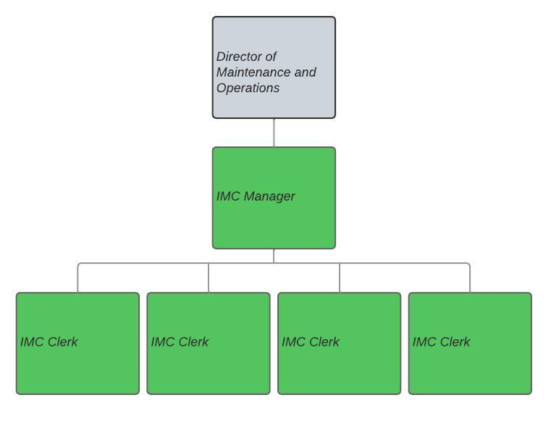
Department of Maintenance and Operations
AIKEN COUNTY PUBLIC SCHOOL DISTRICT

Slide 19
Department of Security and Emergency Management
AIKEN COUNTY PUBLIC SCHOOL DISTRICT

Slide 20
Proposed Department of Technology
Proposal is cost neutral
AIKEN COUNTY PUBLIC SCHOOL DISTRICT

Slide 21
Proposed Department of Student Services
AIKEN COUNTY PUBLIC SCHOOL DISTRICT

Slide 22
Proposed Department of Maintenance and Operations
Skilled Labor Positions will be requested in subsequent years.
AIKEN COUNTY PUBLIC SCHOOL DISTRICT

Slide 23
Proposed Department of Security and Emergency Management
AIKEN COUNTY PUBLIC SCHOOL DISTRICT

Slide 24
QUESTIONS & COMMENTS
AIKEN COUNTY PUBLIC SCHOOL DISTRICT

