Slide 1
Human Resources Overview
AIKEN COUNTY PUBLIC SCHOOL DISTRICT February 11, 2025

Slide 2
Division Overview
Administration: 2 FTE
Communications: 3 FTE
Human Resources: 13.5 FTE
AIKEN COUNTY PUBLIC SCHOOL DISTRICT
Notes:
3 departments

Slide 3
HR Mission Statement
To create an extraordinary experience for every employee that prioritizes well-being, engagement, and individualized growth to create an environment where all students thrive. We are committed to ensuring that each employee feels valued and supported in their journey toward purpose, innovation, and excellence.
AIKEN COUNTY PUBLIC SCHOOL DISTRICT

Slide 4
HR Functions
AIKEN COUNTY PUBLIC SCHOOL DISTRICT

Slide 5
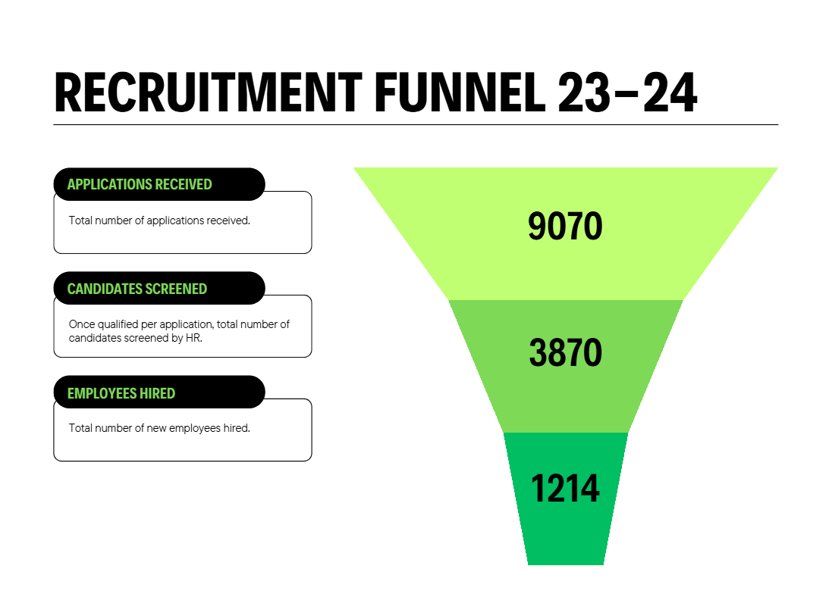
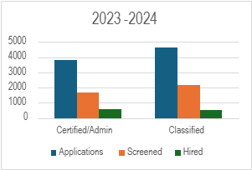
Talent Acquisition
AIKEN COUNTY PUBLIC SCHOOL DISTRICT

Slide 6
Comp & Benefits
Medical Leave Cases Managed:
Workers Compensation Claims Managed
Unemployment Costs
438
253
Reduced From $168,000 to $33,000
Accommodation Requests
Affordable Care Act
Safety & OSHA
AIKEN COUNTY PUBLIC SCHOOL DISTRICT

Slide 7
Training & Development
Induction Data
 | 2023-2024
Alt Cert | 44
Traditional | 63
FACES | 5
Total Induction | 112
AIKEN COUNTY PUBLIC SCHOOL DISTRICT

Slide 8
Training & Development
Pathways to Teaching Alternative Certification
Program | Cert Areas | Prerequisites to Teaching | Contact
Alt Pathway to Educator Cert | Early Childhood Elementary Dance Middle Level Special Education Multi-cat Secondary English and Math | SC teaching certification courses (1 year) Master’s degree option (18 mos) Passing Praxis score | Columbia College Marla Sanders 803-786-3067 Email: msanders@columbiasc.edu or Kelly Kinard Email: kkinard@columbiasc.edu
American Board | Middle Level: Math, ELA, Sci Secondary: Math, Science, English | Pass Knowledge Exam Pass ABCTE exam | Email: info@americanboard.org
Converse | Art | Passing Praxis score | Jill Feist 864-596-9404 Email: jill.feist@converse.edu
PACE | Variety of Pk-12 SpEd: Emotional Disabilities | Passing Praxis score Statement of Eligibility Pre-service Institute | 803-896-0325 (choose option 2) Email: altcertification@ed.sc.gov
SC Create | Special Education | Employed in a SC school to qualify accepted to Columbia College Passing Praxis score | Joe Sutton jsutton@ed.sc.gov
Teach for America | PreK-12 | Passing Praxis score | Email: SouthCarolina@TeachforAmerica.org
Teachers of Tomorrow | Early Childhood Elementary SpEd: all content area options Variety of Pk-12 | Self-paced Classroom Readiness Modules (approx. 100 hours, self-paced) Passing Praxis score Letter of Eligibility | Email: teach@southcarolinateachers.org or enroll@southcarolinateachers.org
AIKEN COUNTY PUBLIC SCHOOL DISTRICT

Slide 9
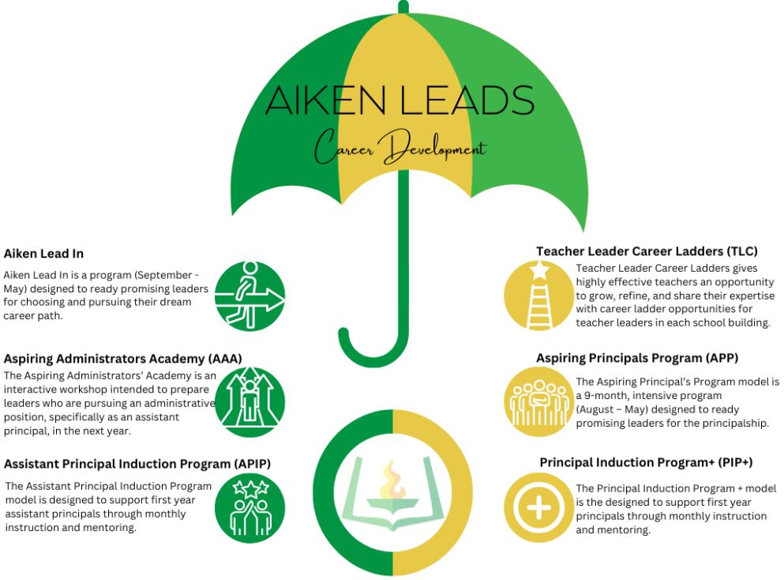
Training & Development
AIKEN COUNTY PUBLIC SCHOOL DISTRICT

Slide 10
Performance Management
4.0 Evaluations
PADEPP Support
Classified Performance Reviews
Individual Development Plans
Progressive Discipline
Feedback & Coaching Support
AIKEN COUNTY PUBLIC SCHOOL DISTRICT

Slide 11
Performance Management
AIKEN COUNTY PUBLIC SCHOOL DISTRICT

Slide 12
Engagement & Retention
AIKEN COUNTY PUBLIC SCHOOL DISTRICT

Slide 13
Engagement & Retention
Pulse Checks
Engagement Surveys
Stay Interviews
Exit Interviews
Onboarding
Orientation
Offboarding
AIKEN COUNTY PUBLIC SCHOOL DISTRICT

Slide 14
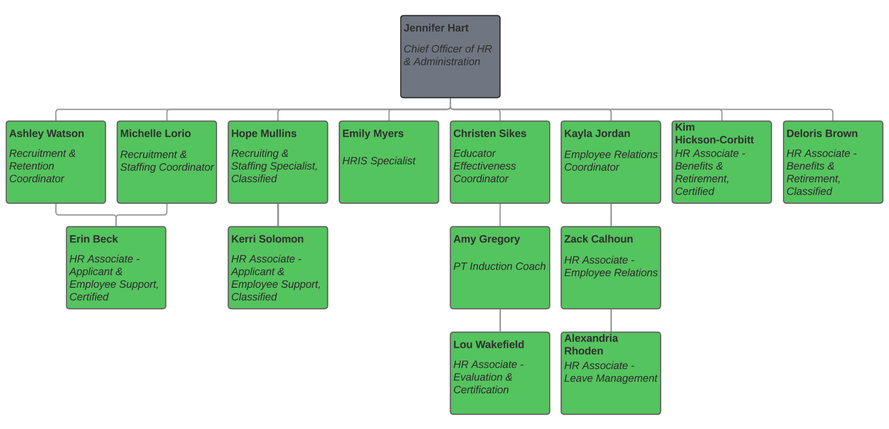
Human Resources Current Org Chart
AIKEN COUNTY PUBLIC SCHOOL DISTRICT
Notes:
3 departments

Slide 15
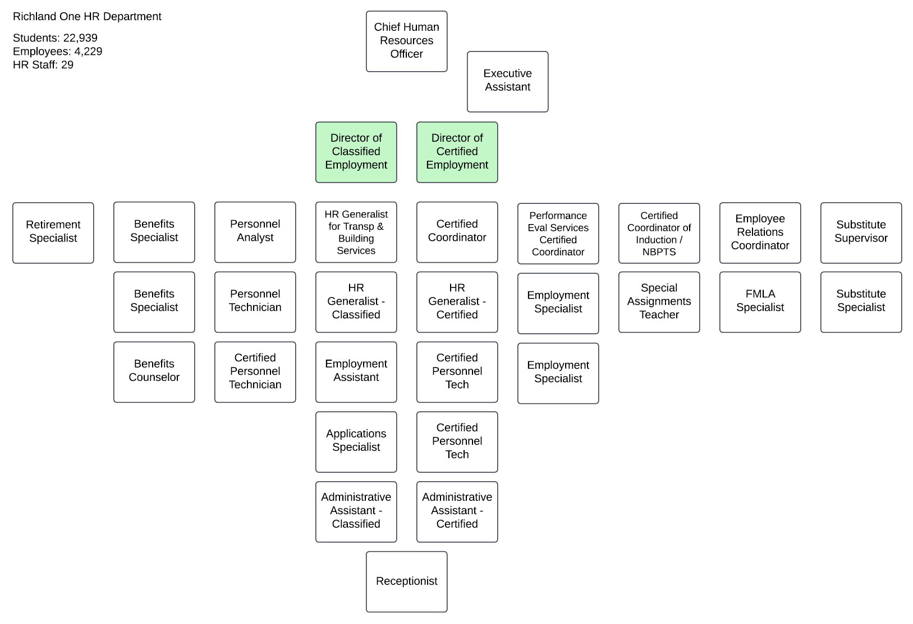
Comparative Org Chart Richland One HR Dept
AIKEN COUNTY PUBLIC SCHOOL DISTRICT
Notes:
3 departments

Slide 16
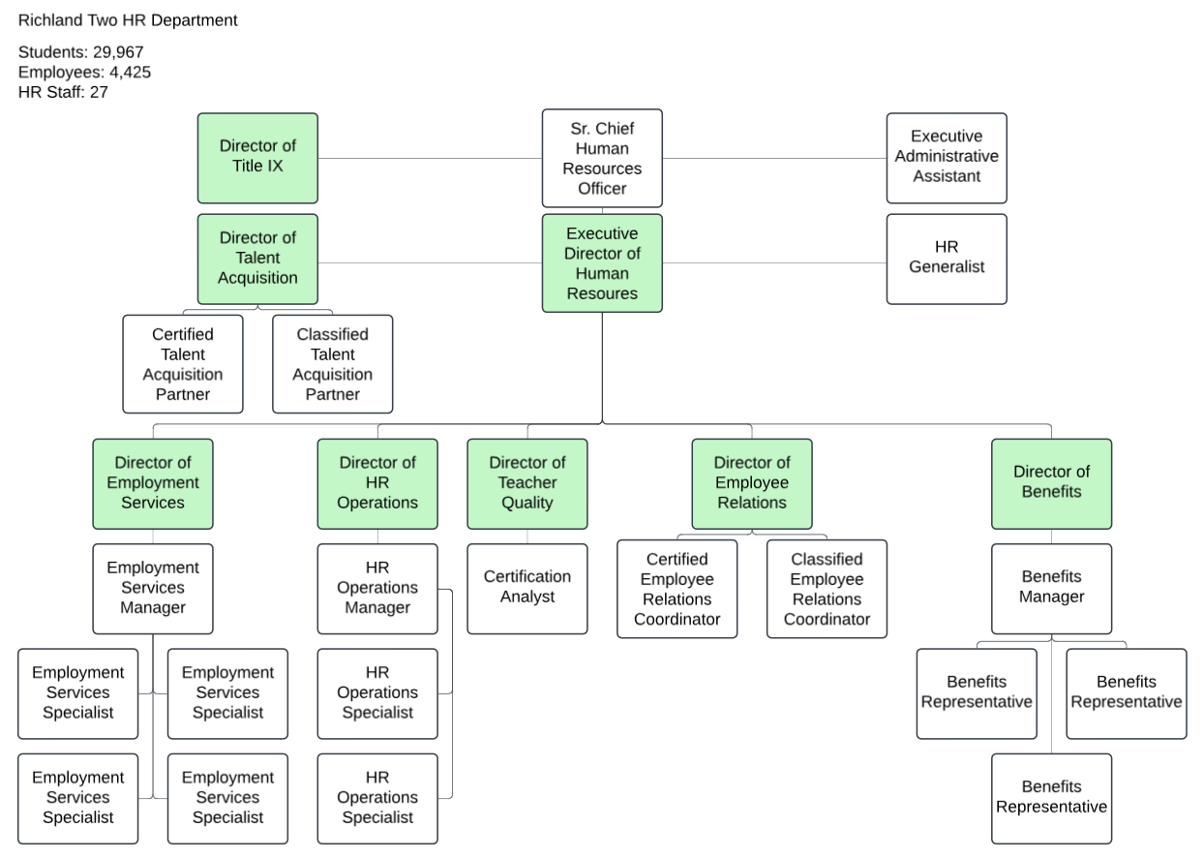
Comparative Org Chart Richland Two HR Dept
AIKEN COUNTY PUBLIC SCHOOL DISTRICT
Notes:
3 departments

Slide 17
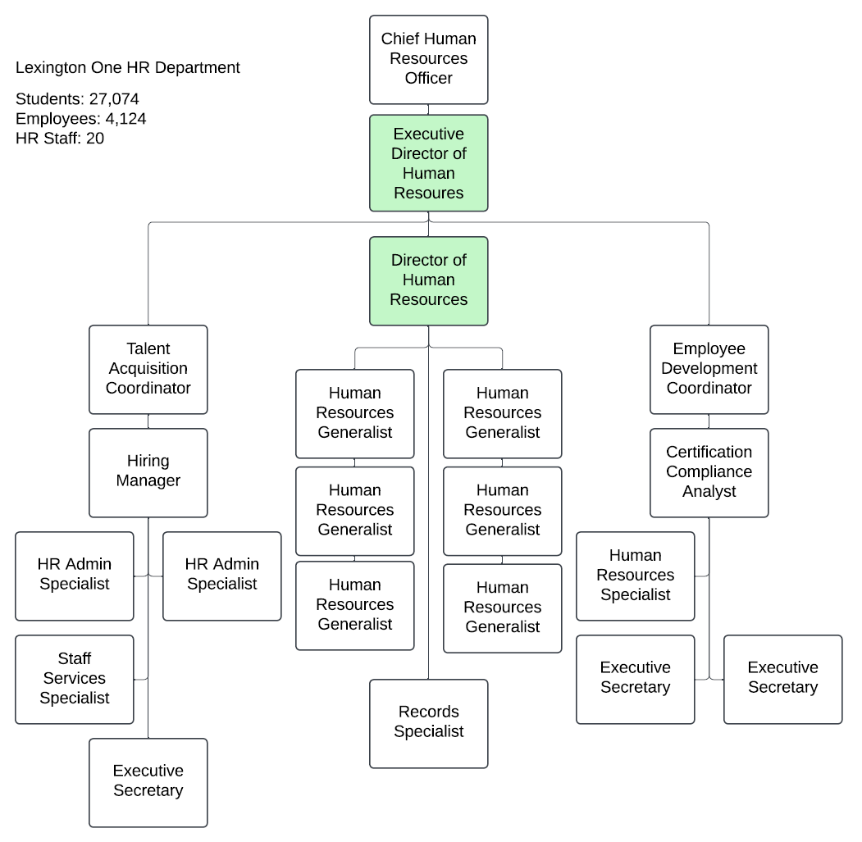
Comparative Org Chart Lexington One HR Dept
AIKEN COUNTY PUBLIC SCHOOL DISTRICT
Notes:
3 departments

Slide 18
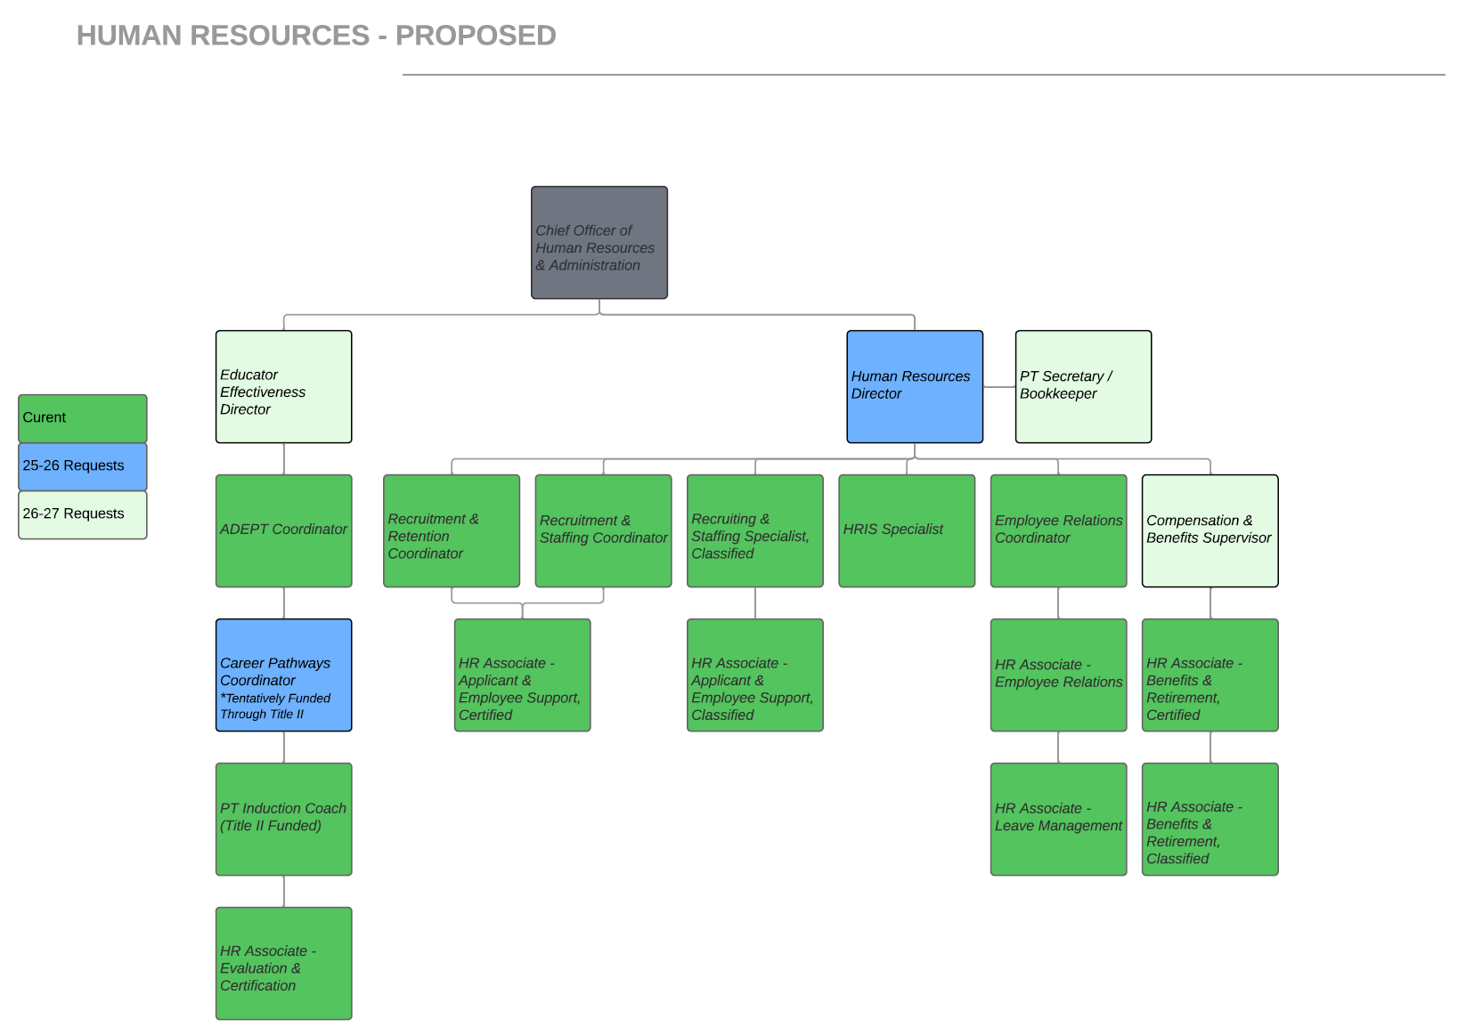
HR Proposed Future Org Chart
Current: 13.5 FTE
Requested 25-26: +2 FTE
Proposed 26-27: +2.5 FTE
AIKEN COUNTY PUBLIC SCHOOL DISTRICT
Notes:
3 departments

Slide 19
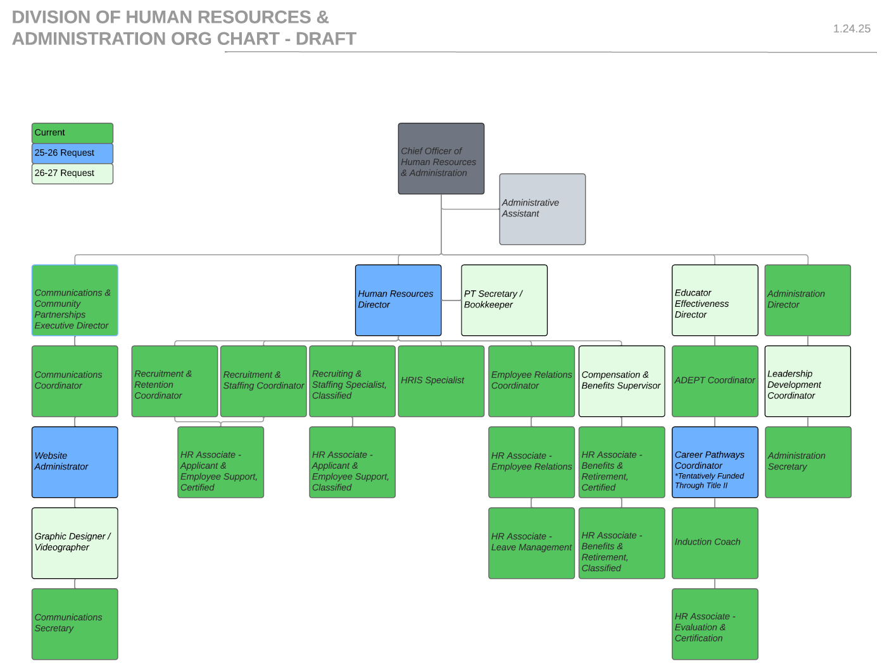
Division Proposed Future Org Chart
Communications
Current: 3 FTE
Requested 25-26: +1 FTE
Proposed 26-27: +1 FTE
Administration
Current: 2 FTE
Requested 25-26: +0 FTE
Proposed 26-27: +1 FTE
Human Resources
Current: 13.5 FTE
Request: 25-26: +2 FTE
Proposed 26-27: +2.5 FTE
AIKEN COUNTY PUBLIC SCHOOL DISTRICT
Notes:
3 departments

Slide 20
Key Responsibilities of HR Director
Direct recruitment process
Manage hiring process & onboarding
Maintain personnel records
Oversee benefits, leave, & retirement
Guide administrators on day-to-day personnel matters
Supervise student teacher & intern placements
Update job descriptions
Submit reports for EEOC, DOL, & CERRA
Serve as the district’s Title IX Coordinator
AIKEN COUNTY PUBLIC SCHOOL DISTRICT
Notes:
3 departments

Slide 21
Key Responsibilities of Chief Officer
Direct the district’s long-term strategic planning process.
Ensure the execution of department level strategic plans.
Advise the Superintendent on personnel and district matters.
Enhance operational efficiency and compliance through policy and procedure development.
Provide leadership for evaluation systems and contract management.
Monitor legal actions and inform district leadership on legal matters.
Facilitate leadership pipeline development and succession planning for district administrators.
Ensure effective public relations, branding, and stakeholder engagement through oversight of communications department.
Develop and administer budgets for each department.
AIKEN COUNTY PUBLIC SCHOOL DISTRICT
Notes:
3 departments

Slide 22
QUESTIONS & COMMENTS
AIKEN COUNTY PUBLIC SCHOOL DISTRICT

