Slide 2
Technology
Nic Carroll
Executive Director of Technology
AIKEN COUNTY PUBLIC SCHOOL DISTRICT Board Meeting |December 10, 2024

Slide 3
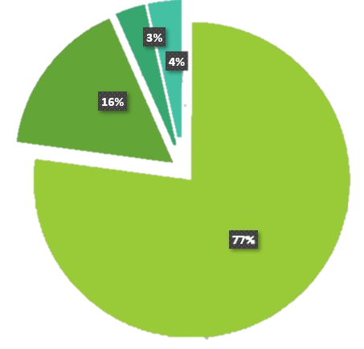
School Devices Numbers
28,000 + LAPTOPS
6,050 + DESKTOPS
1,150 + CLEAR TOUCH PANELS
1,140 + APPLE DEVICES
+ PRINTERS, SCANNERS, ETC.
1
AIKEN COUNTY PUBLIC SCHOOL DISTRICT Board Meeting |December 10, 2024

Slide 4
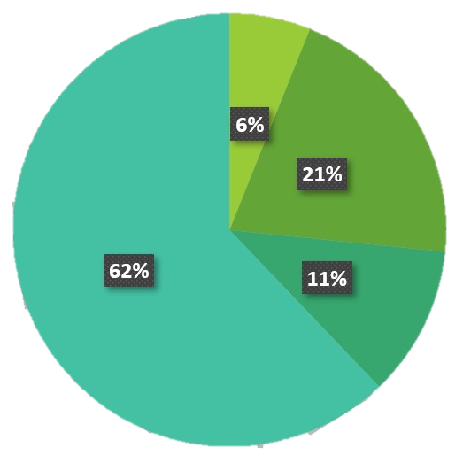
Network Devices
2,334 WIFI ACCESS POINTS
740 ROUTERS/SWITCHES
500 + SECURITY CAMS
470 SERVERS
+ counting
370 + ACCESS CONTROLLED DOORS
+ counting
37 ALERT SYSTEM/AUDIO ENHANCEMENT SITES
2
AIKEN COUNTY PUBLIC SCHOOL DISTRICT Board Meeting |December 10, 2024

Slide 5
Challenges
Increase in number of access control doors
Increase in number of security cameras
Addition of Audio Enhancement alert system in every classroom
Interactive touch panels in every classroom
Difficulty keeping up with maintenance and repairs
Lack of in-house expertise for certain technologies
Inability to respond and resolve issues quickly
3
AIKEN COUNTY PUBLIC SCHOOL DISTRICT Board Meeting |December 10, 2024

Slide 6
Technology Growth Support Challenges
Increase in number of access control doors
Increase in number of security cameras
Addition of Alert System Audio Enhancement in every classroom
Interactive touch panels in every classroom
Difficulty keeping up with maintenance and repairs
Lack of in-house expertise for certain technologies
Inability to respond and resolve issues quickly
4
AIKEN COUNTY PUBLIC SCHOOL DISTRICT Board Meeting |December 10, 2024

Slide 7
Current Department Structure SY 24-25
Executive Director
Technology Coordinator
Technology Services
Network Coordinator
Network Services
CT
CT
CT
Lead Technology Specialist
Lead Technology Specialist
Lead Technology Specialist
System
Administrator
Network
Administrator
Network
Administrator
Security
Administrator
Telecommunications
Specialist
Network
Technician
Network
Technician
TS
TS
TS
TS
TS
TS
TS
TS
TS
TS
CT
CT
CT
CT
CT
CT
CT
CT
CT
KEY:
Lead TS (Receives Supplement) – Supports 3+ Schools
TS = Technology Specialist (Pro I Pay Scale) – Supports 3+ Schools
CT = Computer Technician (Support V Pay Scale) – Supports 3+ Schools
5
AIKEN COUNTY PUBLIC SCHOOL DISTRICT Board Meeting |December 10, 2024

Slide 8
Proposed Solution
1 (New) Security Systems Administrator (Physical Security)
2 (Additional) Network Technicians
Move Coordinators to Directors
Move the current (12) Computer Technicians to Technology Specialist ($25,000 in starting pay)
Computer Technicians currently do the same job as the Technology Specialist
Currently each CT/TS support 2 or more sites/schools
6
AIKEN COUNTY PUBLIC SCHOOL DISTRICT Board Meeting |December 10, 2024

Slide 9
Cost Saving/Cost Neutral Proposed Solution
1 (New) Security Systems Administrator (Physical Security)
2 (Additional) Network Technicians
Move Coordinators to Directors
Move the current (12) Computer Technicians to Technology Specialist
7
AIKEN COUNTY PUBLIC SCHOOL DISTRICT Board Meeting |December 10, 2024

Slide 10
NEW Department Structure Requested
Executive Director
Technology Director
Technology Services
Network Director
Network Services
TS
TS
TS
Lead Technology Specialist
Lead Technology Specialist
Lead Technology Specialist
System
Administrator
Network
Administrator
Network
Administrator
Security
Administrator
Telecommunications
Specialist
Security System
Administrator
TS
TS
TS
TS
TS
TS
TS
TS
TS
TS
TS
TS
TS
TS
TS
TS
TS
TS
Network
Technician
Network
Technician
Network
Technician
Network
Technician
TS
KEY:
Lead TS (Receives Supplement) – Supports 3+ Schools
TS = Technology Specialist (Pro I Pay Scale) – Supports 3+ Schools
CT = Computer Technician (Support V Pay Scale) – Supports 3+ Schools
8
AIKEN COUNTY PUBLIC SCHOOL DISTRICT Board Meeting |December 10, 2024

Slide 11
Cost of Services and Request
Current Cost of Contracted Service (Yearly Cost)
Access Controls…………………………………………………………………………………...…….$350,500
Data Cabling and Installation………………………………………………………………………..$30,500
Security Alert System.…………………………………………………………………………….…..$145,000
Clear Touch Maintenance……………………………………………………………………………$150,000
Total………………………………………………………………………………………………………..$676,000
(1) Security Systems Administrator…………………………………………....................$125,000
(2) Infrastructure Technicians……………………………………………………………….……$160,000
(12) Computer Technicians -> Technology Specialist……………………………....…$300,000
(2) Coordinators -> Directors………………………………………………………………….…...$40,000
Total……………………………………………………………………………………………………….$625,000
9
AIKEN COUNTY PUBLIC SCHOOL DISTRICT Board Meeting |December 10, 2024

Slide 12
Questions & Comments
AIKEN COUNTY PUBLIC SCHOOL DISTRICT Board Meeting |December 10, 2024

