Slide 1


Slide 2




SILVER BLUFF HIGH SCHOOL
SCHEMATIC DESIGN SUMMARY
AIKEN COUNTY PUBLIC SCHOOL DISTRICT
August 26, 2025
AIKEN COUNTY PUBLIC SCHOOL DISTRICT SILVER BLUFF HIGH SCHOOL | August 26, 2025

Slide 3
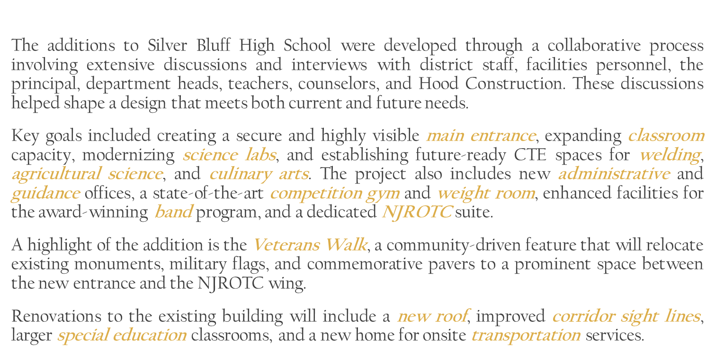
PROJECT GOALS
AIKEN COUNTY PUBLIC SCHOOL DISTRICT SILVER BLUFF HIGH SCHOOL | August 26, 2025

Slide 4
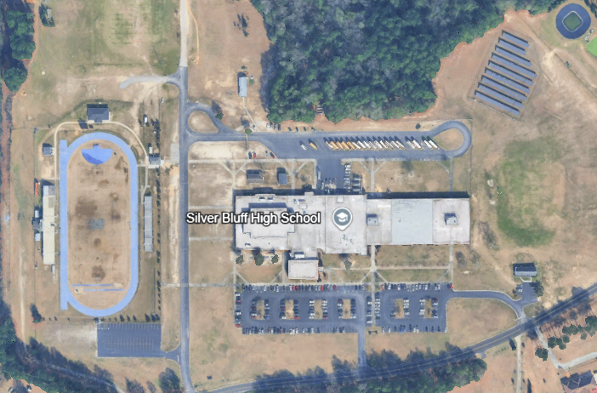
PROJECT SITE
AIKEN COUNTY PUBLIC SCHOOL DISTRICT SILVER BLUFF HIGH SCHOOL | August 26, 2025

Slide 5
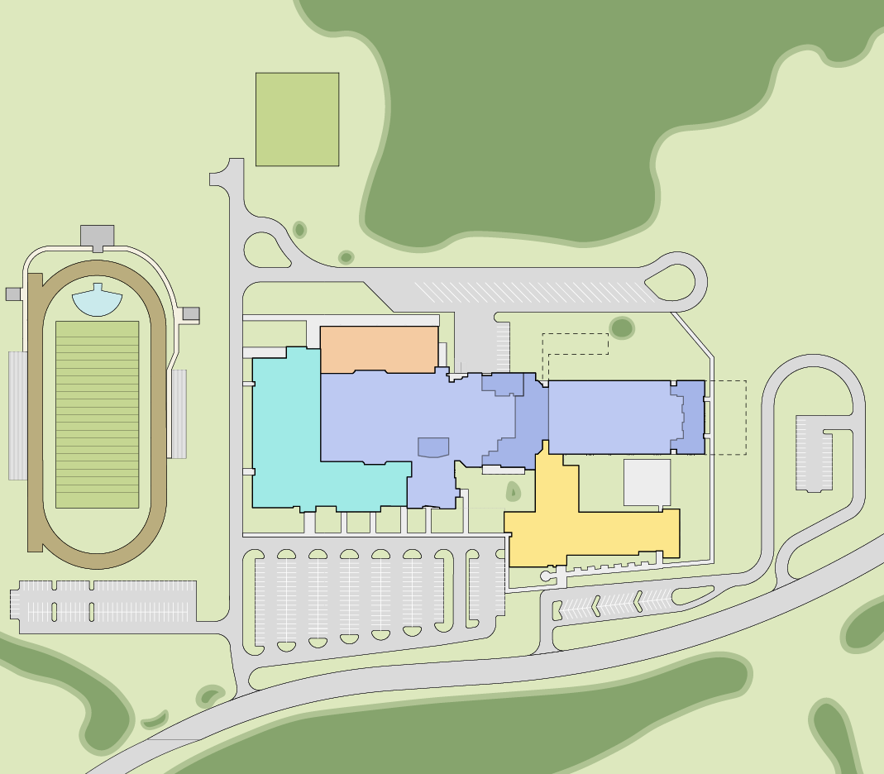
SILVER BLUFF HIGH SCHOOL
TOTAL BUDGET $55,000,000
PRELIMINARY SITE PHASING PLAN
BAND PRACTICE FIELD
PHASE 1A
NEW ADMINISTRATION / GUIDANCE,
CLASSROOMS, & NJROTC
ESTIMATED COST $20,449,958
TOWER
GREEN HOUSE
PHASE 1B
BUS LOOP
NEW COMPETITION GYM, WEIGHT ROOM, BAND ROOM
ESTIMATED COST $23,536,520
1C
CTE LABS
20,000 SF
FUTURE
PHASE 1C
STADIUM
1B
EXISTING BUILDING
126,500 SF
2
1D
2
1D
FUTURE
NEW CTE LABS (AG SCIENCE, WELDING, CULINARY)
ESTIMATED COST $9,160,025
BULLDOG DR
PARKING
COMPETITION GYM, WEIGHT & BAND ROOM
64,500 SF
DRILL PAD
CAR STACKING LOOP
1A
FUTURE
FIELD
HOUSE
ADMIN / GUIDANCE,
CLASSROOMS, & NJROTC
43,000 SF
DEMO
PHASE 1D
SELECTIVE RENOVATION
ESTIMATED COST $1,853,498
STUDENT & EVENT PARKING
STAFF PARKING
VETERANS WALK
EVENT PARKING
VISITOR PARKING
PHASE 2
REMAINING RENOVATION
DESOTO DR
* ALL FIGURES INCLUDE SITE COSTS
AIKEN COUNTY PUBLIC SCHOOL DISTRICT SILVER BLUFF HIGH SCHOOL | August 26, 2025

Slide 6
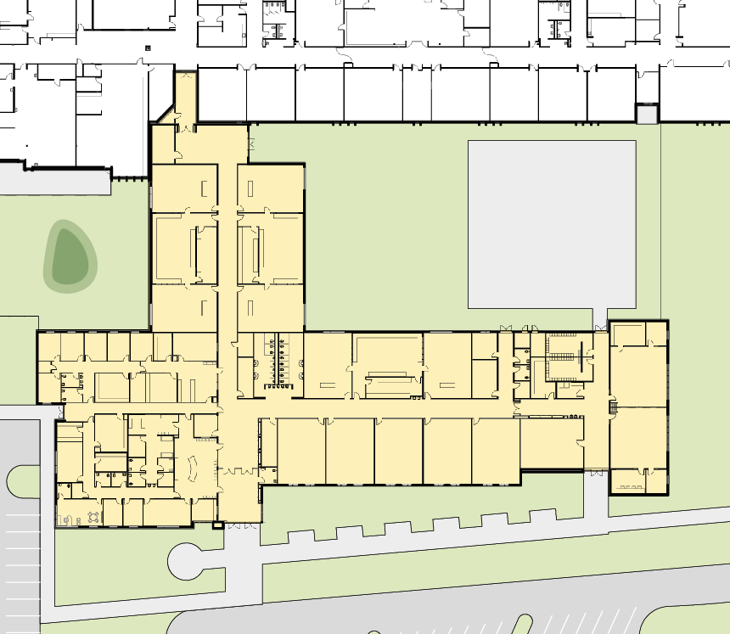
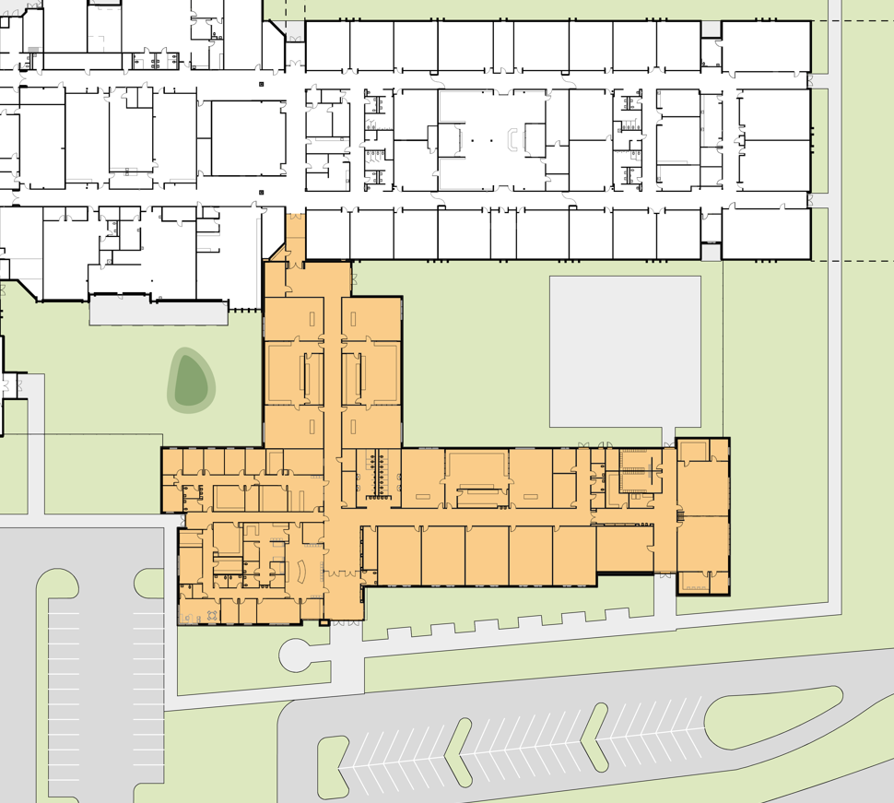
SILVER BLUFF HIGH SCHOOL
TOTAL BUDGET $55,000,000
PRELIMINARY SITE PHASING PLAN
PHASE 1A
NEW ADMINISTRATION / GUIDANCE,
CLASSROOMS, & NJROTC
ESTIMATED COST $20,449,958
ST
SCI
CL
SCI
CL
PHASE 1B
DRILL PAD
NEW COMPETITION GYM, WEIGHT ROOM, BAND ROOM
ESTIMATED COST $23,536,520
LAB
LAB
SCI
CL
SCI
CL
PHASE 1C
O
O
O
O
O
REC
CONF
AP
LOCK
ARMS
OFF
NEW CTE LABS (AG SCIENCE, WELDING, CULINARY)
ESTIMATED COST $9,160,025
SCI
CL
LAB
SCI
CL
GUID
WRK
LOCK
NJROTC
CL
O
WRK
ST
COLL
1A
ST
ST
WRK
CLINIC
SRO
NJROTC
CL
PHASE 1D
O
ADMIN
ST
CL
CL
CL
CL
CL
UNIFORM
SELECTIVE RENOVATION
ESTIMATED COST $1,853,498
CONF
VLT
SEC
ENT
LAB
OFF
PRINC
SEC
BK
CONF
ATT
PHASE 2
VETERANS WALK
REMAINING RENOVATION
* ALL FIGURES INCLUDE SITE COSTS
AIKEN COUNTY PUBLIC SCHOOL DISTRICT SILVER BLUFF HIGH SCHOOL | August 26, 2025

Slide 7
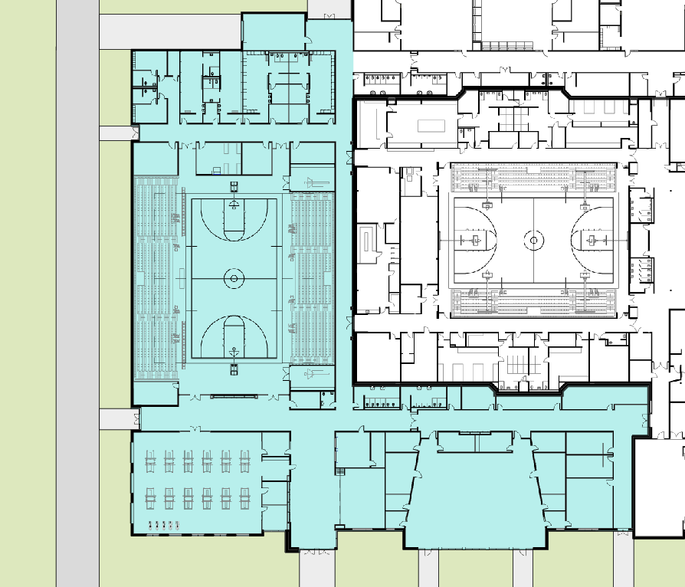
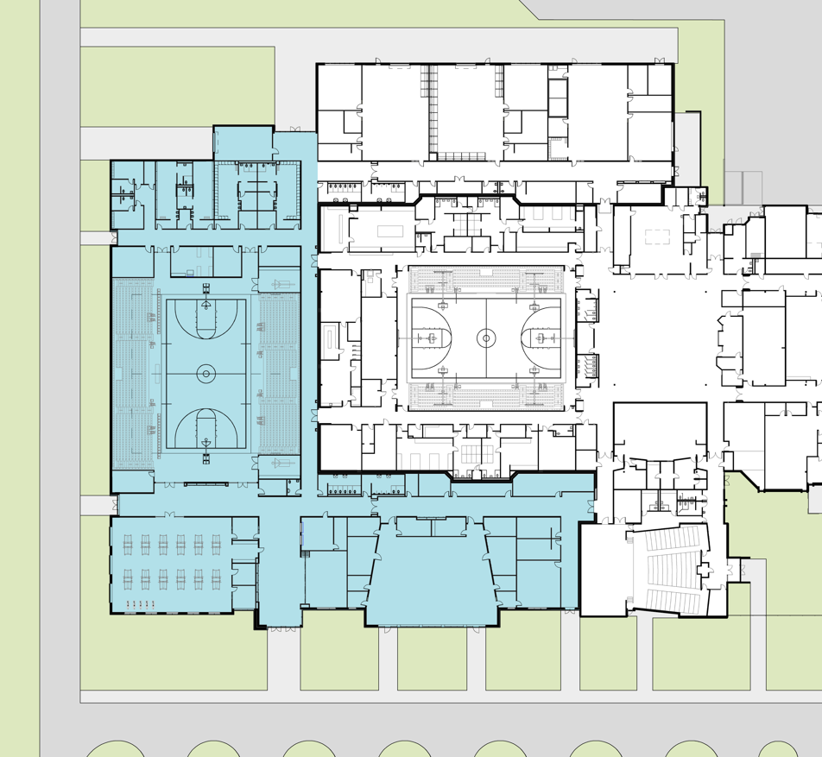
SILVER BLUFF HIGH SCHOOL
BAND
EXT ST
TOTAL BUDGET $55,000,000
PRELIMINARY SITE PHASING PLAN
REF
VIS LOCK
VIS LOCK
LOCK
LOCK
ST
PHASE 1A
ST
REF
COACH
ST
COACH
NEW ADMINISTRATION / GUIDANCE,
CLASSROOMS, & NJROTC
ESTIMATED COST $20,449,958
COACH
COACH
LAUND
TRAIN
ST
MEETING
STOR
PHASE 1B
NEW COMPETITION GYM, WEIGHT ROOM, BAND ROOM
ESTIMATED COST $23,536,520
COMPETITION
GYM
1B
PHASE 1C
NEW CTE LABS (AG SCIENCE, WELDING, CULINARY)
ESTIMATED COST $9,160,025
COACH
COACH
SOUND
STOR
UNIFORM
PHASE 1D
STOR
ST
ST
SELECTIVE RENOVATION
ESTIMATED COST $1,853,498
ATH
DIR
PR
LIB
REPAIR
PR
DRESS
CONC
WEIGHT
NUTR
INST
PERC
DRESS
LOBBY
MEETING/
CLASS
BAND
PHASE 2
ST
PR
PR
BAND
CL
REMAINING RENOVATION
ASST
AD
O
O
* ALL FIGURES INCLUDE SITE COSTS
AIKEN COUNTY PUBLIC SCHOOL DISTRICT SILVER BLUFF HIGH SCHOOL | August 26, 2025

Slide 8
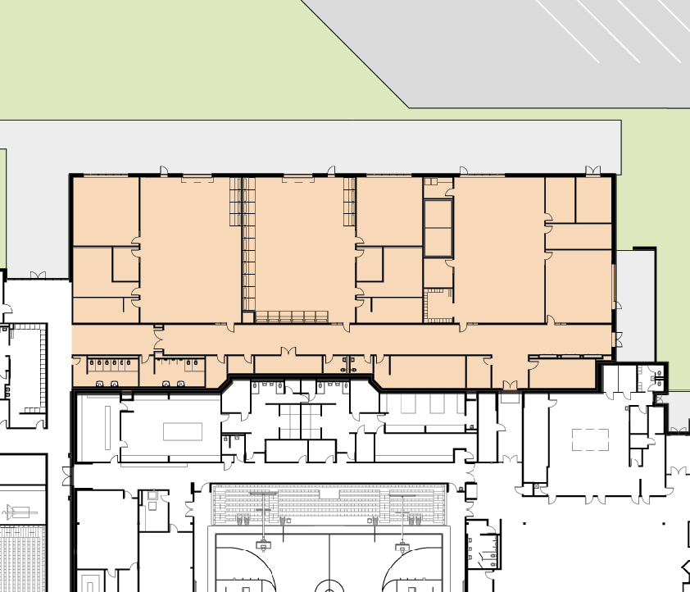
SILVER BLUFF HIGH SCHOOL
TOTAL BUDGET $55,000,000
PRELIMINARY SITE PHASING PLAN
PHASE 1A
NEW ADMINISTRATION / GUIDANCE,
CLASSROOMS, & NJROTC
ESTIMATED COST $20,449,958
AG CL
1C
LAUN
DRY ST
EXT ST
PHASE 1B
WELD CL
FRZ
NEW COMPETITION GYM, WEIGHT ROOM, BAND ROOM
ESTIMATED COST $23,536,520
AG SCI
WELDING
CLR
CULINARY
ST
ST
OFF
OFF
ST
OFF
DINING / CL
PHASE 1C
LOCK
LOCK
LOCK
PATIO
NEW CTE LABS (AG SCIENCE, WELDING, CULINARY)
ESTIMATED COST $9,160,025
ST
GIRLS LOCK
ST
PHASE 1D
SELECTIVE RENOVATION
ESTIMATED COST $1,853,498
PHASE 2
REMAINING RENOVATION
* ALL FIGURES INCLUDE SITE COSTS
AIKEN COUNTY PUBLIC SCHOOL DISTRICT SILVER BLUFF HIGH SCHOOL | August 26, 2025

Slide 9
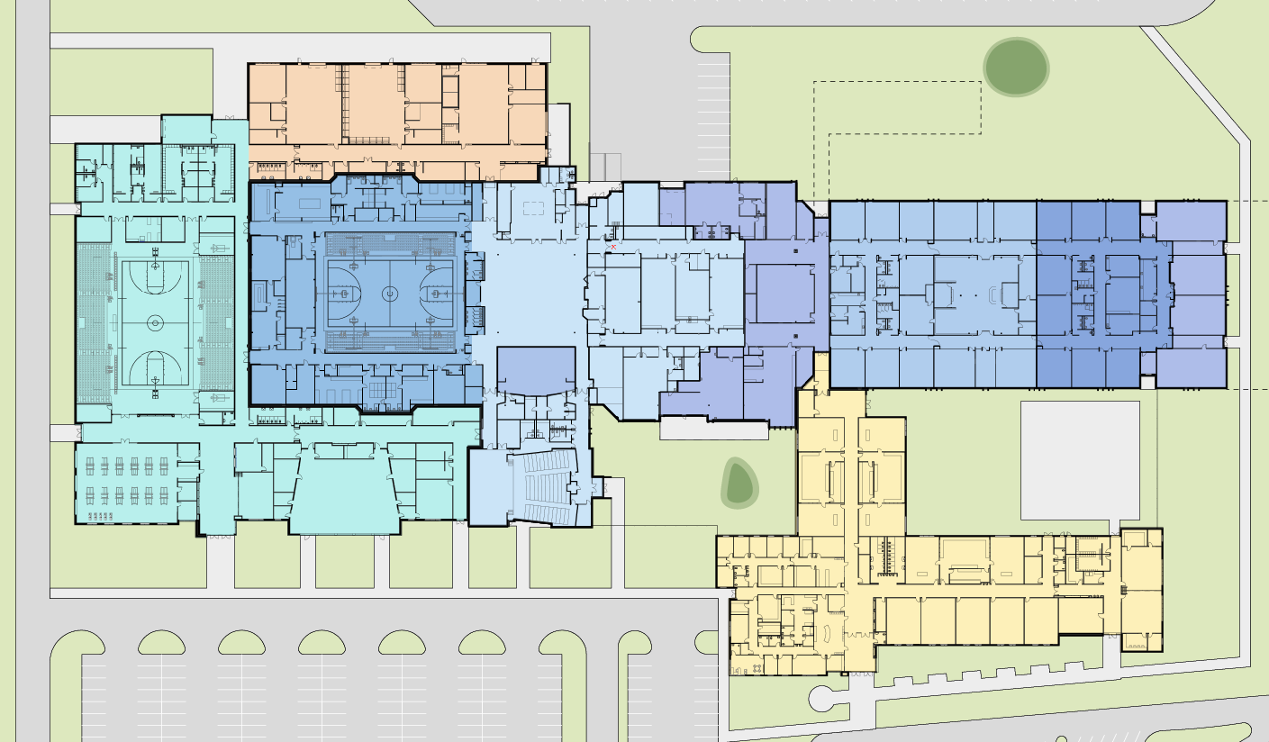
SILVER BLUFF HIGH SCHOOL
PHASING PLAN
PHASE 1
ADDITIONS & SELECTIVE RENOVATION
WELD
1A
1C
AG
SCI
CUL
BAND
ST
1B
REF
L
L
L
L
REF
TRANSP.
1C
LND
TRN
MTG
KIT
CL
SPED
ST
COMMONS
2A
1D
1B
AUX GYM
2C
2B
2D
CTE
1D
1D
MEDIA
COMPETITION
GYM
1D
ART
CL
SPED
PHASE 2
REMAINING RENOVATION
SND
UNIF
2A
O
CON
DR
WEIGHT
DR
SCI
SCI
S
MTG
CL
BAND
BAND
CL
AUDITORIUM
1A
2B
O
SCI
2C
GUIDANCE
NJROTC
ADMIN
CL
2D
SEC
ENT
VETERANS WALK
AIKEN COUNTY PUBLIC SCHOOL DISTRICT SILVER BLUFF HIGH SCHOOL | August 26, 2025

Slide 10
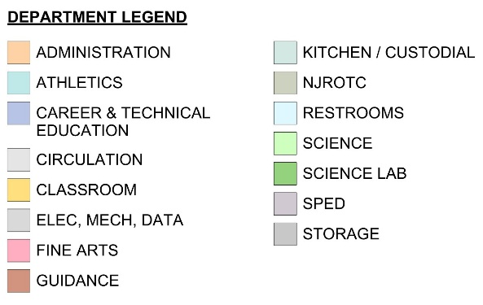
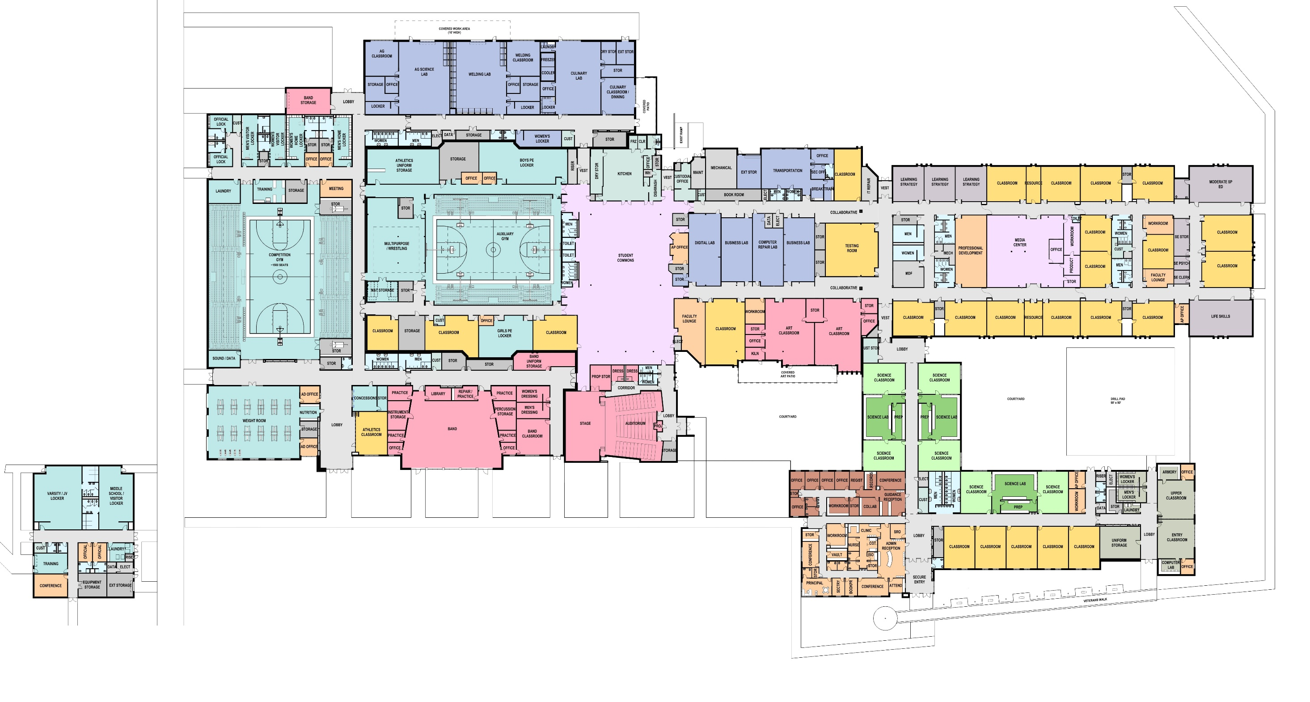
SILVER BLUFF HIGH SCHOOL
FLOOR PLAN
FUTURE
FIELD HOUSE
AIKEN COUNTY PUBLIC SCHOOL DISTRICT SILVER BLUFF HIGH SCHOOL | August 26, 2025

Slide 11
AIKEN COUNTY PUBLIC SCHOOL DISTRICT SILVER BLUFF HIGH SCHOOL | August 26, 2025

Slide 12
AIKEN COUNTY PUBLIC SCHOOL DISTRICT SILVER BLUFF HIGH SCHOOL | August 26, 2025

Slide 13
AIKEN COUNTY PUBLIC SCHOOL DISTRICT SILVER BLUFF HIGH SCHOOL | August 26, 2025

Slide 14
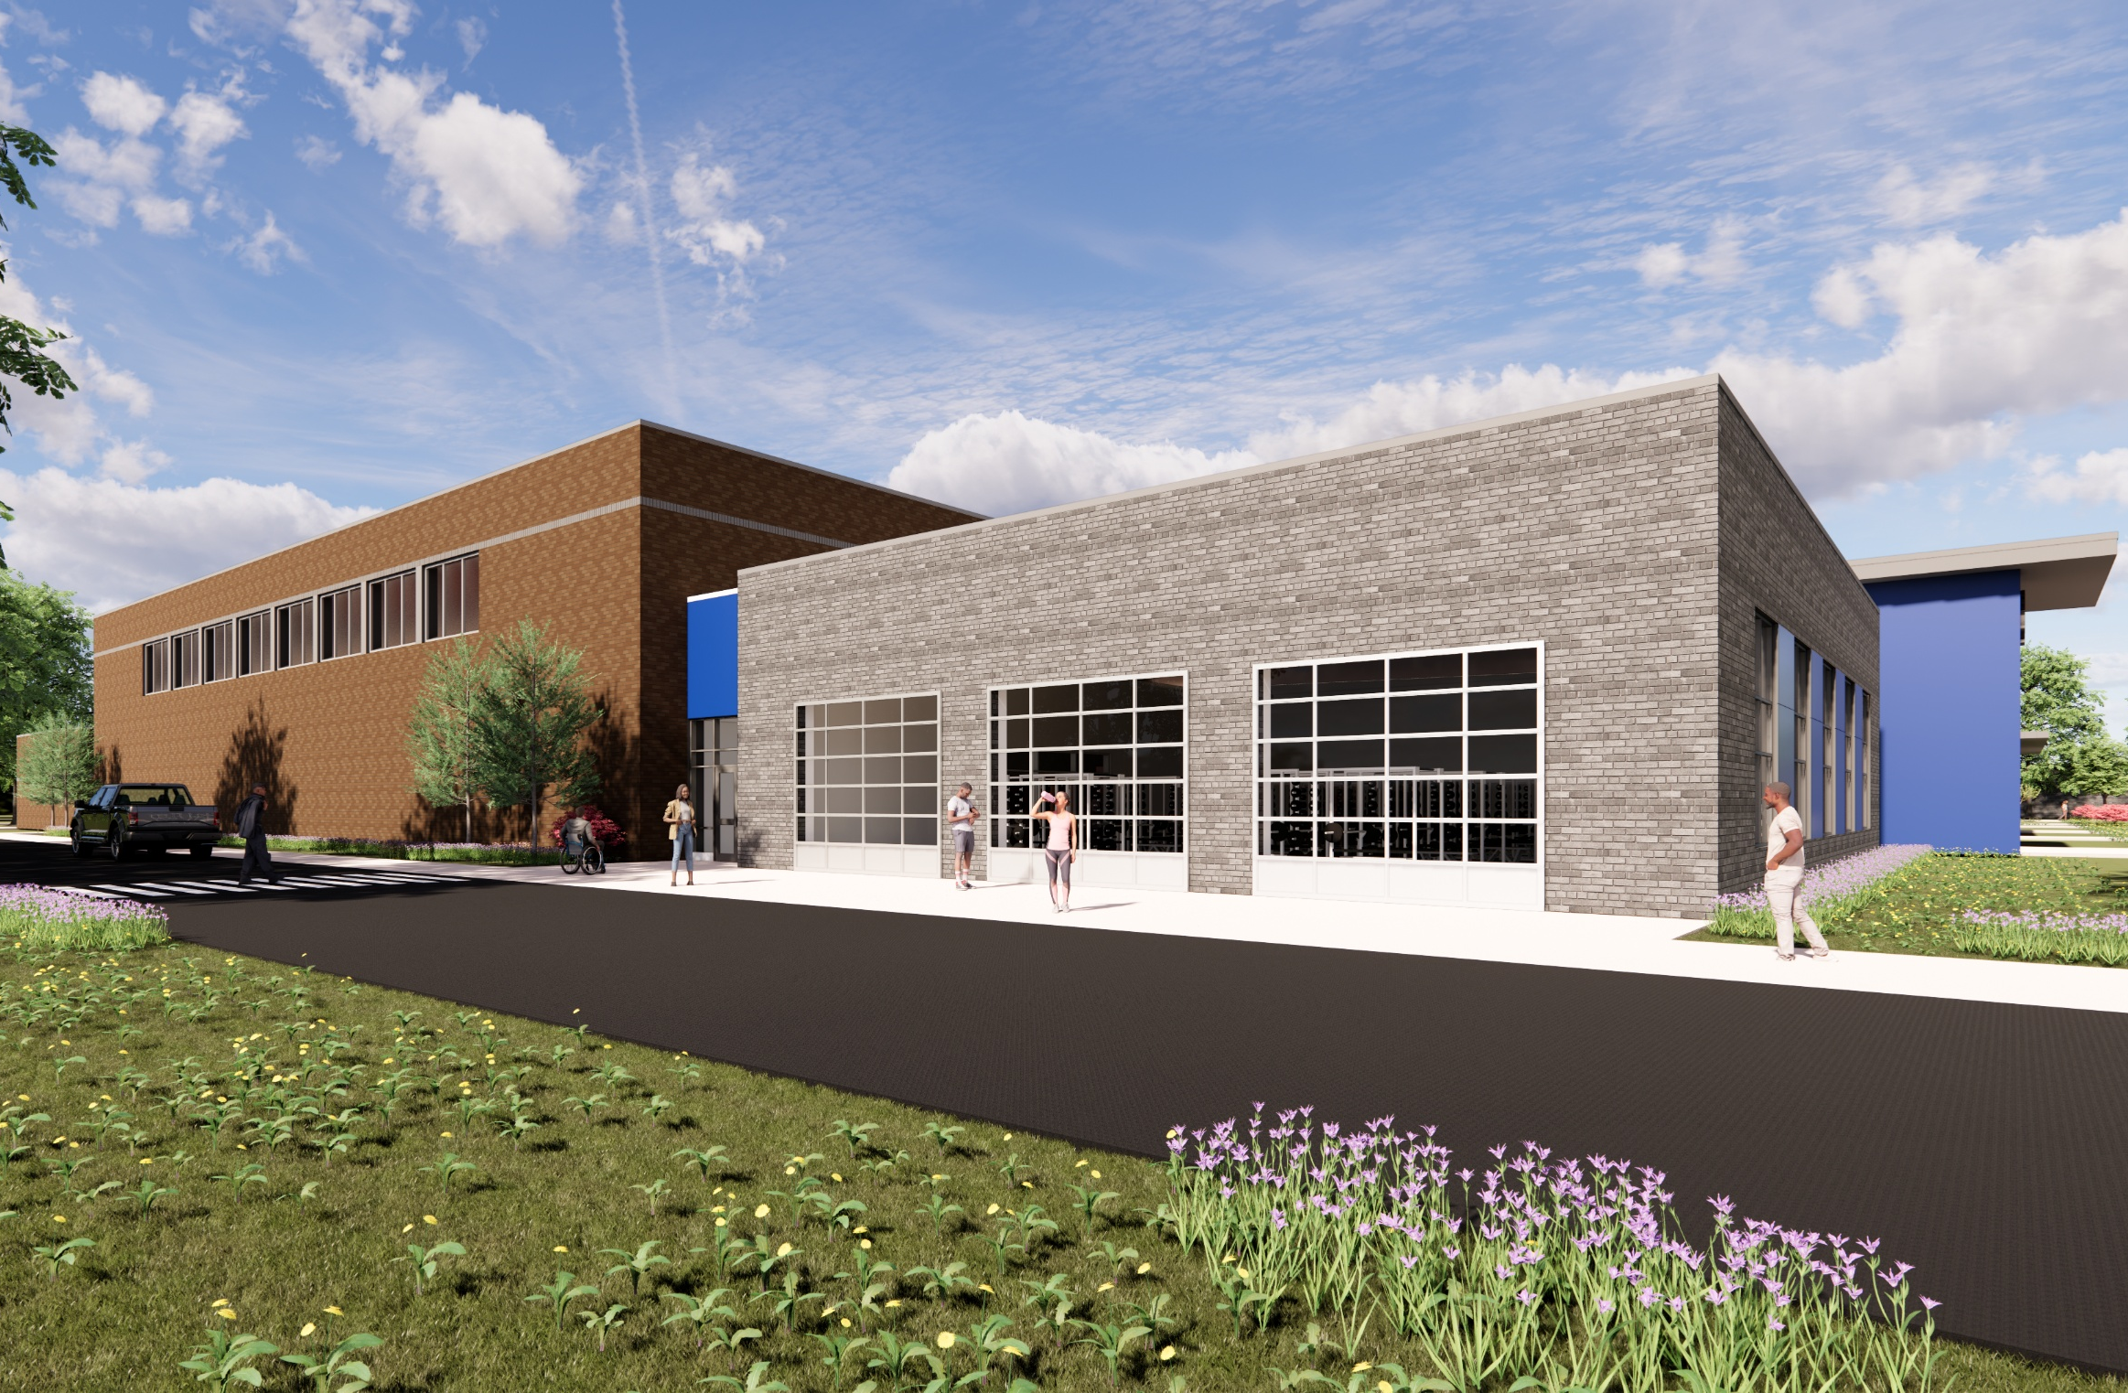
GYM & WEIGHT ROOM
SILVER BLUFF HIGH SCHOOL RENDERING
AIKEN COUNTY PUBLIC SCHOOL DISTRICT SILVER BLUFF HIGH SCHOOL | August 26, 2025

Slide 15
AIKEN COUNTY PUBLIC SCHOOL DISTRICT SILVER BLUFF HIGH SCHOOL | August 26, 2025

Slide 16
AIKEN COUNTY PUBLIC SCHOOL DISTRICT SILVER BLUFF HIGH SCHOOL | August 26, 2025

Slide 17
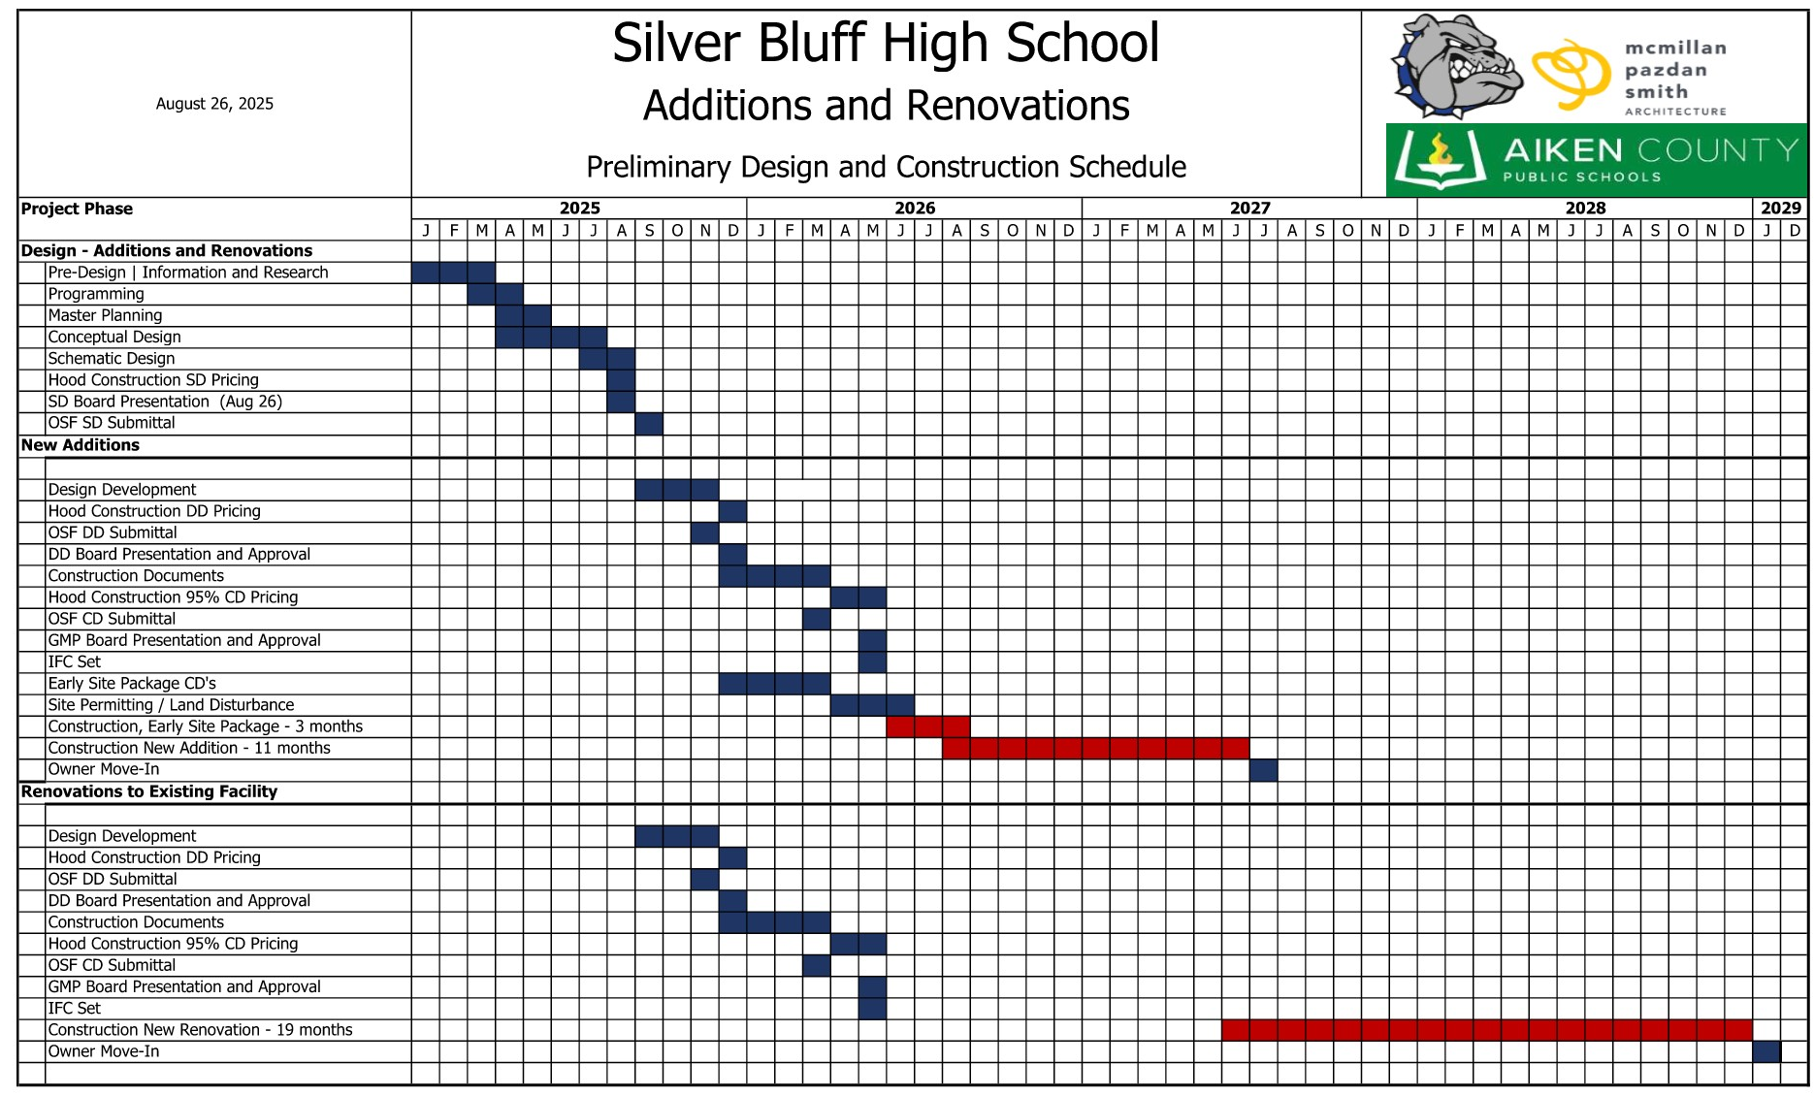
AIKEN COUNTY PUBLIC SCHOOL DISTRICT SILVER BLUFF HIGH SCHOOL | August 26, 2025

Slide 18
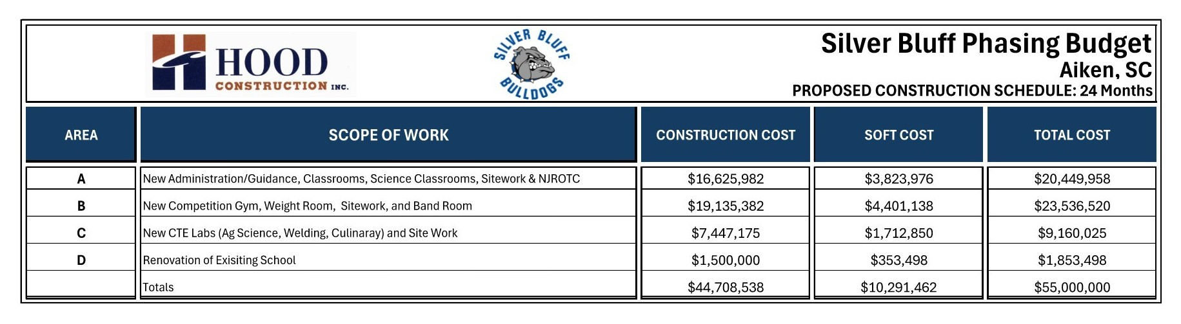
PROJECT BUDGET
AIKEN COUNTY PUBLIC SCHOOL DISTRICT SILVER BLUFF HIGH SCHOOL | August 26, 2025

Slide 19
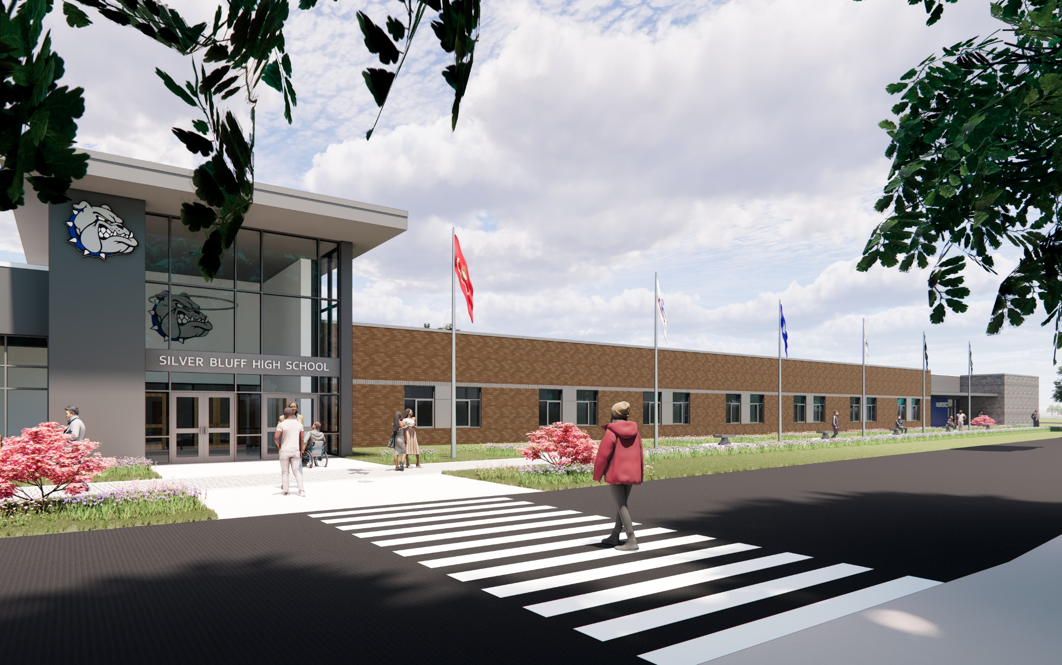
QUESTIONS &
COMMENTS
11
AIKEN COUNTY PUBLIC SCHOOL DISTRICT SILVER BLUFF HIGH SCHOOL | August 26, 2025

