Slide 1
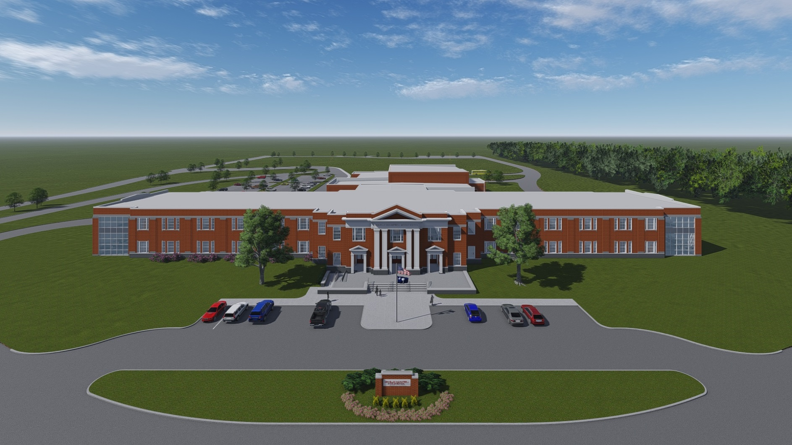
The New Leavelle McCampbell Middle School
Design Development Presentation

Slide 2
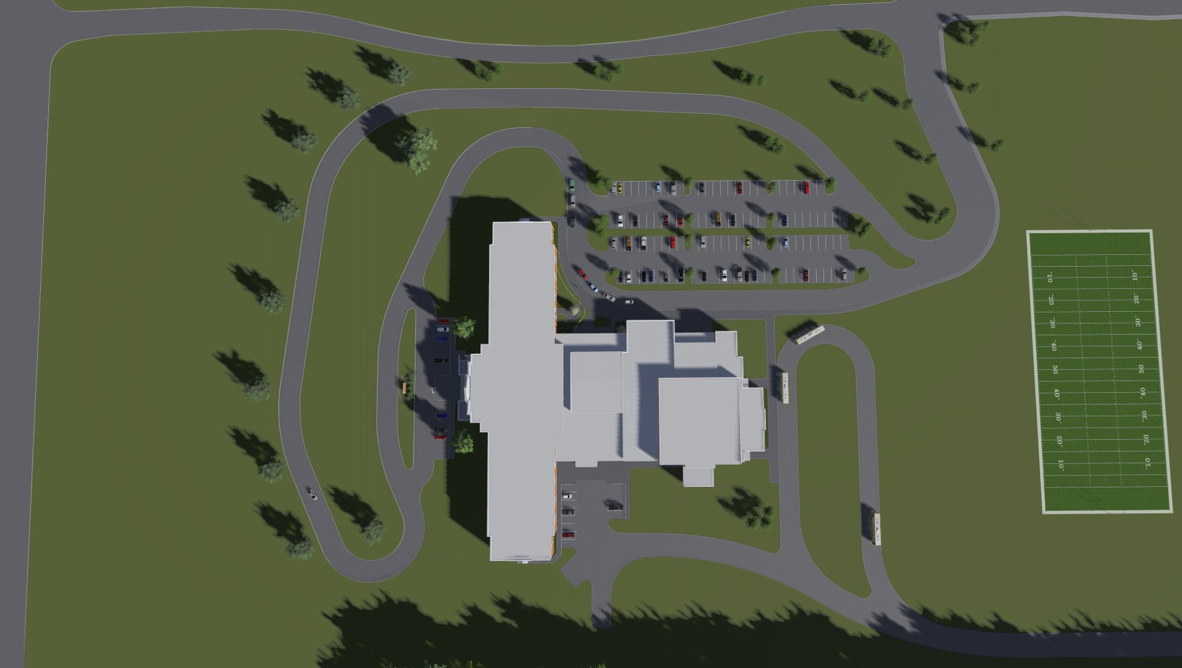
The New Leavelle McCampbell Middle School
Site Plan

Slide 3
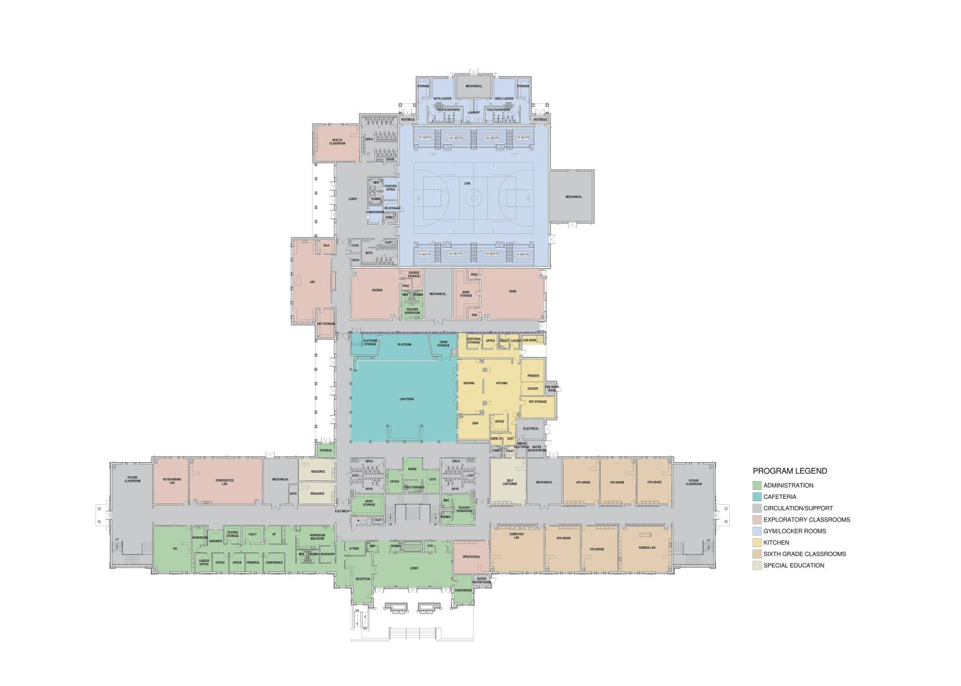
The New Leavelle McCampbell Middle School
Overall Ground Floor Plan

Slide 4
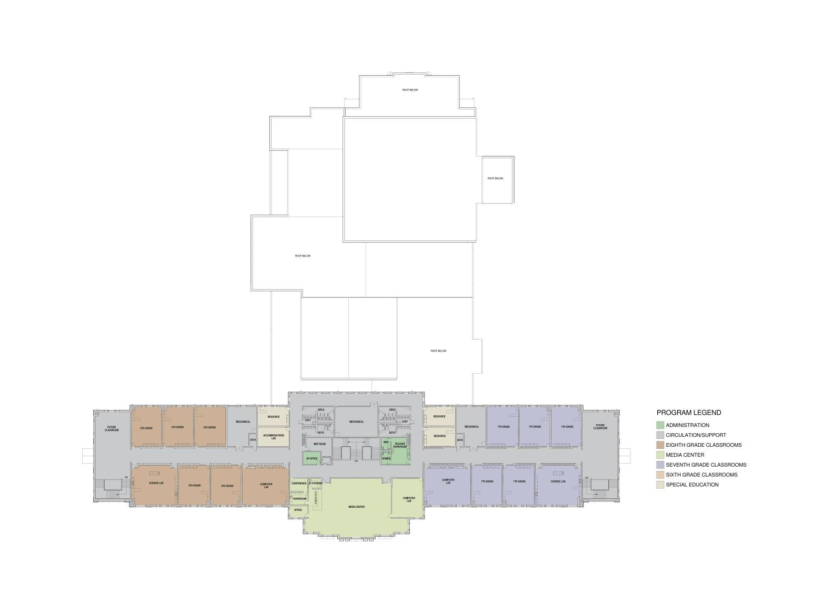
The New Leavelle McCampbell Middle School
Overall First Floor Plan

Slide 5
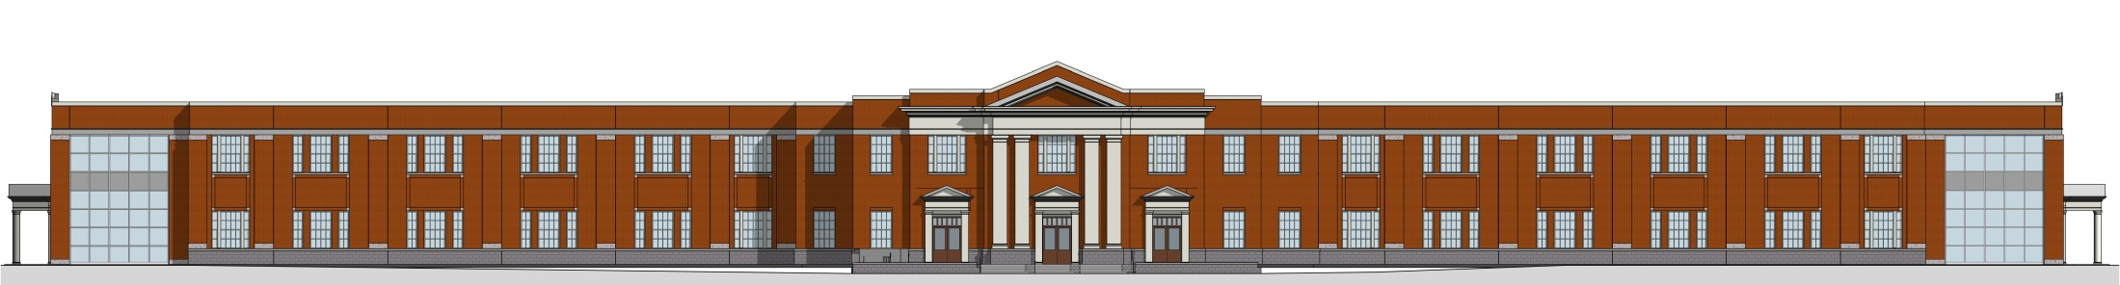
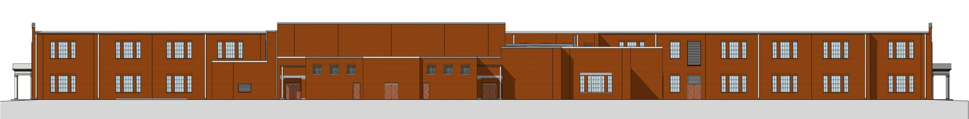
The New Leavelle McCampbell Middle School
Elevations
Front Elevation
Rear Elevation

Slide 6
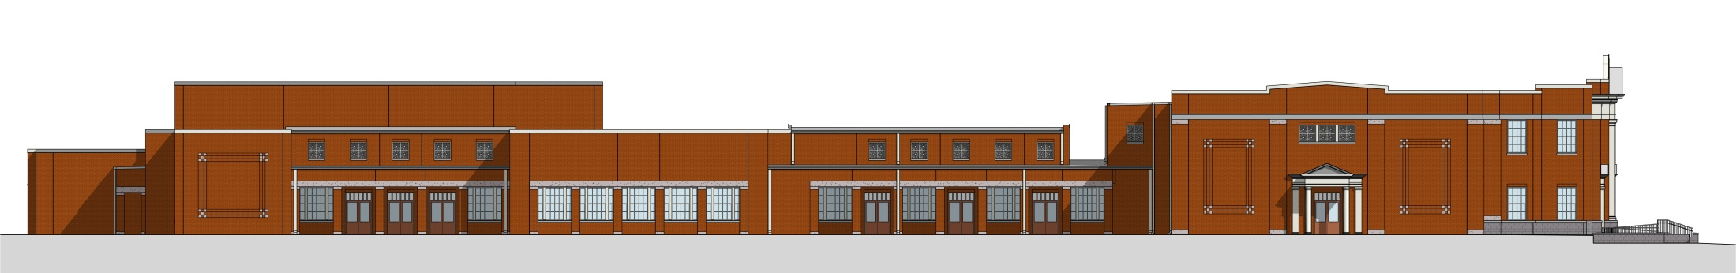
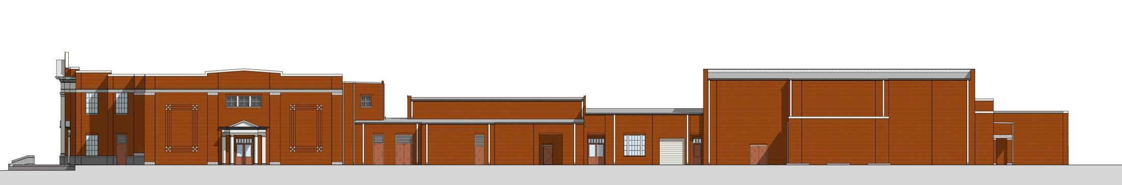
The New Leavelle McCampbell Middle School
Elevations
Side Elevation
Side Elevation

Slide 7
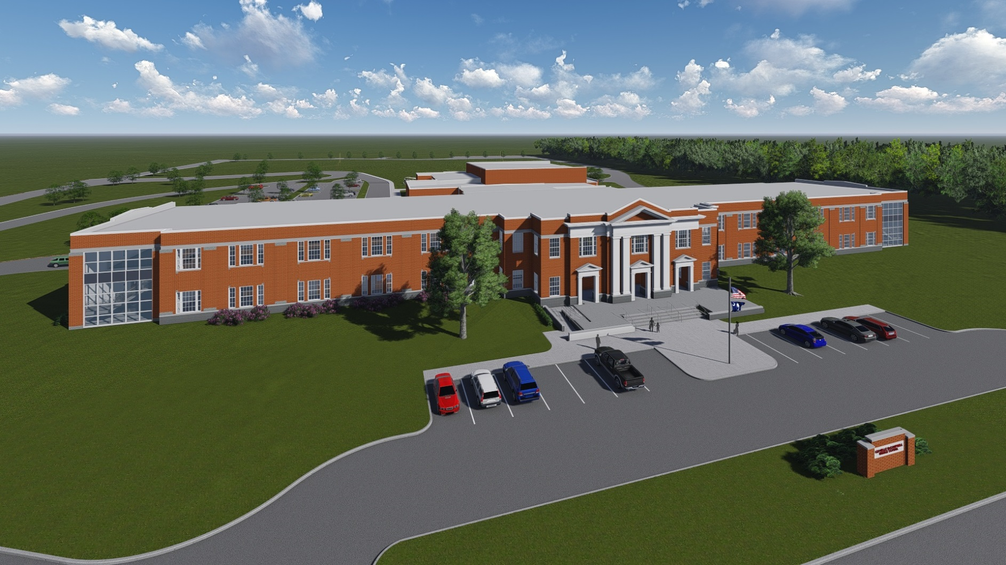
The New Leavelle McCampbell Middle School
Aerial

Slide 8
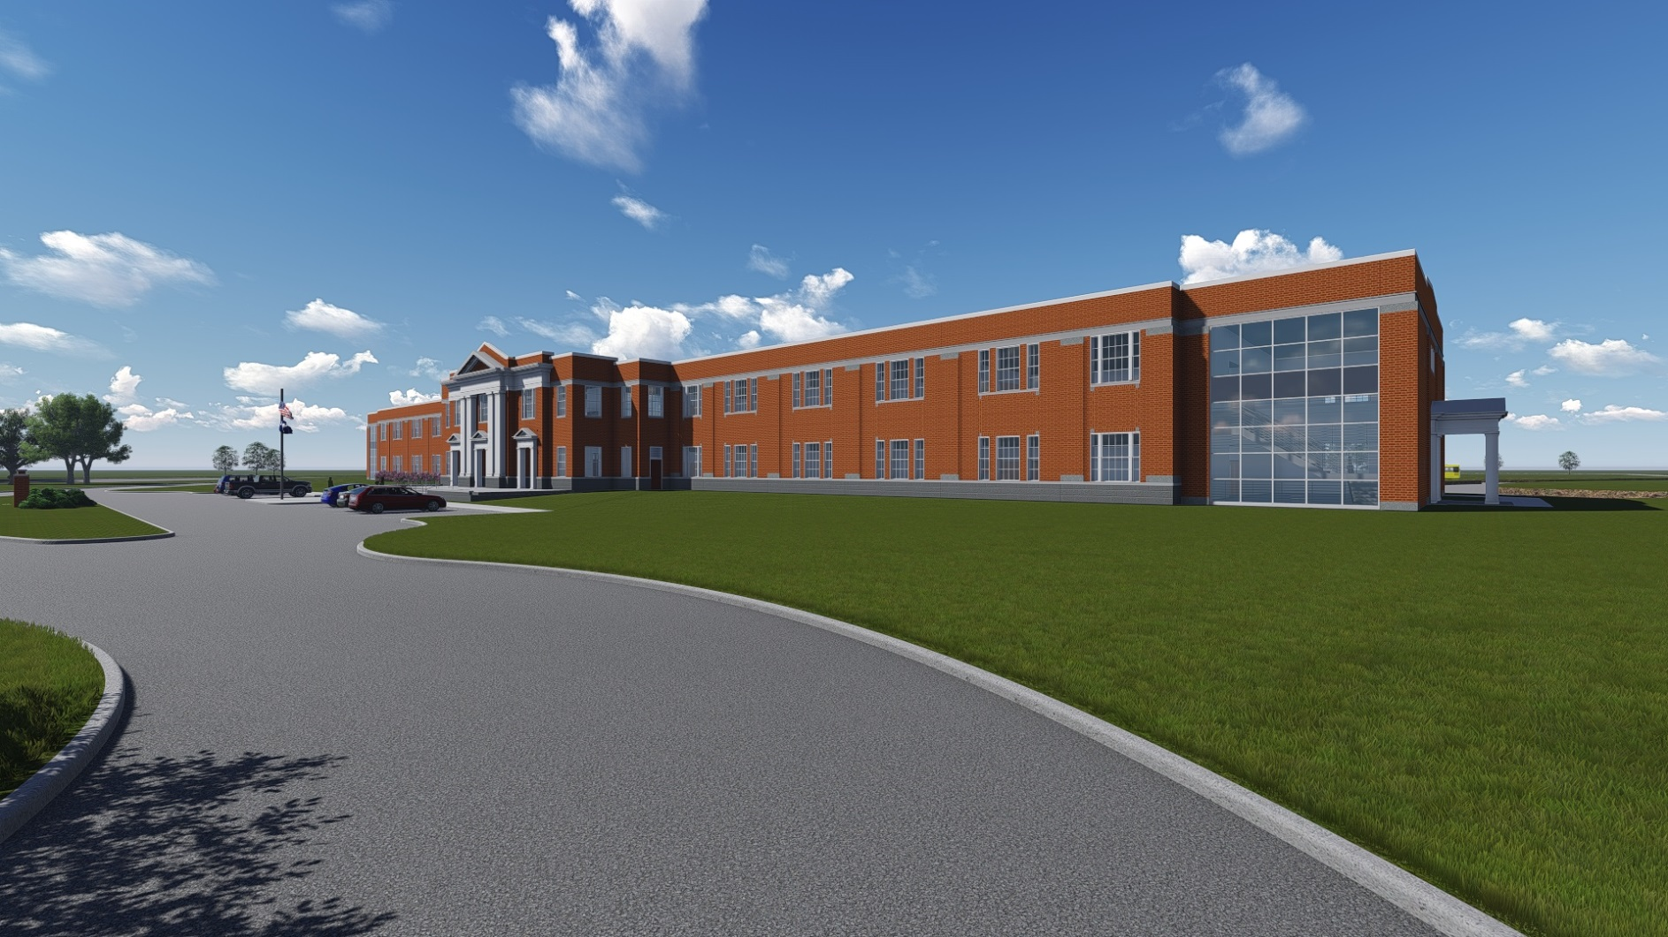
The New Leavelle McCampbell Middle School
Approach

Slide 9
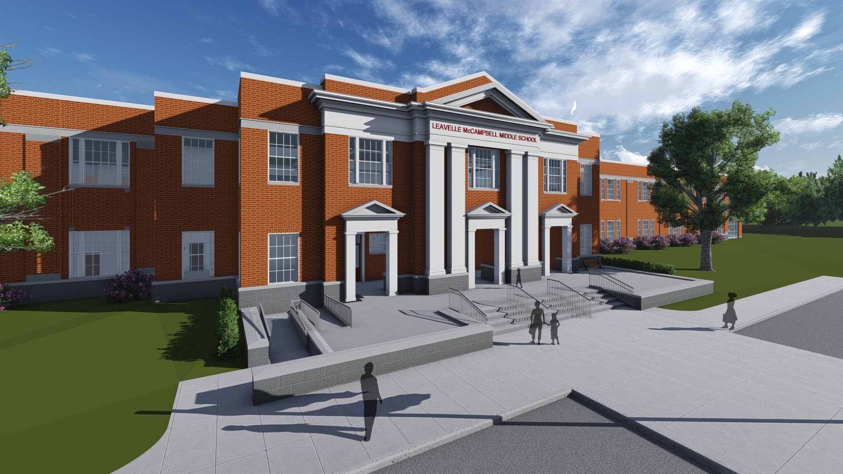
The New Leavelle McCampbell Middle School
Front Entrance

Slide 10
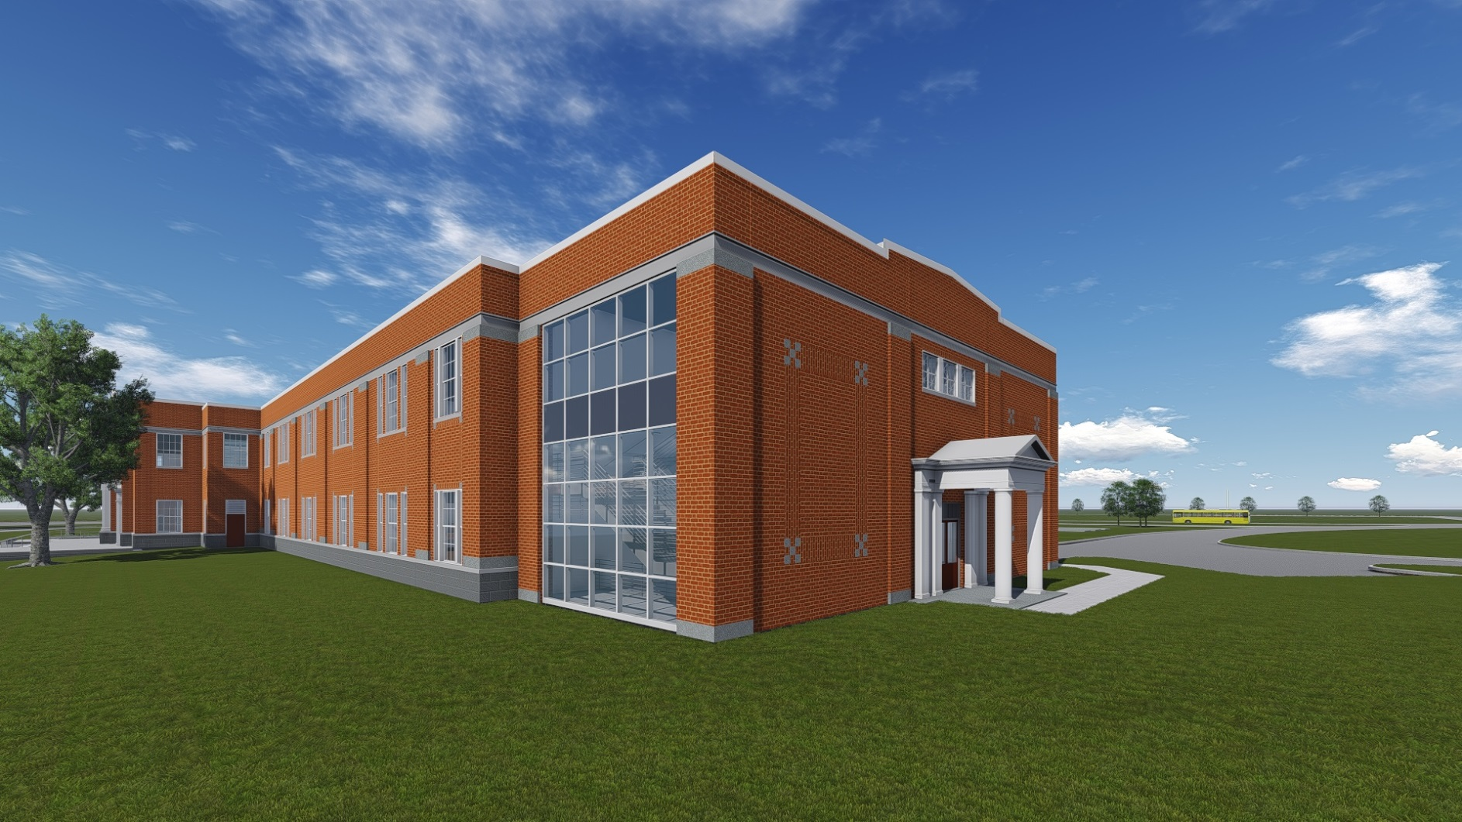
The New Leavelle McCampbell Middle School
Classroom Wing

Slide 11
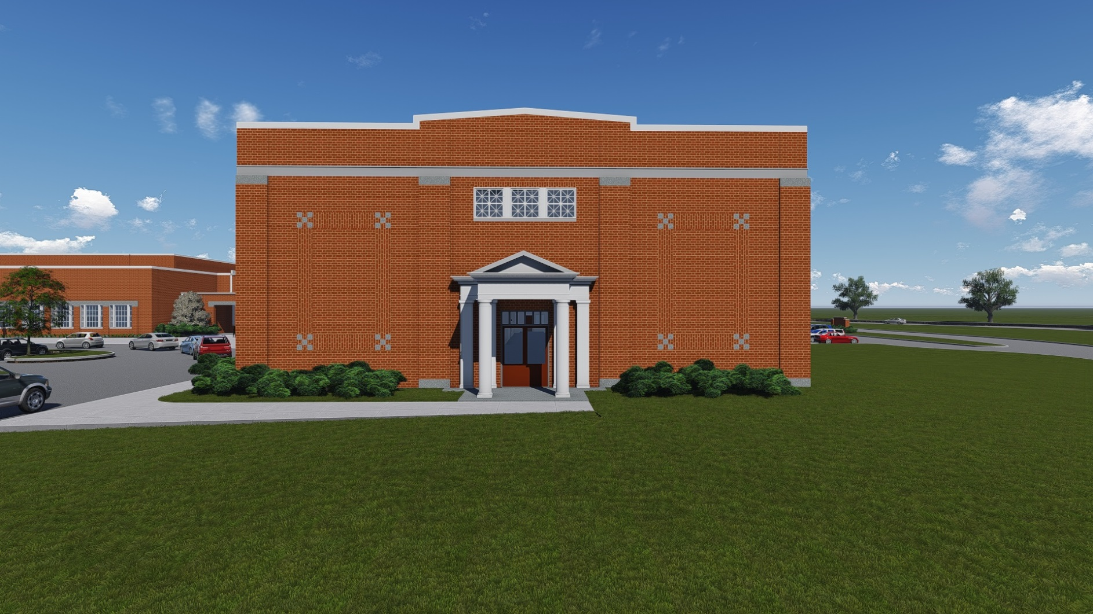
The New Leavelle McCampbell Middle School
Classroom Wing

Slide 12
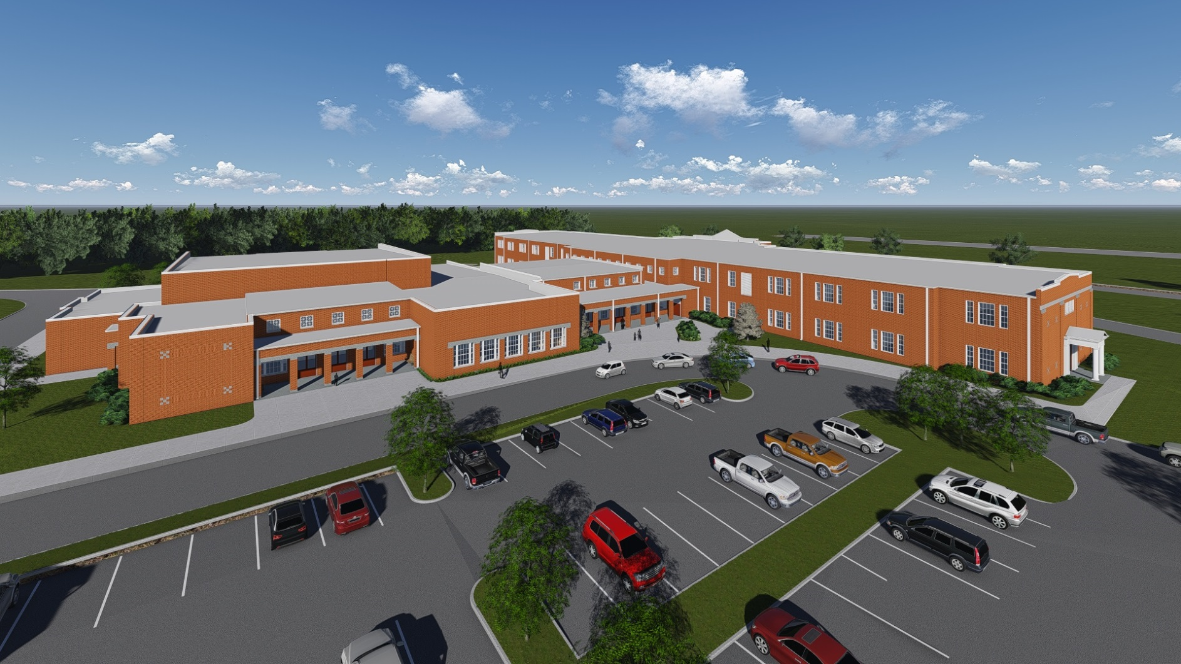
The New Leavelle McCampbell Middle School
Aerial

Slide 13
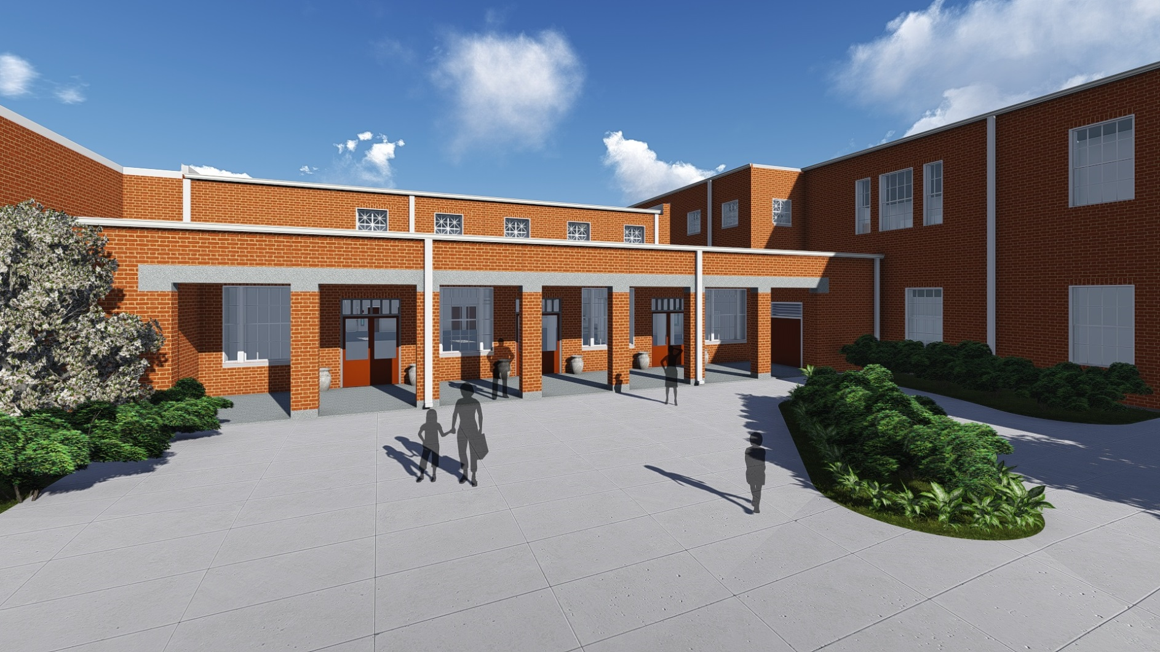
The New Leavelle McCampbell Middle School
Cafetorium Entrance

Slide 14
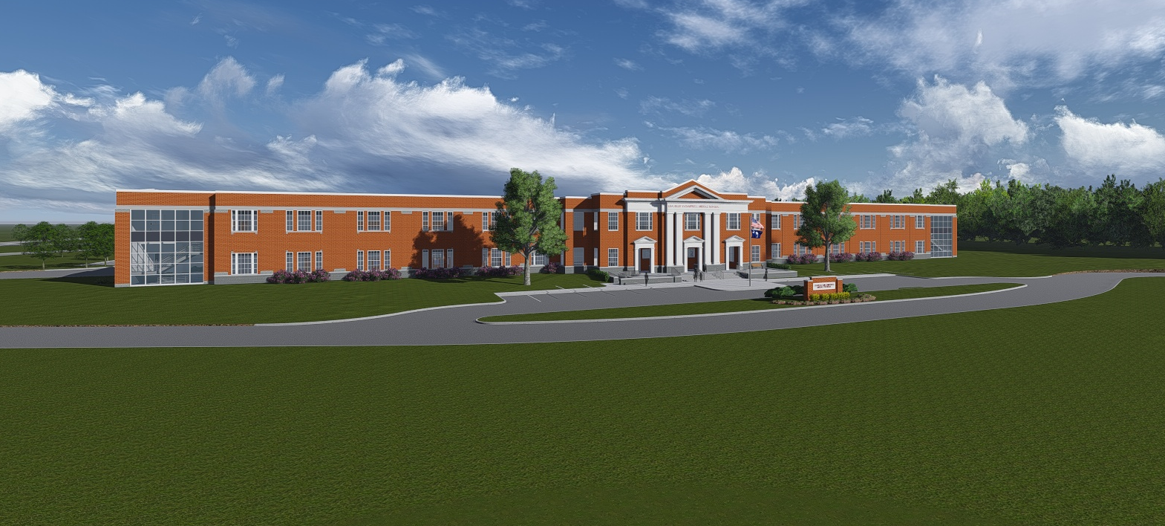
The New Leavelle McCampbell Middle School
Animation
Click Image to Play Animation

Slide 15
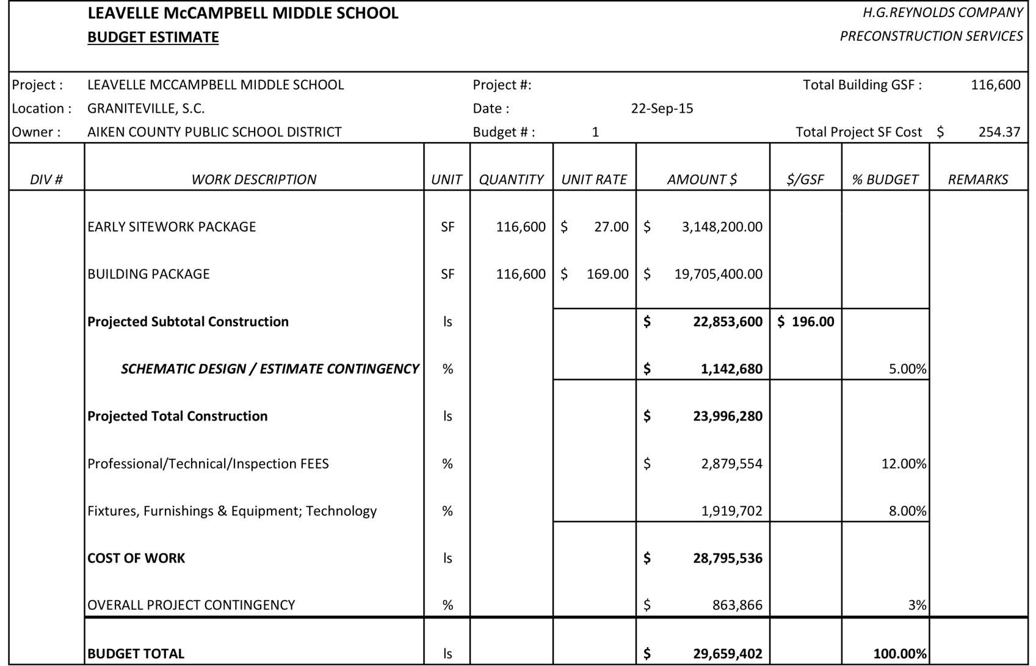

The New Leavelle McCampbell Middle School
Budget Estimate

Slide 16
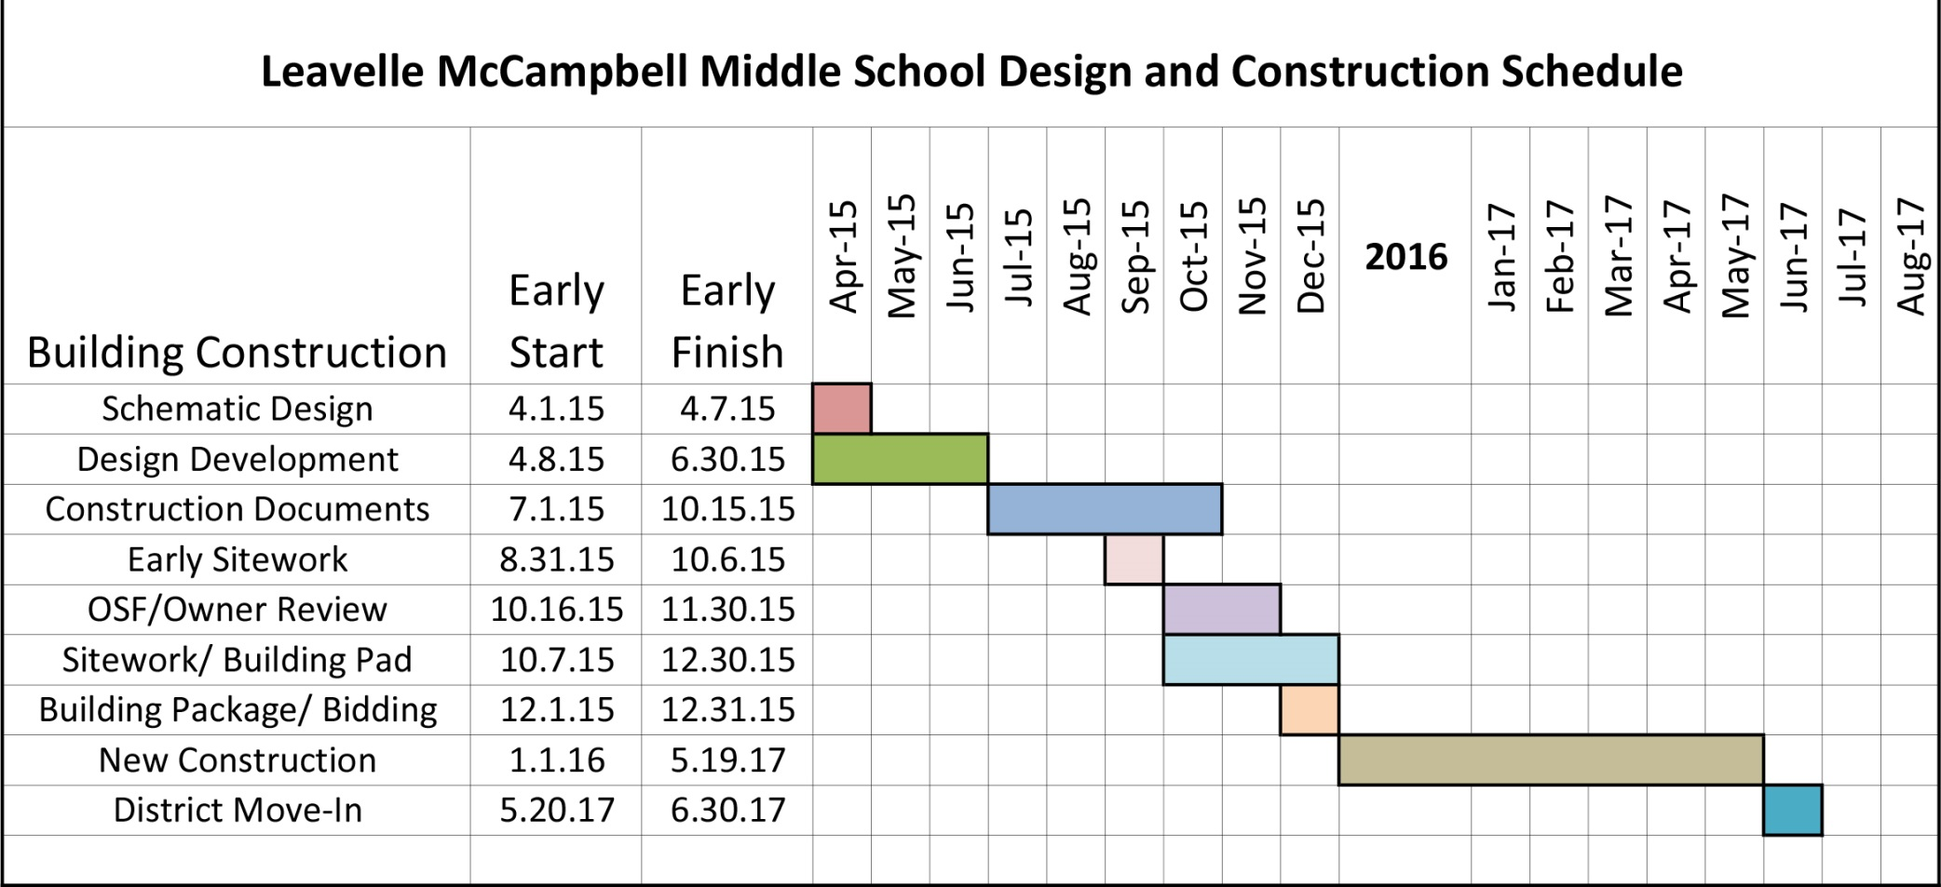
The New Leavelle McCampbell Middle School
Project Schedule

