Slide 2
DESIGN DEVELOPMENT SUMMARY
AIKEN COUNTY CAREER AND TECHNOLOGY CENTER
AIKEN COUNTY PUBLIC SCHOOL DISTRICT AUGUST 13, 2024

Slide 3
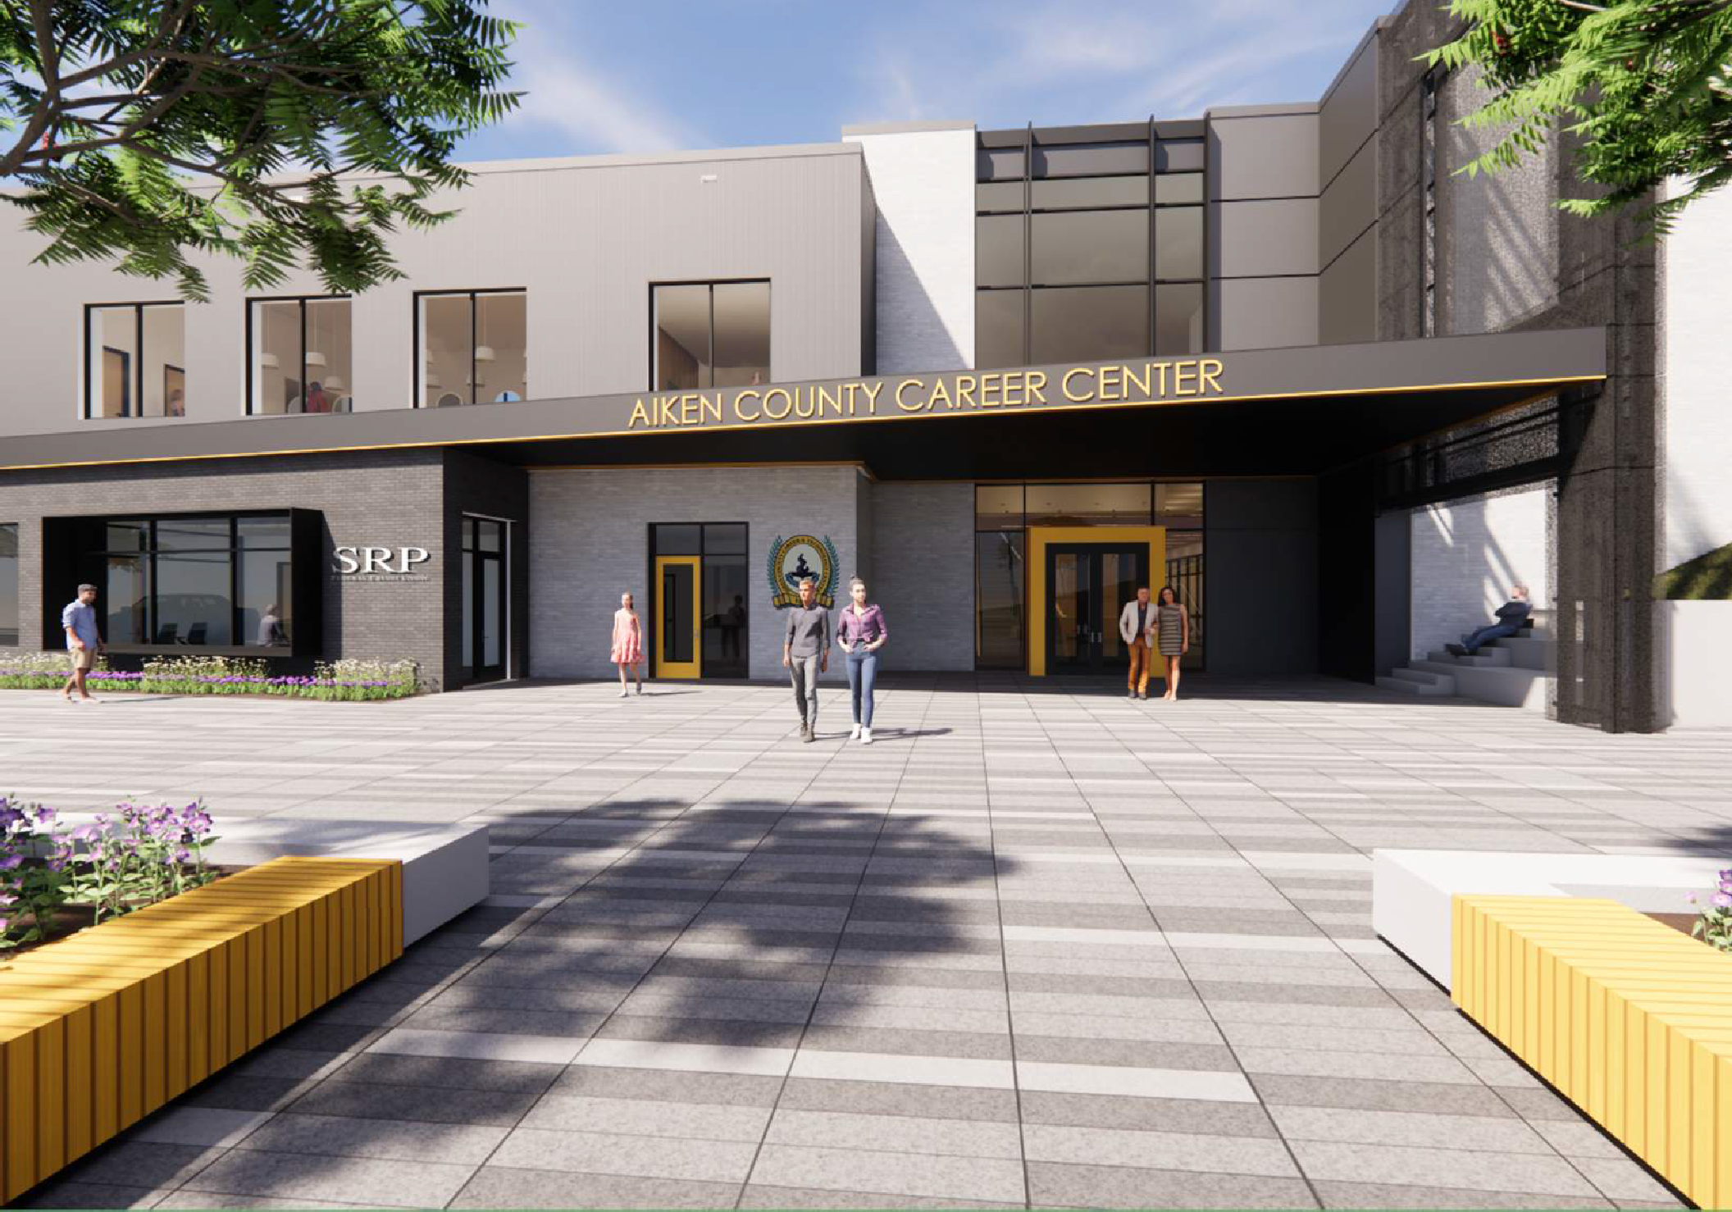

Slide 4
PROJECT REVIEW
Since the previous Schematic Design Submission, we have:
H. G. Reynolds has joined the team as the Contractor Construction Services and a comprehensive GMP.
to provide
Further developed the overall design and floorplans with district and career center staff to confirm the performance of the building.
We have coordinated with OSF and submitted for DD project review.
An SRP branch bank has been added off the secure lobby. This branch will not have a vault but will provide ATM “pods” inside. Students are able to gain workplace experience without handling cash directly through transactions with customers.
The result of these efforts is a 100,000 SF state-of-the-art Career Center that will house 20 unique programs and is set to open in the beginning of 2026.

Slide 5
VISION STATEMENT
The Aiken County Career and Technology Center will be built to empower, support,
and develop the students of Aiken County Public Schools.
The Career Center will
bridge the gap between education and careers, preparing students to enter the
workforce or college with a strong foundation and ready to be successful.
The new Career Center will be built to look and perform like the professional workplace, projecting it’s mission not just through its students and staff, but through the architecture.
The clear and deliberate composition of space will encourage cross curriculum development, collaboration, and community as clusters of like programs are positioned around a network of open collaborative areas.
As one moves through and around the building, it will showcase the programs and the work that occur within it, while students are trained by industry experts in authentic workplace inspired environments.

Slide 6
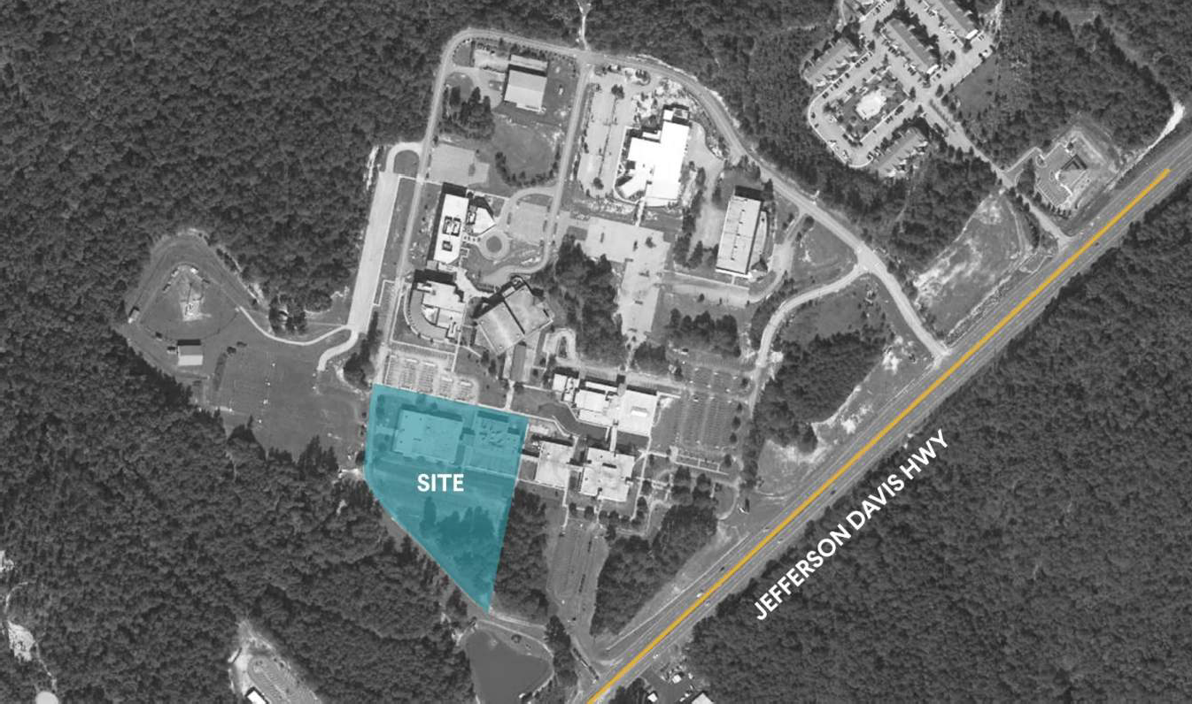
PROJECT S ITE

Slide 7
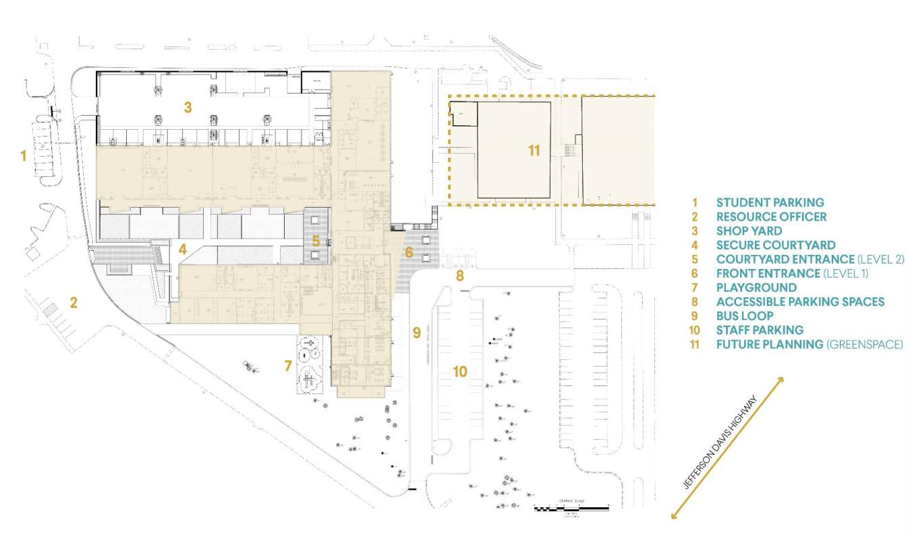
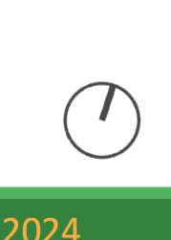
S ITE PLAN

Slide 8
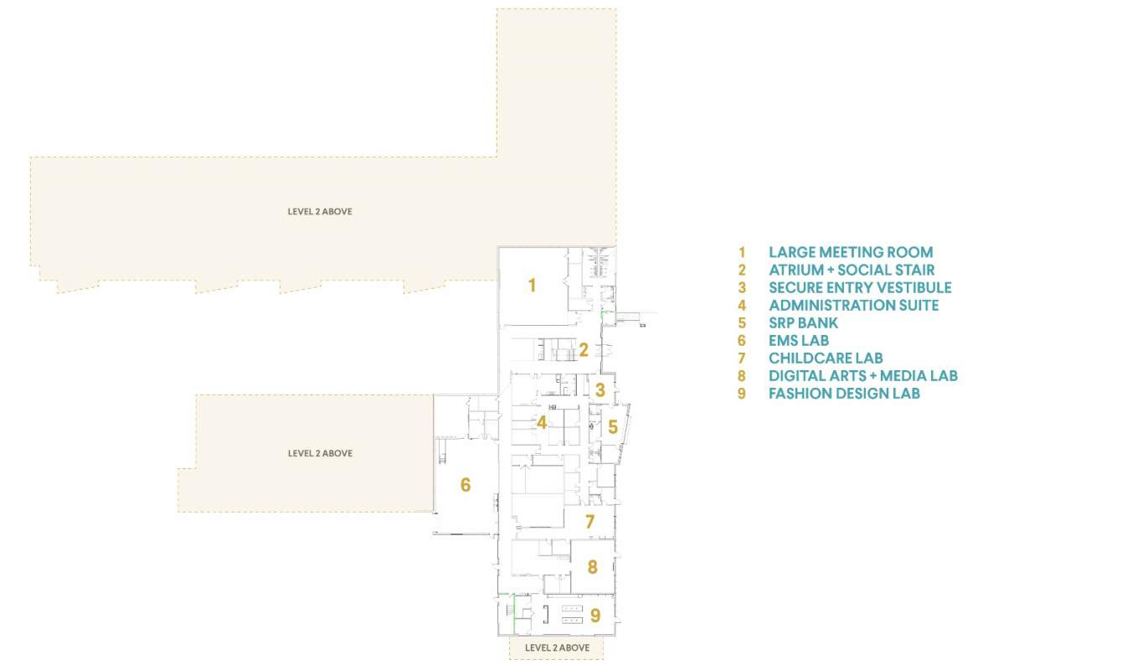
F IRST LEVEL PLAN

Slide 9
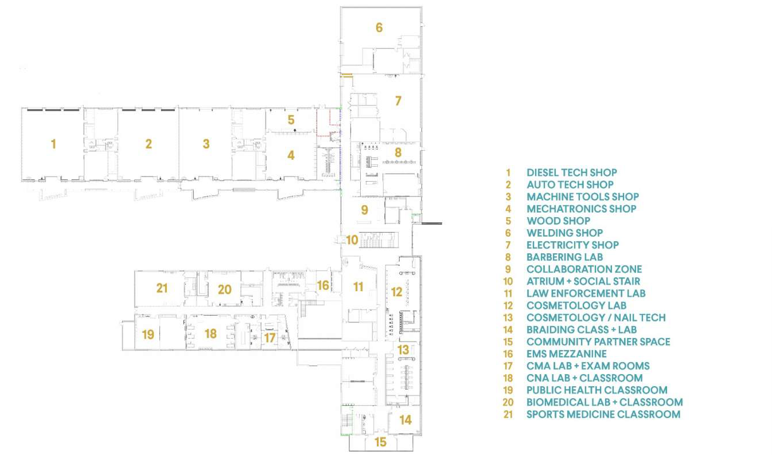
SECOND LEVEL PLAN

Slide 10
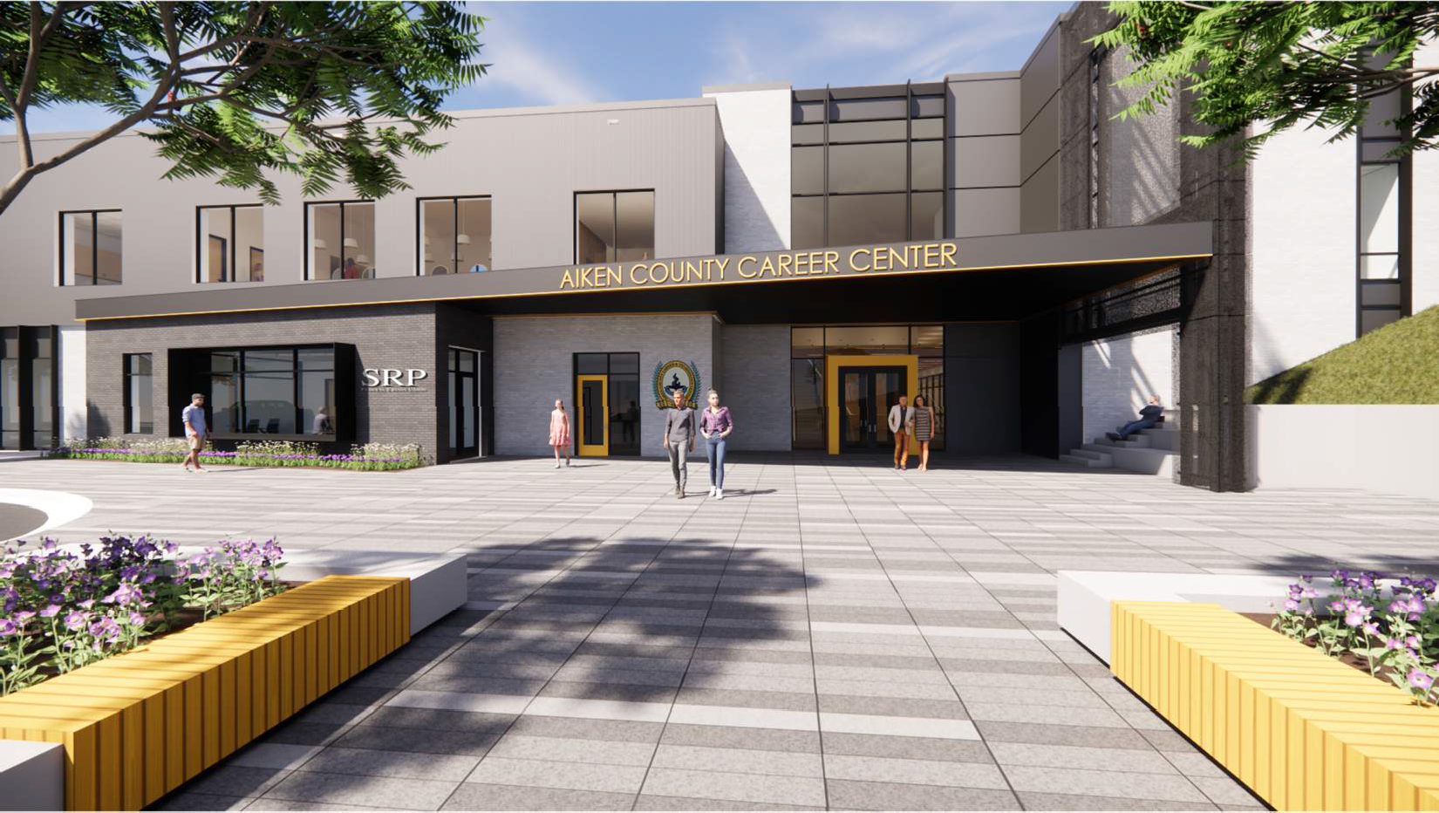

Slide 11
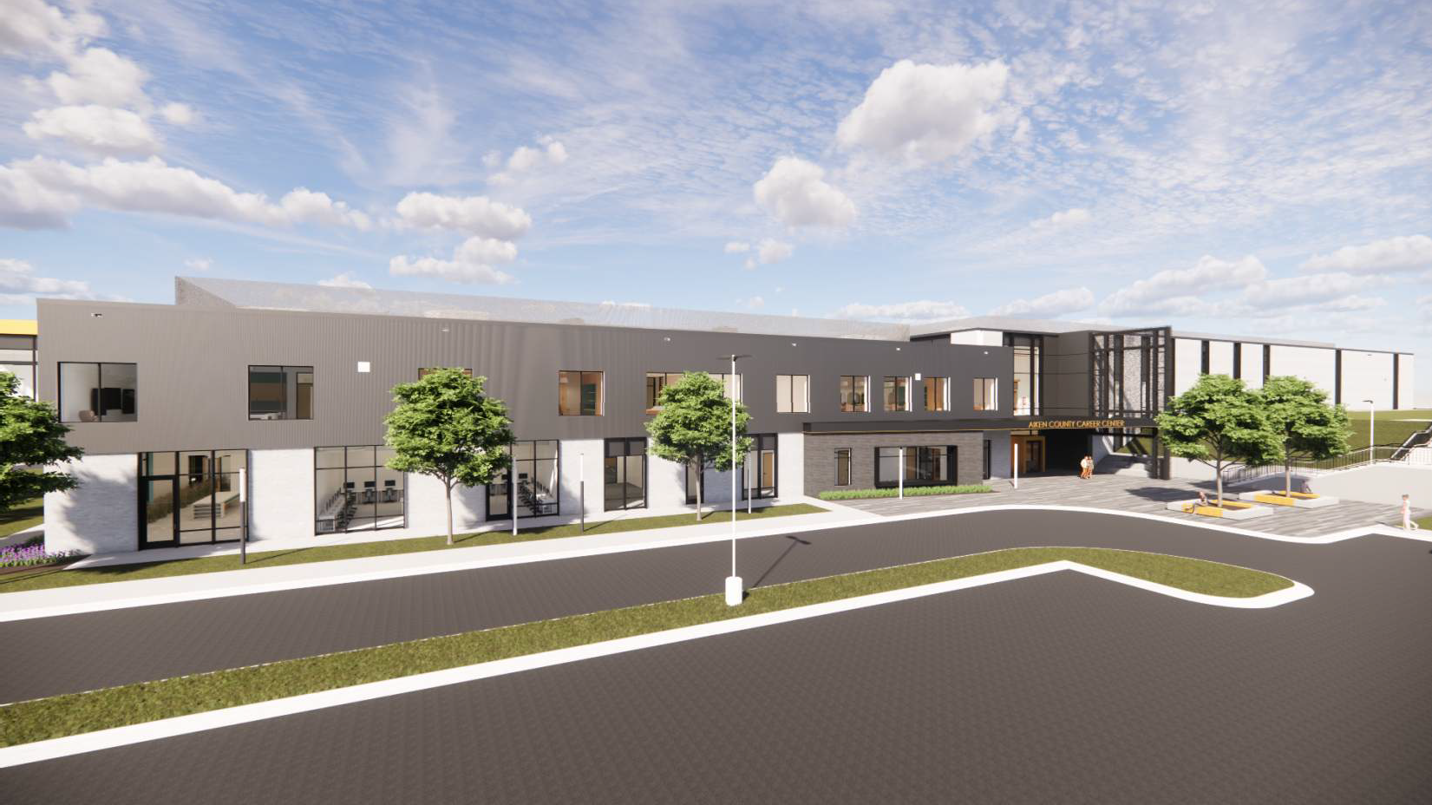

Slide 12
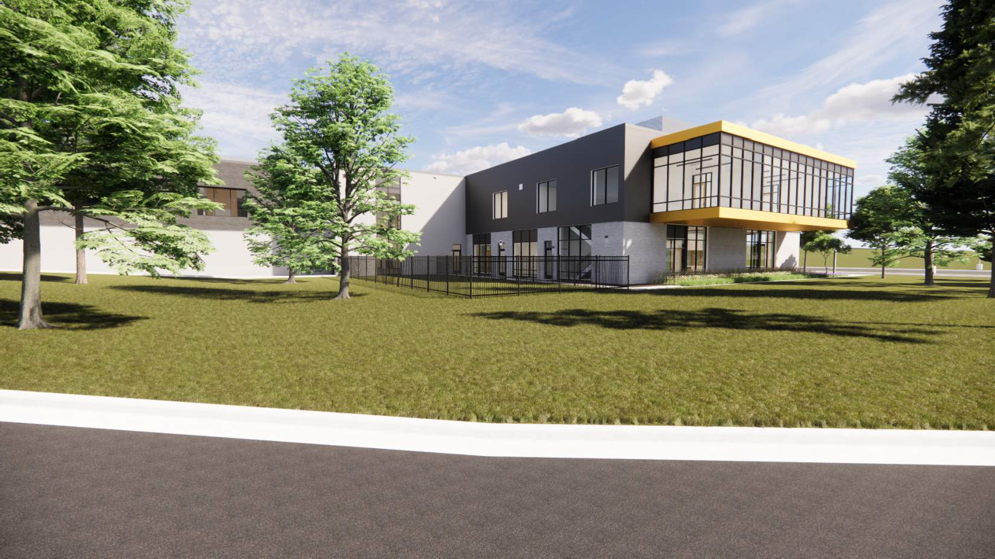

Slide 13
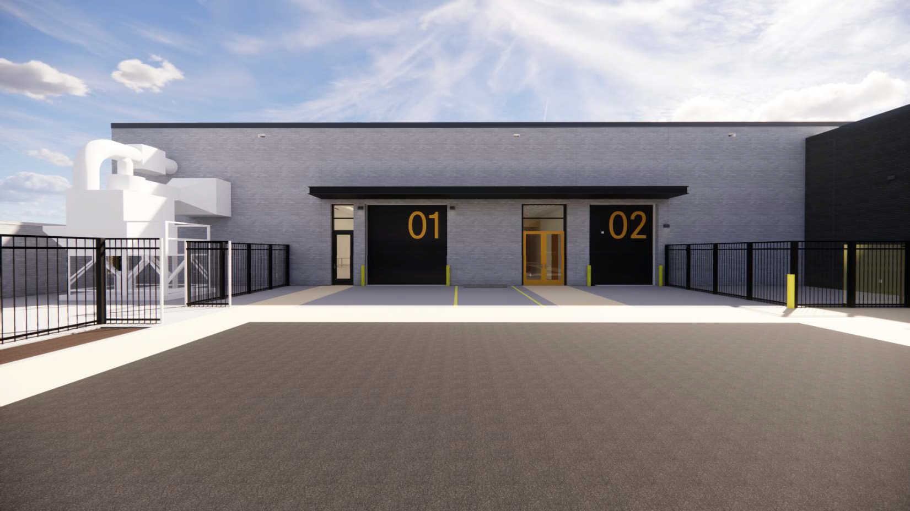

Slide 14
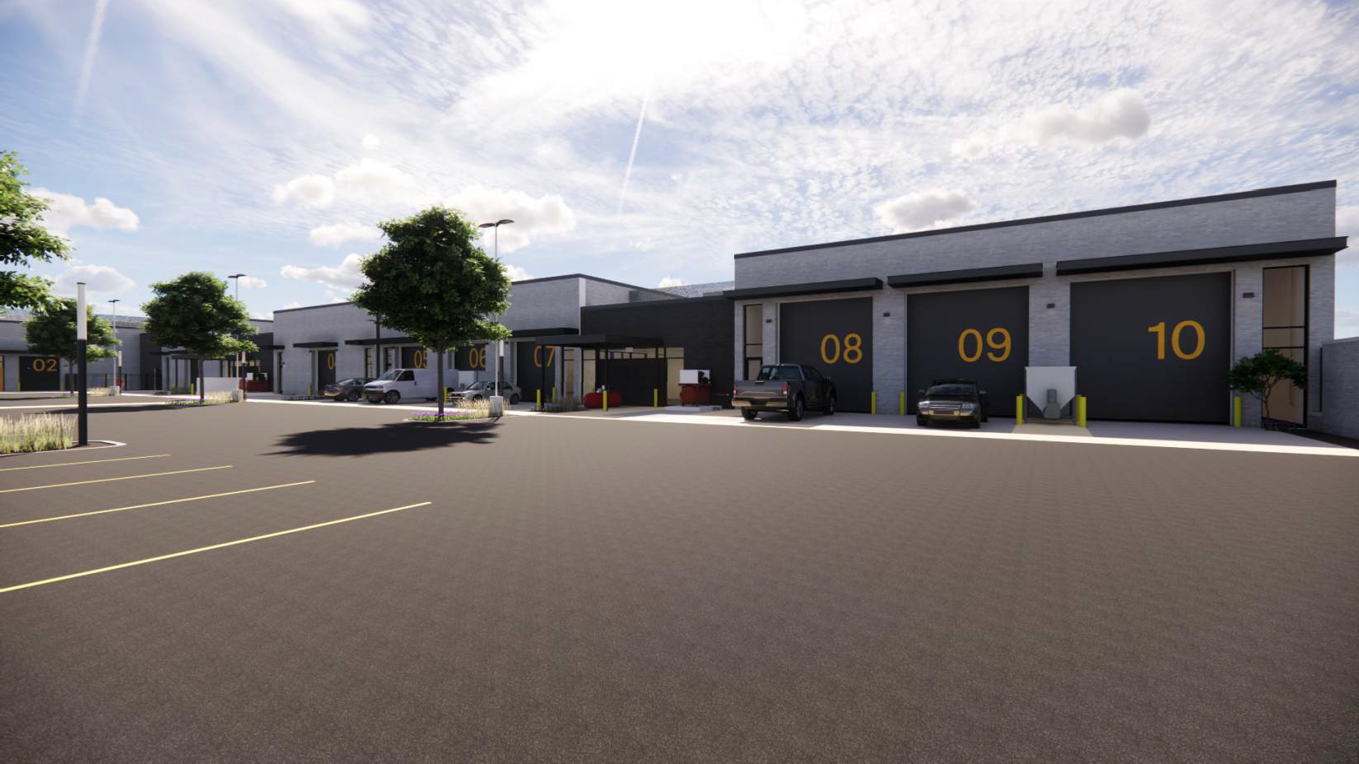

Slide 16
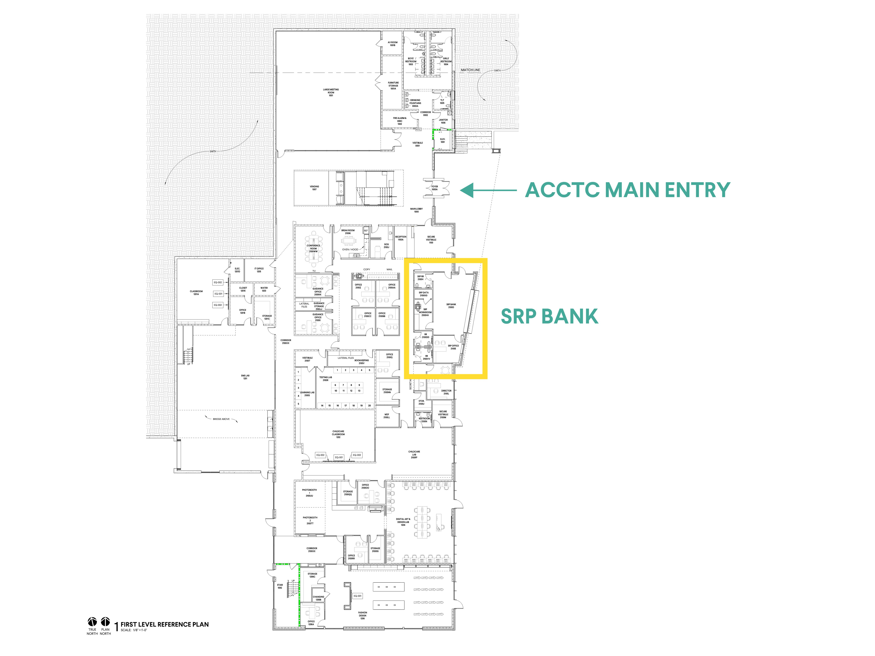

Slide 17
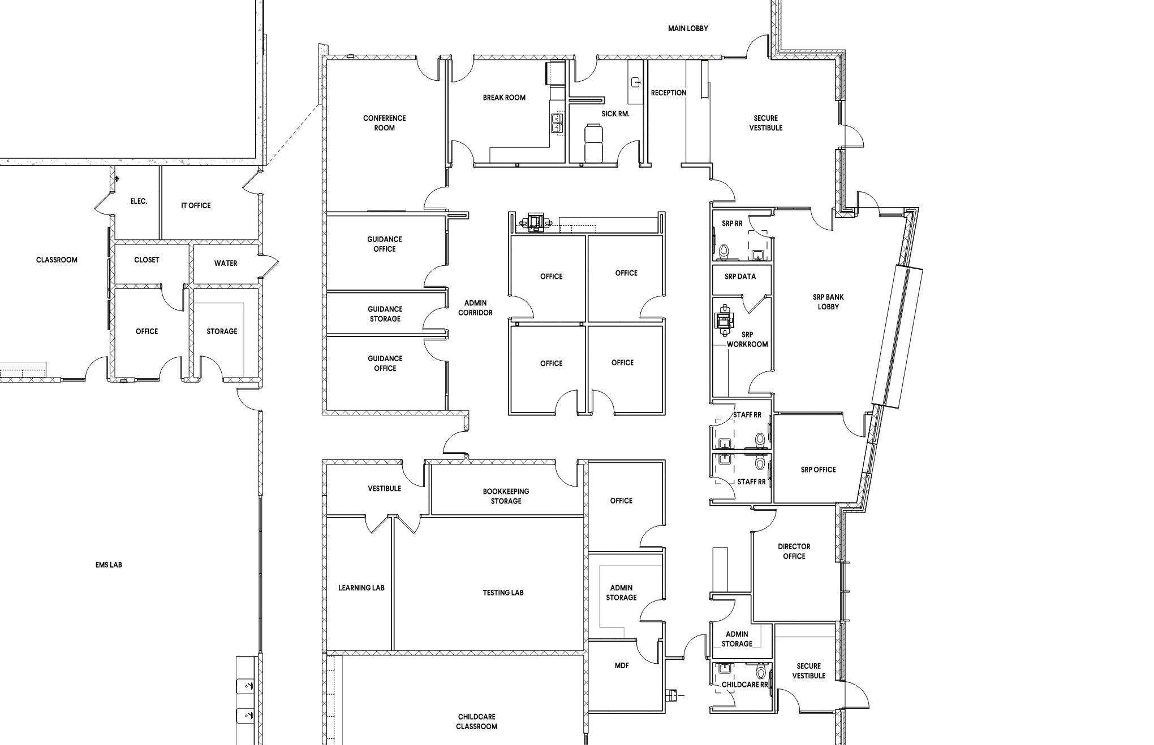

Slide 18
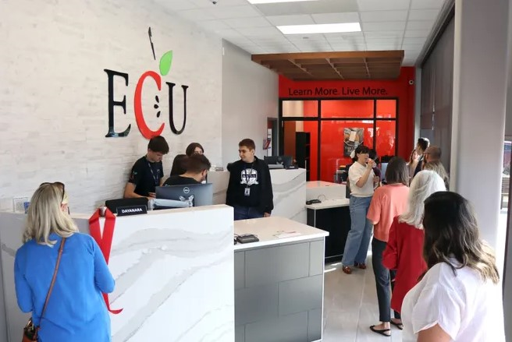

Slide 19
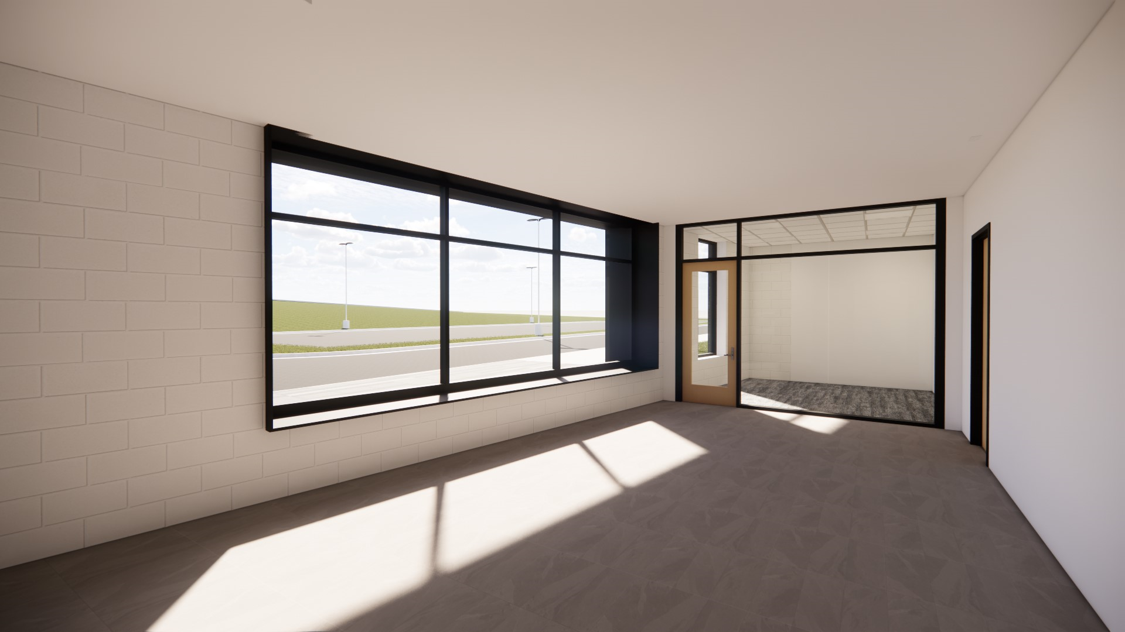

Slide 20
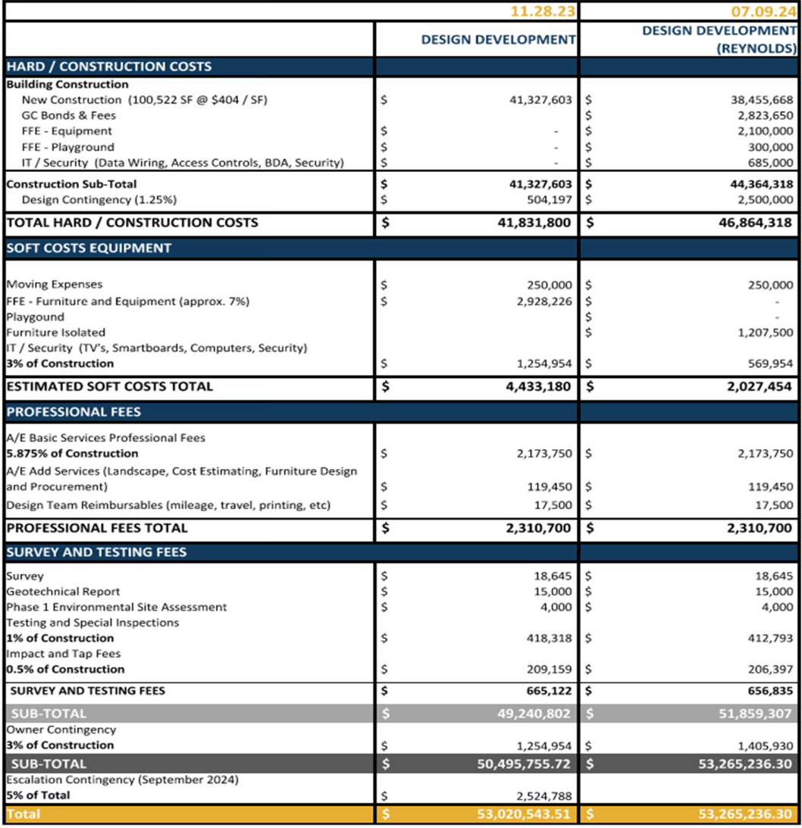
T O TA L
P R O J E C T B U D G E T

Slide 21
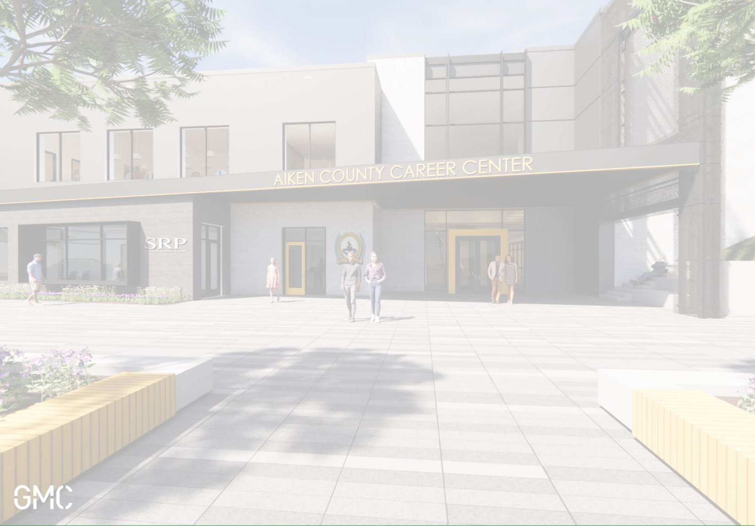
QUESTIONS & COMMENTS

