Slide 2
AIKEN COUNTY CAREER AND TECHNOLOGY CENTER
CONSTRUCTION DOCUMENT & GMP SUMMARY
AIKEN COUNTY PUBLIC SCHOOL DISTRICT December 10, 2024
Notes:
**It’s not really this complicated, just erase all but one letter and enter your own info (then erase that first letter). But if you’re curious and want to play around with the presentation, the below is the guide:
TITLE:
font: Calibri Light Headings (all caps); Bold
font size: lg. depending on length 50/60 pt.
color: Black & Gray (Black, Text 1 Lighter 35%)
Subheading:
Part 1 (ACPSD): Font: Calibri Light (Headings) All Caps, Light Green, 24 pt.
Part 2 (DATE): Font: Calibri Light (Headings) Small Caps, Gray (Black, Text 1 Lighter 35%)

Slide 3
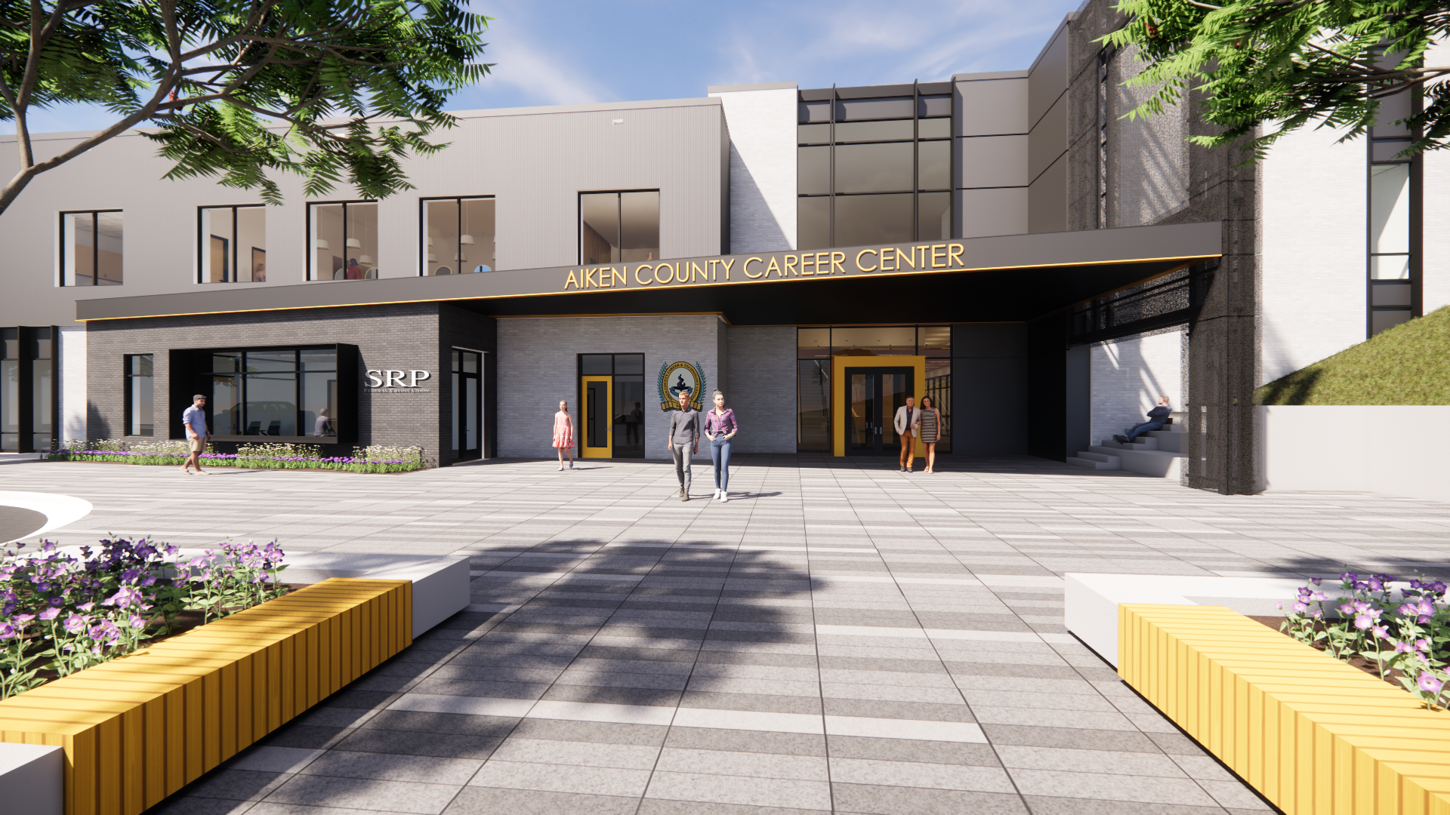
AIKEN COUNTY PUBLIC SCHOOL DISTRICT ACCTC | December 10, 2024

Slide 4
PROJECT REVIEW
Since the previous Design Development Submission:
Minor changes to the building design have been incorporated into the documents. GMC has submitted the documents to OSF and Aiken County for the necessary construction permits.
H. G. Reynolds has completed the pricing of the Construction Document Package and developed a comprehensive GMP to construct the new Career and Technology Center.
The overall project budget including the cost of construction and associated equipment and fees has been reviewed by ACPS facilities, GMC and H.G. Reynolds.
AIKEN COUNTY PUBLIC SCHOOL DISTRICT ACCTC | December 10, 2024
Notes:
Title:
Font: Calibri Light (Headings)
Size: about 54+ pt., depending on length
I use “AV” to increase the space between letters to as loose as possible.
Section Content:
Font: Californian 20+ size, black
Color: Light green/black/gray bullets (your preference)
Info Bar at Bottom:
Enter the title of your presentation (Font: Calibri; Size: 18 pt, all lower case; Color: white) and Date (Font: Calibri; Size: 18 pt., small caps; Color: gray)
Copy and paste on each slide, with the exception of slide 1.

Slide 5
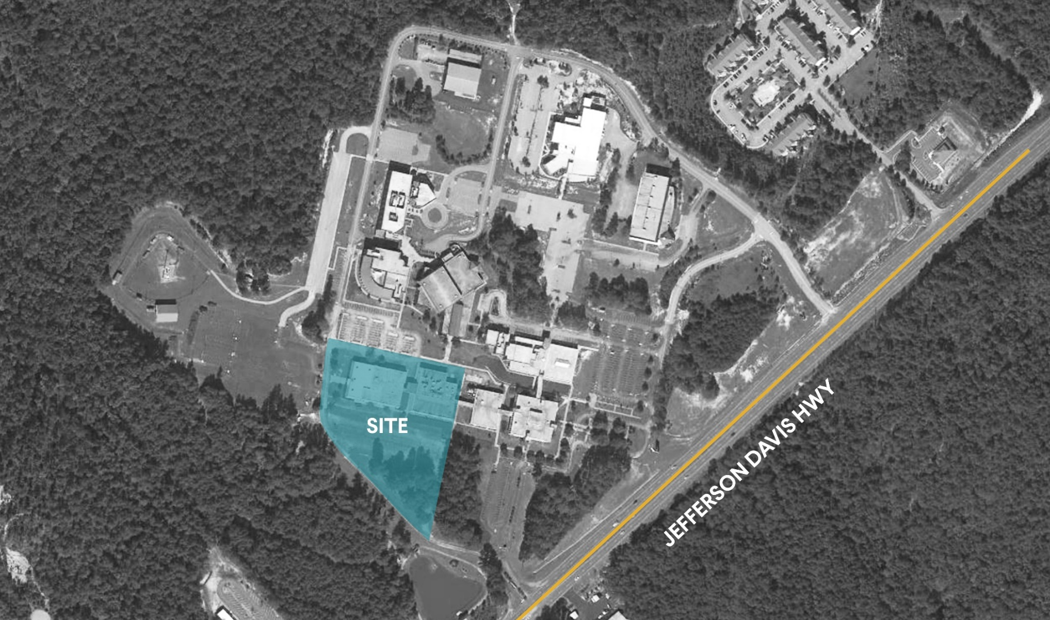
PROJECT SITE
AIKEN COUNTY PUBLIC SCHOOL DISTRICT ACCTC | December 10, 2024
Notes:
Title:
Font: Calibri Light (Headings)
Size: about 54+ pt., depending on length
I use “AV” to increase the space between letters to as loose as possible.
Section Content:
Font: Californian 20+ size, black
Color: Light green/black/gray bullets (your preference)
Info Bar at Bottom:
Enter the title of your presentation (Font: Calibri; Size: 18 pt, all lower case; Color: white) and Date (Font: Calibri; Size: 18 pt., small caps; Color: gray)
Copy and paste on each slide, with the exception of slide 1.

Slide 6
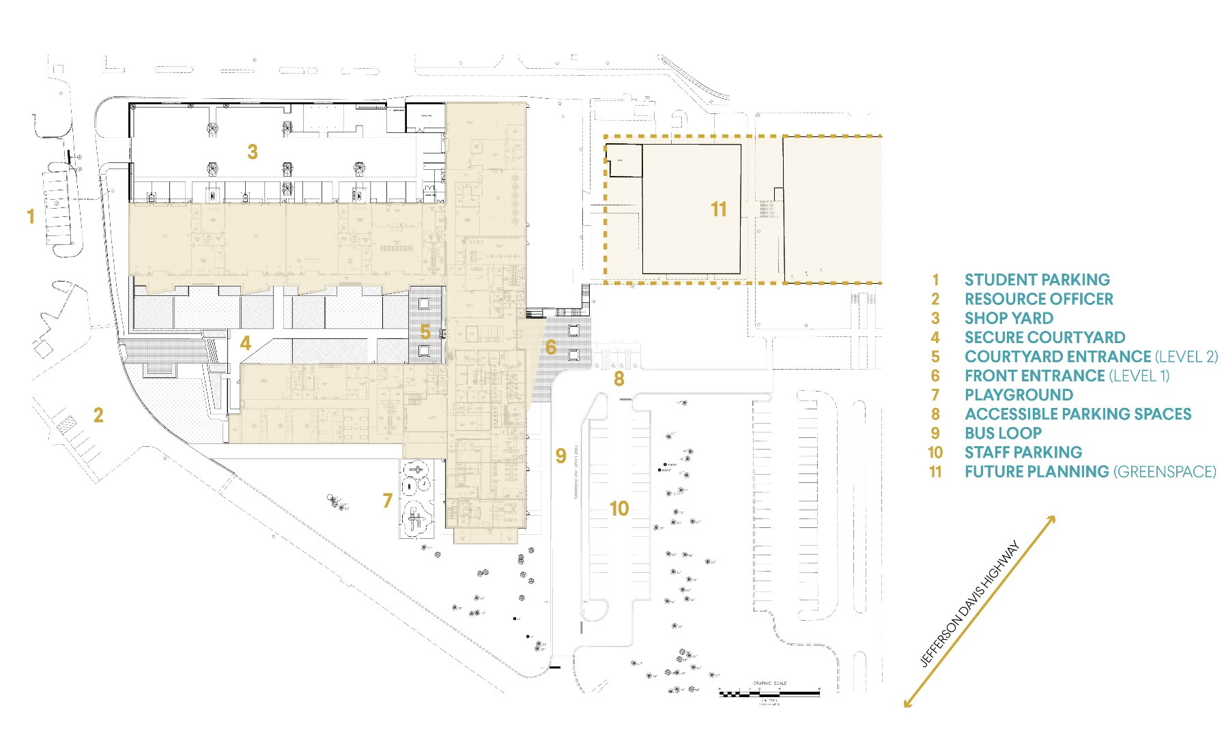
SITE PLAN
AIKEN COUNTY PUBLIC SCHOOL DISTRICT ACCTC | December 10, 2024
Notes:
Title:
Font: Calibri Light (Headings)
Size: about 54+ pt., depending on length
I use “AV” to increase the space between letters to as loose as possible.
Section Content:
Font: Californian 20+ size, black
Color: Light green/black/gray bullets (your preference)
Info Bar at Bottom:
Enter the title of your presentation (Font: Calibri; Size: 18 pt, all lower case; Color: white) and Date (Font: Calibri; Size: 18 pt., small caps; Color: gray)
Copy and paste on each slide, with the exception of slide 1.

Slide 7
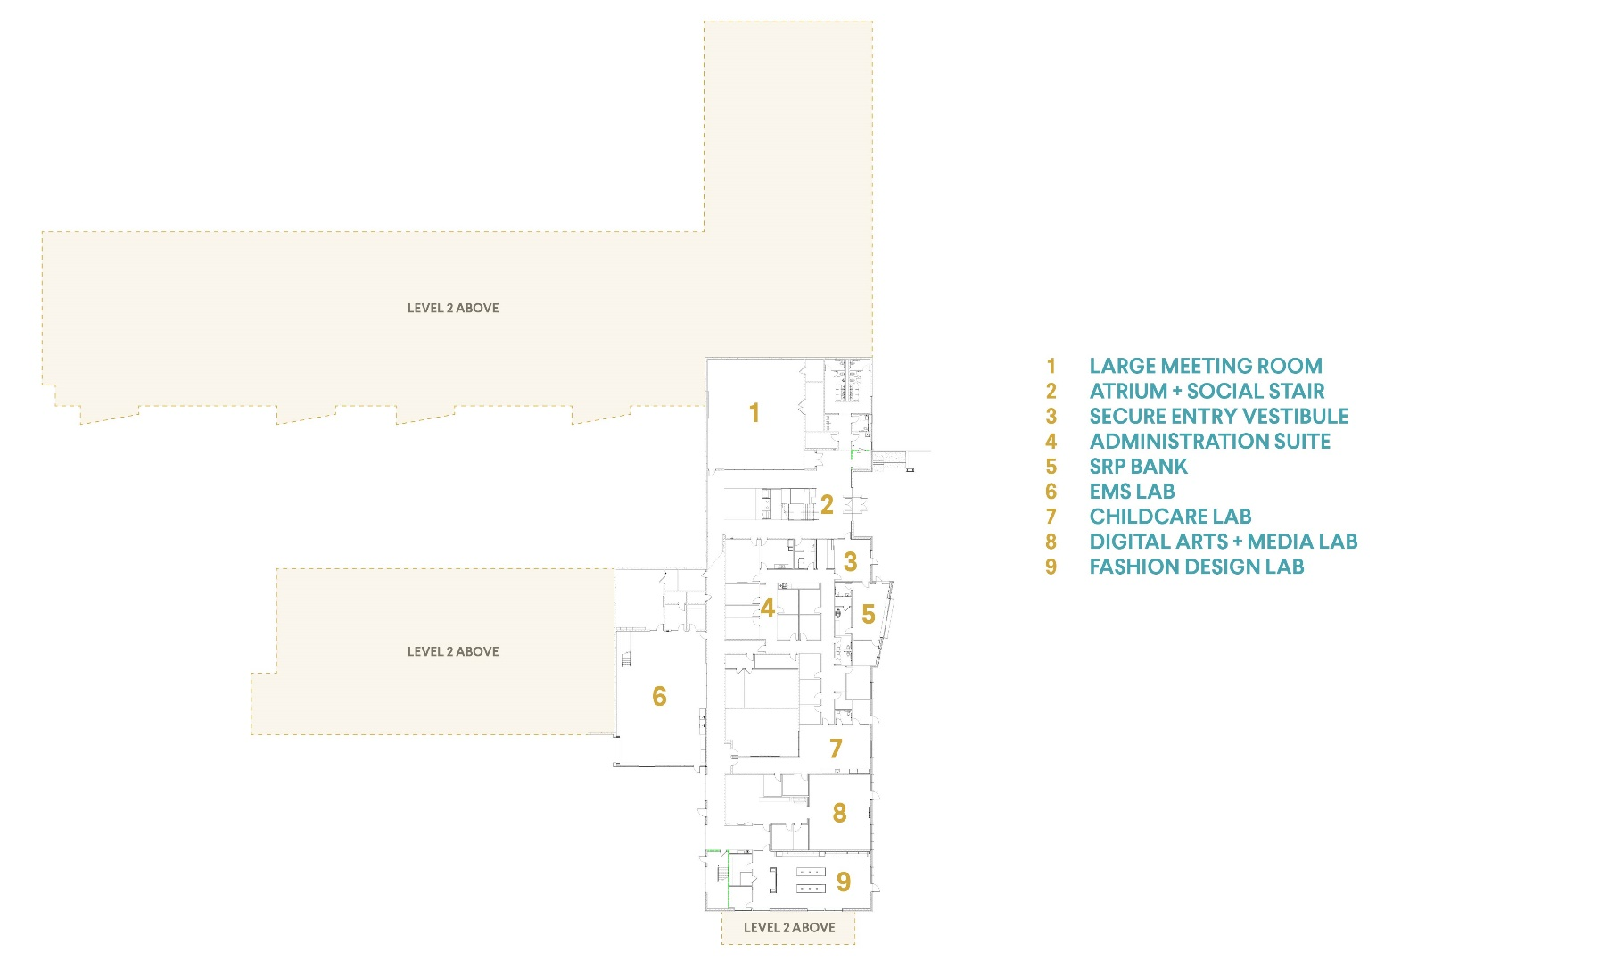
FIRST LEVEL PLAN
AIKEN COUNTY PUBLIC SCHOOL DISTRICT ACCTC | December 10, 2024
Notes:
Title:
Font: Calibri Light (Headings)
Size: about 54+ pt., depending on length
I use “AV” to increase the space between letters to as loose as possible.
Section Content:
Font: Californian 20+ size, black
Color: Light green/black/gray bullets (your preference)
Info Bar at Bottom:
Enter the title of your presentation (Font: Calibri; Size: 18 pt, all lower case; Color: white) and Date (Font: Calibri; Size: 18 pt., small caps; Color: gray)
Copy and paste on each slide, with the exception of slide 1.

Slide 8
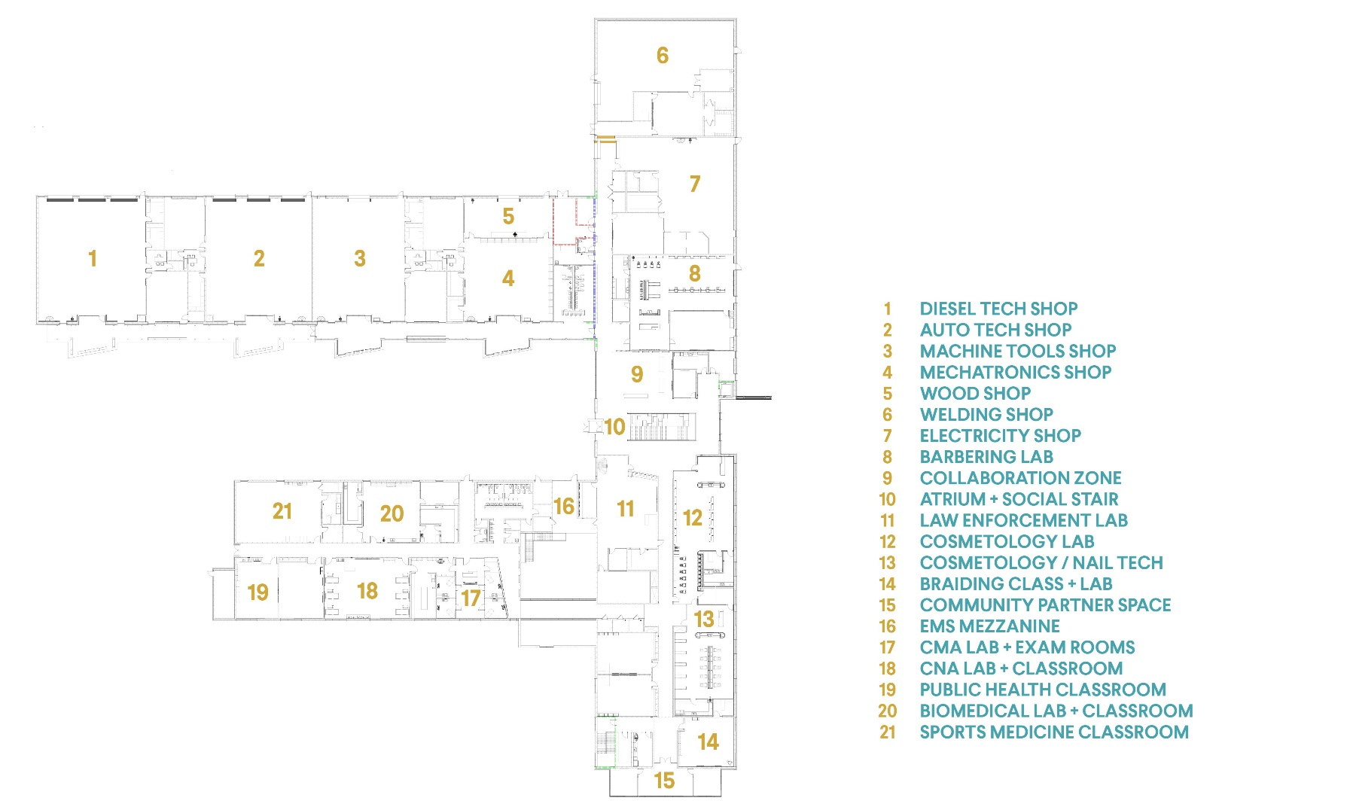
SECOND LEVEL PLAN
AIKEN COUNTY PUBLIC SCHOOL DISTRICT ACCTC | August 13, 2024
Notes:
Title:
Font: Calibri Light (Headings)
Size: about 54+ pt., depending on length
I use “AV” to increase the space between letters to as loose as possible.
Section Content:
Font: Californian 20+ size, black
Color: Light green/black/gray bullets (your preference)
Info Bar at Bottom:
Enter the title of your presentation (Font: Calibri; Size: 18 pt, all lower case; Color: white) and Date (Font: Calibri; Size: 18 pt., small caps; Color: gray)
Copy and paste on each slide, with the exception of slide 1.

Slide 9
AIKEN COUNTY PUBLIC SCHOOL DISTRICT ACCTC | December 10, 2024

Slide 10
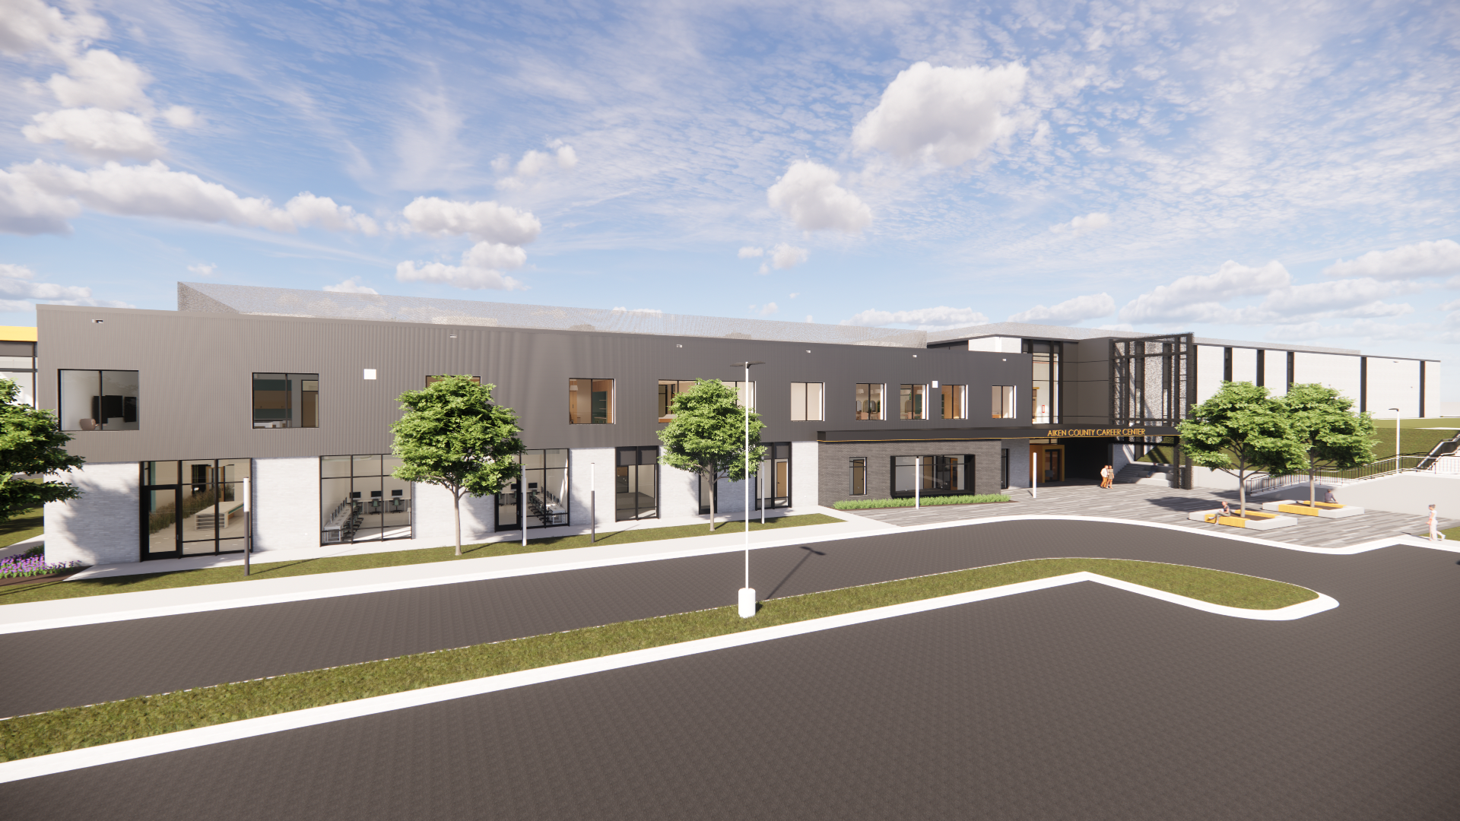
AIKEN COUNTY PUBLIC SCHOOL DISTRICT ACCTC | December 10, 2024

Slide 11
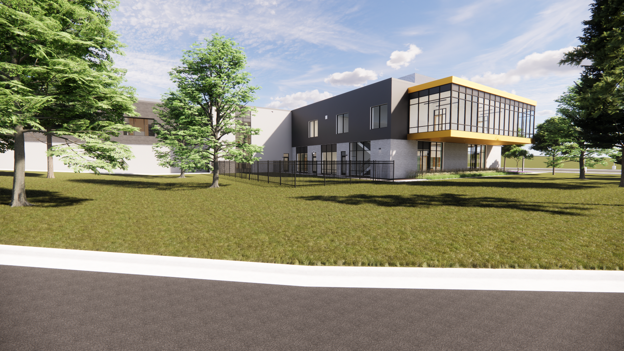
AIKEN COUNTY PUBLIC SCHOOL DISTRICT ACCTC | December 10, 2024

Slide 12
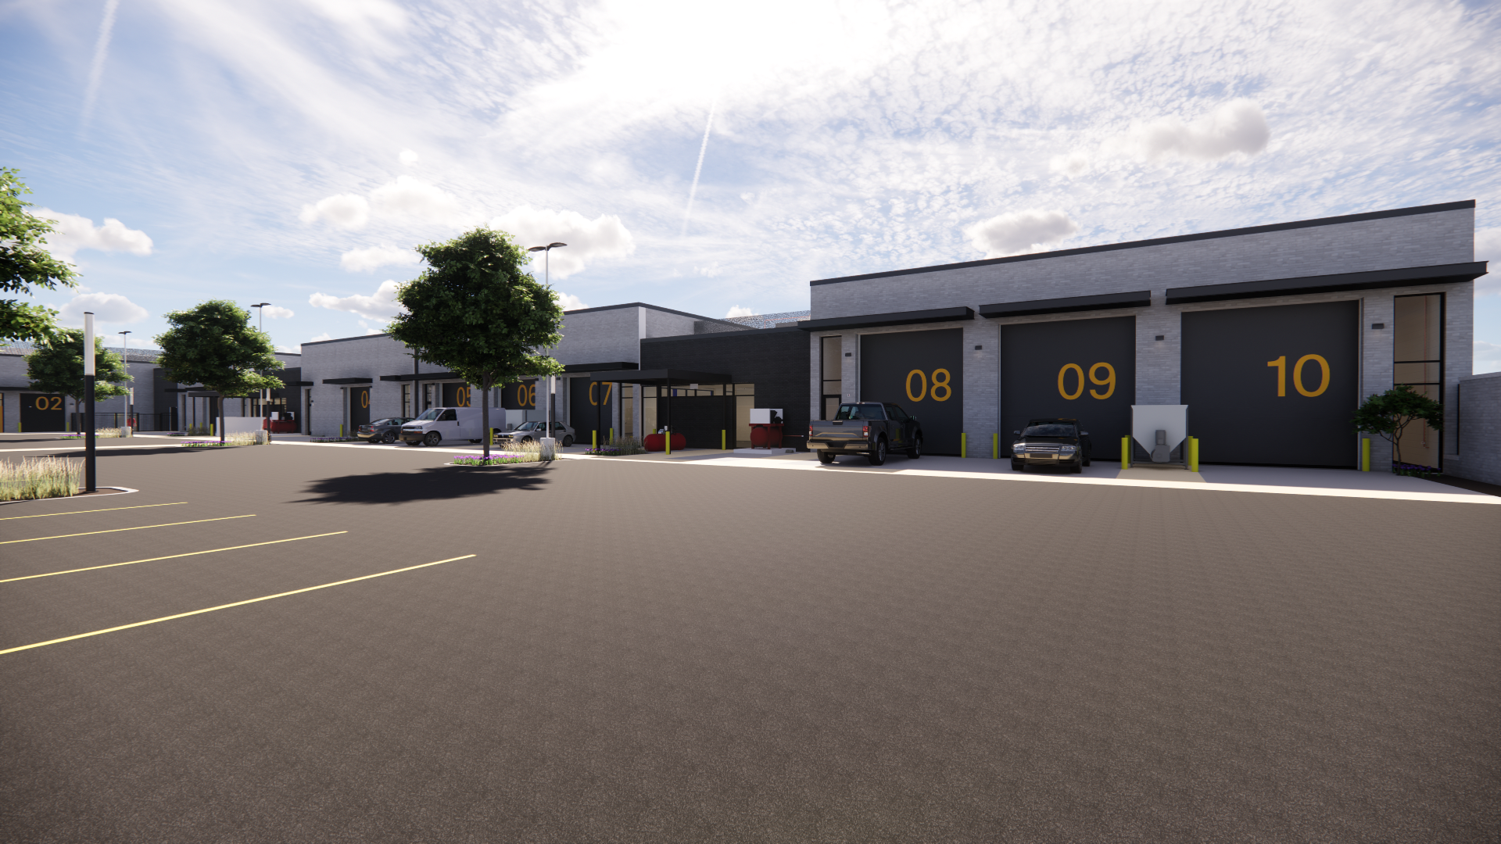
AIKEN COUNTY PUBLIC SCHOOL DISTRICT ACCTC | December 10, 2024

Slide 13
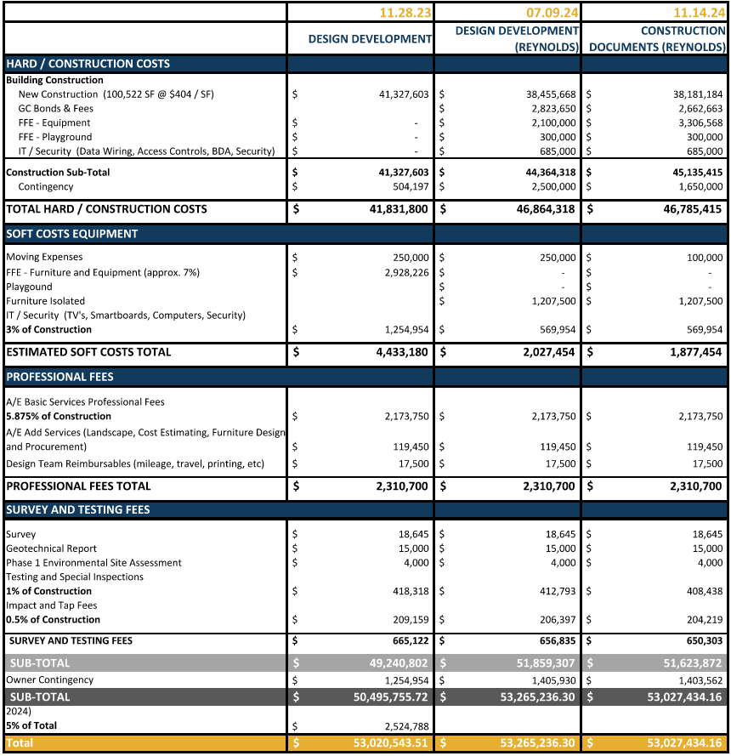
TOTAL PROJECT BUDGET
AIKEN COUNTY PUBLIC SCHOOL DISTRICT ACCTC | December 10, 2024

Slide 14
QUESTIONS & COMMENTS
AIKEN COUNTY PUBLIC SCHOOL DISTRICT ACCTC | December 10, 2024
Notes:
Font: Californian FB
Size: 72
Color: gray and black

