Slide 1

Notes:
Please begin presentations with the new logo

Slide 2

Notes:
Provide index card to record answers
Provide instructions – record answer after each question; neighbor will check after each response
Person with highest points?

Slide 3
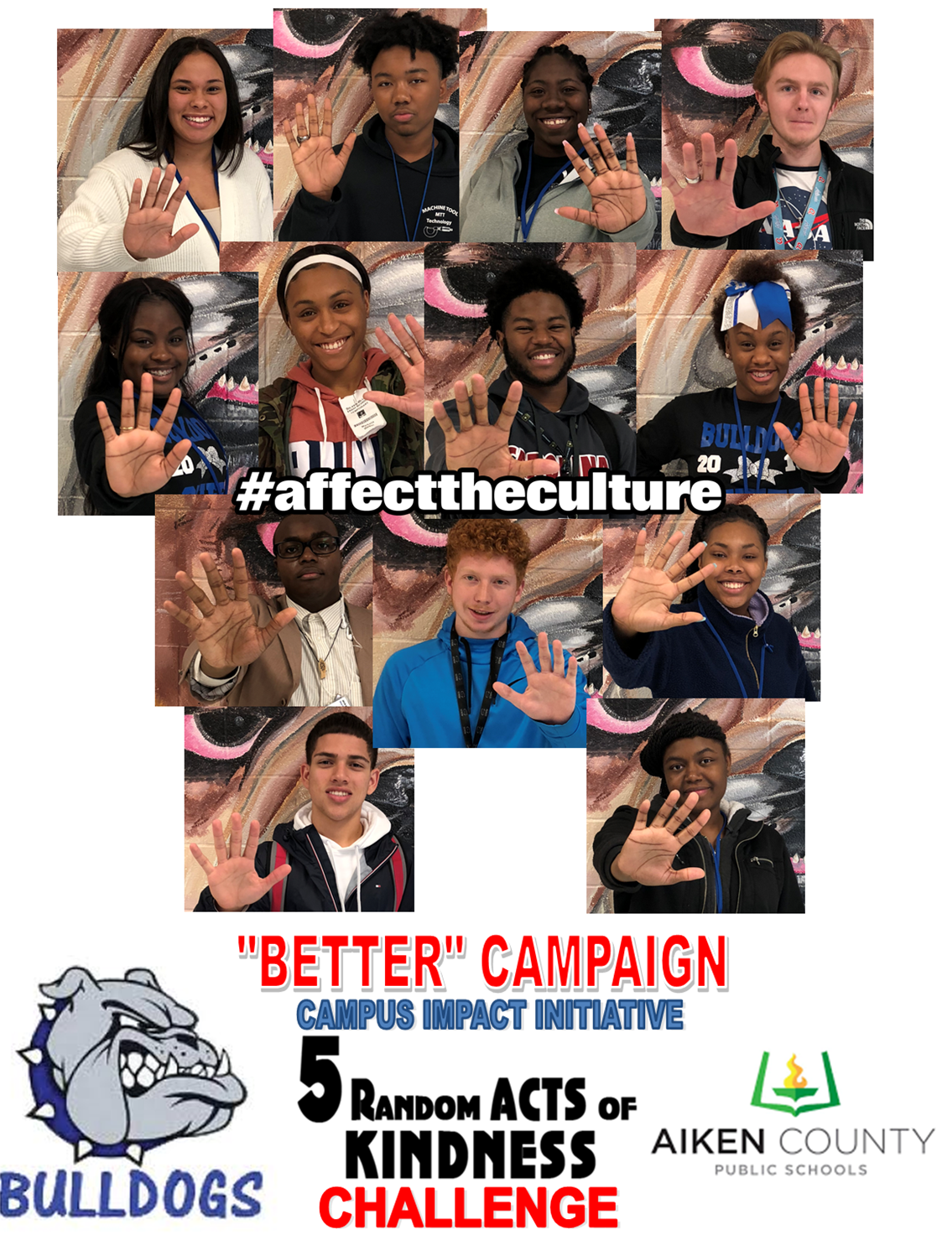
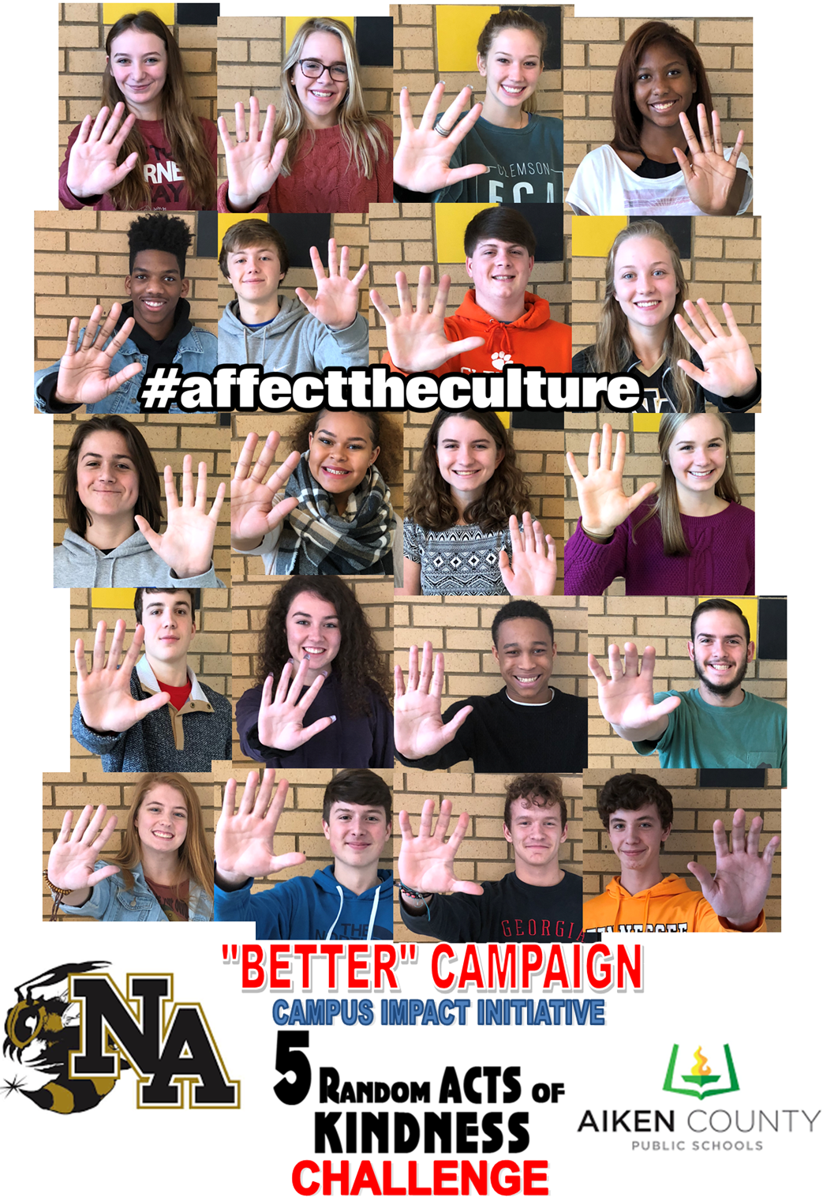

How are ACPSD
High Schools Affecting Culture?
Lead Teacher(s) at each high school
Student Organizations
  Rotary Interact Club
  Student Government
  Key Club
  HOSA
  Band
  Beta Club
  SIA (Students in Action)

Slide 4
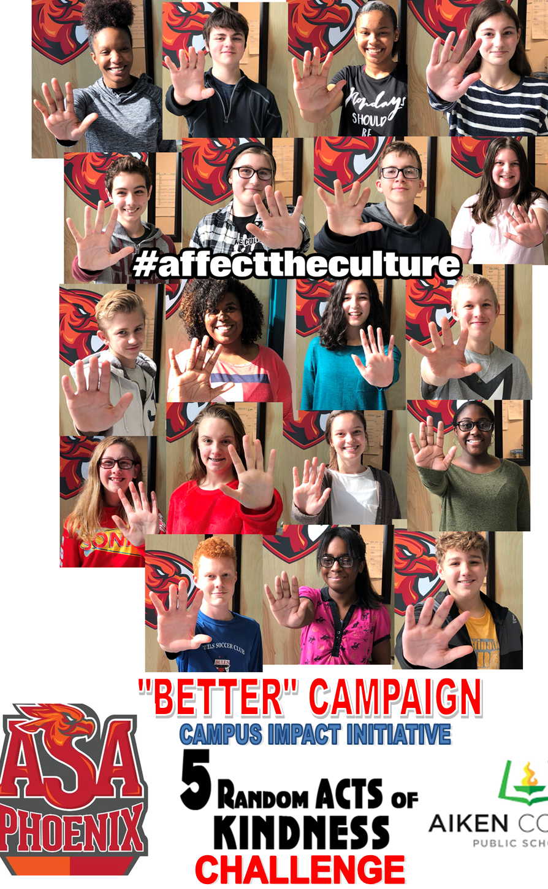
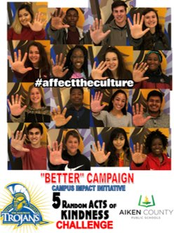
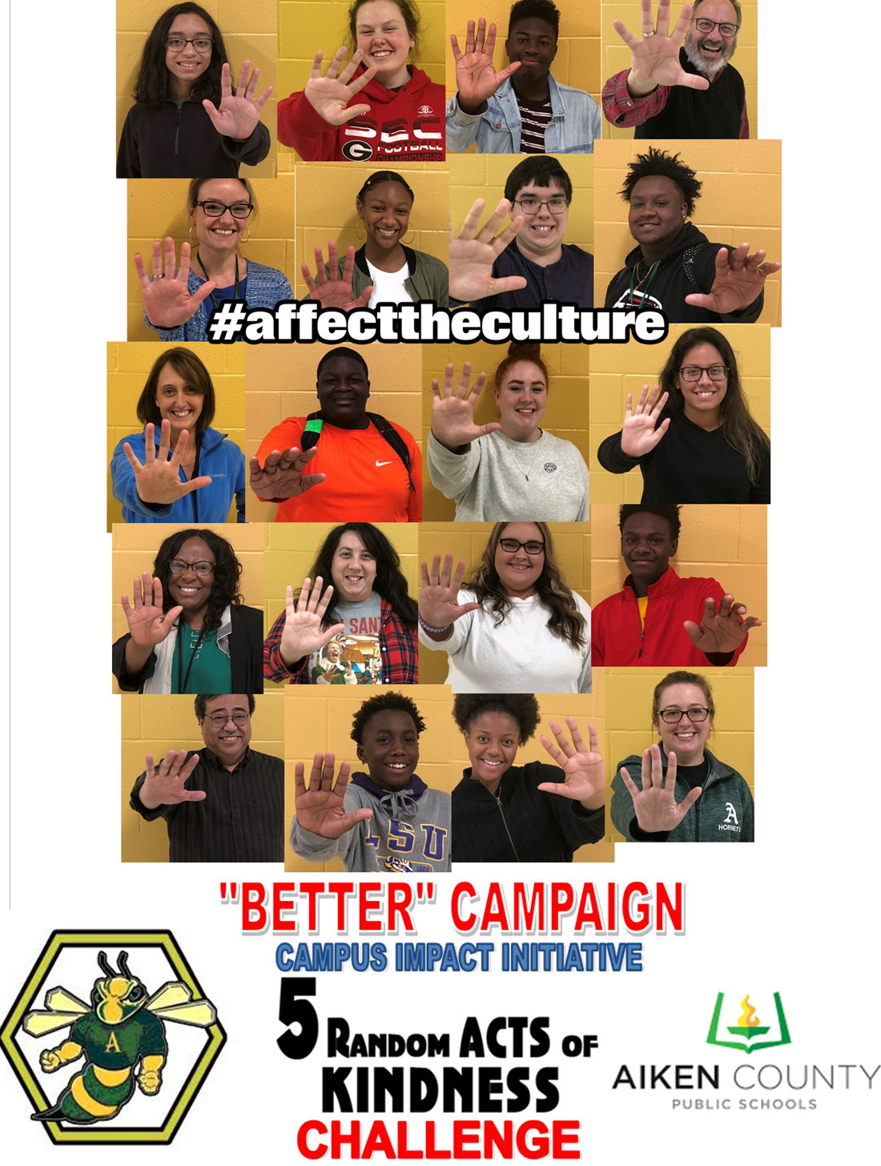
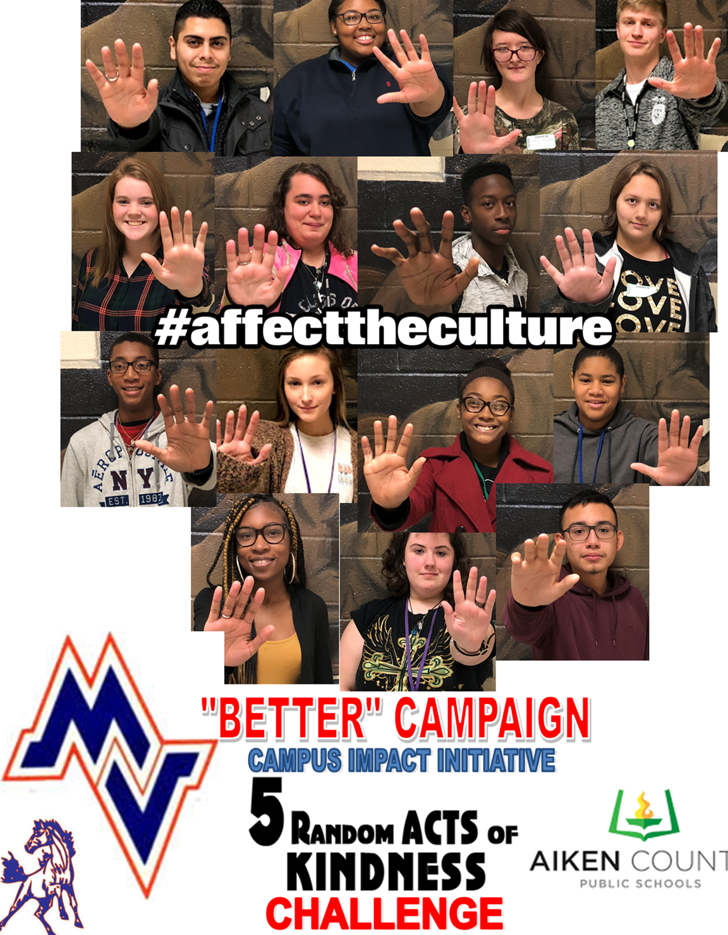
School-wide kickoff Nov./Dec. 2018
Student lead positive impact on school culture and climate
Measure impact through social media
Challenge among all high schools – Which will "Be Better!"
ACPSD "Be Better Challenge" ends Feb. 1, 2019

Slide 5
ACPSD High Schools
Better Campaign
Midland Valley - #stangsforachange https://www.youtube.com/watch?v=QolstG7QJy4
Ridge Spring-Monetta High - #trojanculture https://www.youtube.com/watch?v=r2u8mQtEX4E
Aiken High - #aikenrandomacts https://www.youtube.com/watch?v=LKxofwl-TQc
South Aiken High - #saaffectstheculture https://www.youtube.com/watch?v=-zzJ9fqlKO0
Aiken Scholars Academy - #phoenixculture https://www.youtube.com/watch?v=oAlwq0JJOp0
Wagener- Salley High - #wshs_sia https://www.youtube.com/watch?v=IKAv41l6gAE
North Augusta High - #NAHSbebetter https://www.youtube.com/watch?v=5_c9QsUCs-4
Silver Bluff - #bulldog5 https://www.youtube.com/watch?v=QWcSoqX_jc0

Slide 6
Notes:
Please end presentations with the new logo

