Slide 2
Recruitment & Retention Committee
AIKEN COUNTY PUBLIC SCHOOL DISTRICT July 16, 2019

Slide 3
Agenda
History
Retention Sub-Committee Update
Recruitment Sub-Committee Update
Additional Outcomes
Next Steps
AIKEN COUNTY PUBLIC SCHOOL DISTRICT

Slide 4
History
The Recruitment and Retention Sub-Committees prepared implementation plans for specific action items.
Retention:
Orientation
School Based Retention Teams – Buddy Program
Social Emotional Learning
Employee Recognition Program
Recruitment:
Lunch & Learn Program
Cross Functional Recruitment Teams
School Based Interview Teams
Referral Reward Program
AIKEN COUNTY PUBLIC SCHOOL DISTRICT

Slide 5
Retention: Orientation
Retention efforts start before the first day of employment.
Electronic new hire documents
New Hire News
Summer benefits information meetings
Comprehensive district orientation
AIKEN COUNTY PUBLIC SCHOOL DISTRICT

Slide 6
Retention: Orientation
Orientation Topics
Welcome from the Superintendent
Mission, Vision, Values & Strategic Plan
Every Role Makes an Impact
Virtual Tour
Organizational Charts
Board Policies & Employee Handbook
Evaluation Systems – Certified & Classified
Email, Employee Self-Service, Absence Management, Safe Schools, MyPEBA
Retirement Options
Benefits
AIKEN COUNTY PUBLIC SCHOOL DISTRICT

Slide 7
Retention: Buddy Program
Principals and Department Heads have been provided an overview of the program and a list of incoming new employees. School and department level implementation supported by the Employee Relations Coordinator.
Year One
Assign a department/grade level buddy who would contact the new hire before their first day of employment
Personal tour of the school/facility
Welcome basket to include a welcome letter, hard copy of faculty handbook with contact list and calendar of yearly events, school spirit items (t-shirt, lanyard, cup), name tag or badge, and basic office supplies
Weekly pulse checks, monthly notes of encouragement, quarterly outings
AIKEN COUNTY PUBLIC SCHOOL DISTRICT

Slide 8
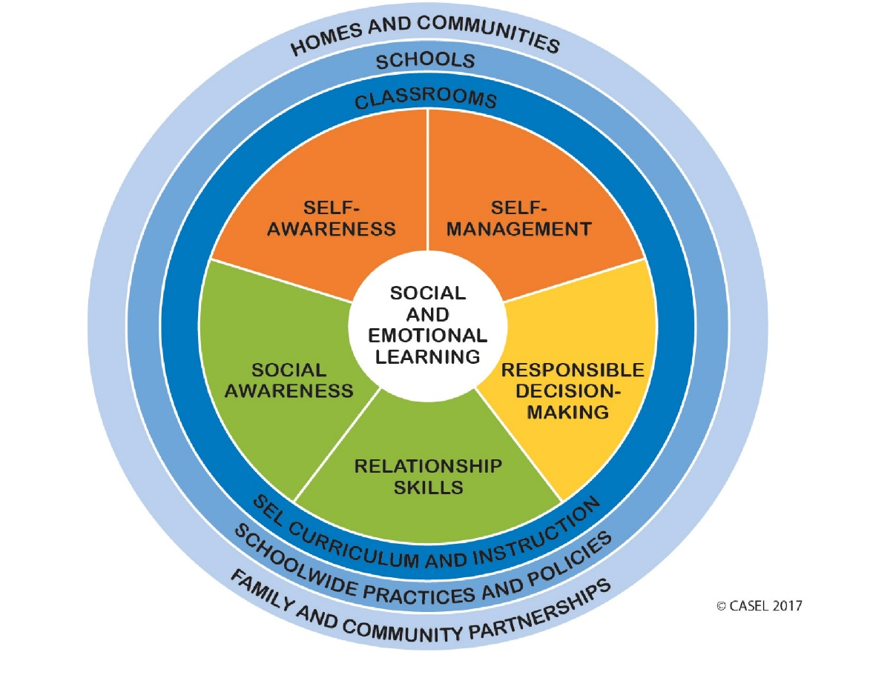
Retention: Social Emotional Learning
Social Emotional Learning is actively being integrated into all Professional Development events.
Leadership Summit
New 2 District
E2
Youth Development Teams are
being established. They will
provide direct support in:
Social Emotional Learning
Behavioral expectations
Classroom Management
Counseling and mental health support
AIKEN COUNTY PUBLIC SCHOOL DISTRICT

Slide 9
Retention: Employee Recognition
USCA Intern will work with Employee Relations Coordinator to implement this program during the Fall 2019 semester.
Work with HR and Communications Department to develop a program name.
Work with HR and Communications Department to design a standard recognition note pad with graphic/logo for the program to incorporate district branding.
Develop district wide directions for distribution and how to use ( anyone in district can write one to any employee within district).
Finalize menu of rewards to spotlight employees demonstrating positive performance.
Create professional development for both employees and administration in the how and why of the program.
Distribute program concept, instruction, and related materials to all departments and schools.
Monitor and encourage use of program across the district. Respond to questions and provide support as needed.
AIKEN COUNTY PUBLIC SCHOOL DISTRICT

Slide 10
Recruitment: Lunch & Learn
Target Universities have been confirmed
Contacts have been identified building on relationships established at Spring recruitment events
Presentation and collateral material are being developed
Schedule and teams directly tied to Cross Functional Recruitment Teams
AIKEN COUNTY PUBLIC SCHOOL DISTRICT

Slide 11
Recruitment: Cross Functional Recruitment Teams
Results from 18-19 recruitment events has been analyzed
Over 200 resumes collected
80 TBDs offered
60 TBDs hired
USCA, Clemson, & Ohio most successful
Draft interest survey created, final will be sent out the last week of July
Committee will review recruitment training at August meeting
Teams will be assigned based on interest survey for Fall Lunch & Learns and Spring Recruitment Events
AIKEN COUNTY PUBLIC SCHOOL DISTRICT

Slide 12
Recruitment: School Based Interview Teams
Program information and Welcome Protocol Menu will be shared at Leadership Summit
School and department level development on track for September – December implementation
Principal and department heads will be supported by Recruitment and Staffing Coordinator
Kick off anticipated in January 2020
AIKEN COUNTY PUBLIC SCHOOL DISTRICT

Slide 13
Recruitment: Teacher Referral Program
Program information and Referral Reward options will be shared at Leadership Summit
Program announcement planned in conjunction with E2/One Team events
Pursuing community support for incentives in partnership with PEP
AIKEN COUNTY PUBLIC SCHOOL DISTRICT

Slide 14
Additional Outcomes
Aspiring Principal Preparation Program
Employee Handbook
Attendance Reward
AIKEN COUNTY PUBLIC SCHOOL DISTRICT

Slide 15
Next Steps
District Orientation to Location Specific Onboarding
Buddy Program Volunteers and Year 2 Planning
PD Development on the 5 Tenants of SEL
Implementation of Employee Recognition Program
Schedule Lunch & Learn Events September-November 2019
CFRT Interest Survey and Team Selection
Interview Welcome Team School/Department Level Development
Communicate Teacher Referral Program
AIKEN COUNTY PUBLIC SCHOOL DISTRICT

Slide 16
QUESTIONS & COMMENTS
AIKEN COUNTY PUBLIC SCHOOL DISTRICT

