Slide 2
Recruitment & Retention Committee Update Job & Task Analysis Data Review
AIKEN COUNTY PUBLIC SCHOOL DISTRICT MAY 14, 2019

Slide 3
Agenda
Background
Teacher Participation
Data Review
Next Steps
Questions
AIKEN COUNTY PUBLIC SCHOOL DISTRICT

Slide 4
Background
The Recruitment and Retention Sub-Committee focused on workload and task analysis finalized a task analysis tool and prepared an implementation plan to conduct a job and task analysis focused on teachers.
A diary method with a pre-defined list of work activity categories was used to gather consistent and meaningful data. The work categories grouped like activities applicable across all grade levels and content areas while providing insight into the varied tasks teachers engage in on a daily, weekly, monthly, quarterly, and annual basis.
Randomly selected teachers completed the diary process beginning March 4 and concluding on March 29. Data entry was randomly audited by PEP Board members to validate accuracy.
AIKEN COUNTY PUBLIC SCHOOL DISTRICT

Slide 5
Teacher Participation
 | Total | % Total | 4K-2nd | 3rd-5th | 6th-8th | 9th-12th
Total Teachers | 240 |  | 60 | 60 | 60 | 60
Initial Drop | 10 | 4% | 3 | 6 | 0 | 1
Non Participation | 23 | 10% | 2 | 4 | 7 | 10
Incomplete Participation | 10 | 4% | 2 | 2 | 4 | 2
Total Participating | 197 | 82% | 53 | 48 | 49 | 47
AIKEN COUNTY PUBLIC SCHOOL DISTRICT

Slide 6
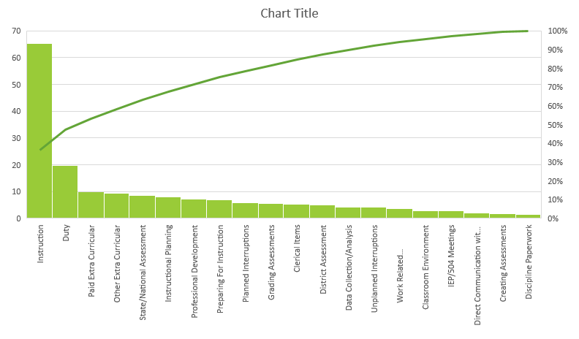
Hours Spent per Activity per Month
AIKEN COUNTY PUBLIC SCHOOL DISTRICT

Slide 7
Professional Development: Observing, PLCs, Safe School, PD
AIKEN COUNTY PUBLIC SCHOOL DISTRICT

Slide 8
Duty: Morning, Lunch, Hall, Afternoon
AIKEN COUNTY PUBLIC SCHOOL DISTRICT

Slide 9
Duty
AIKEN COUNTY PUBLIC SCHOOL DISTRICT

Slide 10
Data Collection: Data Analysis, Progress Monitoring
AIKEN COUNTY PUBLIC SCHOOL DISTRICT

Slide 11
IEP/504 Meetings: Meetings Only, Not Paperwork
AIKEN COUNTY PUBLIC SCHOOL DISTRICT

Slide 12
Grading Assessments: Quizzes, Tests, Projects
AIKEN COUNTY PUBLIC SCHOOL DISTRICT

Slide 13
Discipline Paperwork: ABE, ISS Work, OSS Makeup Work
AIKEN COUNTY PUBLIC SCHOOL DISTRICT

Slide 14
Work Related Communication: Emails, Classroom Newsletter, Webpage
AIKEN COUNTY PUBLIC SCHOOL DISTRICT

Slide 15
Direct Communication with Parents: Conferences, Email, Phone, Dojo, Remind
AIKEN COUNTY PUBLIC SCHOOL DISTRICT

Slide 16
Instructional Planning: Planning Meetings, Uploading Lesson Plans, Accommodations
AIKEN COUNTY PUBLIC SCHOOL DISTRICT

Slide 17
Preparing for Instruction: Making Copies, Gathering Material
AIKEN COUNTY PUBLIC SCHOOL DISTRICT

Slide 18
Creating Assessments
AIKEN COUNTY PUBLIC SCHOOL DISTRICT

Slide 19
Instruction: Whole, small, and intervention groups, classroom assessments
AIKEN COUNTY PUBLIC SCHOOL DISTRICT

Slide 20
Instruction
AIKEN COUNTY PUBLIC SCHOOL DISTRICT

Slide 21
Planned Interruptions: Announcements, Programs
AIKEN COUNTY PUBLIC SCHOOL DISTRICT

Slide 22
Unplanned Interruptions: Technology Issues, Tardies, Discipline Problems
AIKEN COUNTY PUBLIC SCHOOL DISTRICT

Slide 23
Total Interruptions
AIKEN COUNTY PUBLIC SCHOOL DISTRICT

Slide 24
Clerical Items: Forms, Receipts, Attendance
AIKEN COUNTY PUBLIC SCHOOL DISTRICT

Slide 25
Classroom Environment: Cleaning, Decorating, Organizing, Hanging Student Work
AIKEN COUNTY PUBLIC SCHOOL DISTRICT

Slide 26
Paid Extra Curricular Activities: Coaching, Tutoring
AIKEN COUNTY PUBLIC SCHOOL DISTRICT

Slide 27
Other Extra Curricular: Sporting Events, PTO Events, Committees, Clubs
AIKEN COUNTY PUBLIC SCHOOL DISTRICT

Slide 28
District Assessments: Administering or Grading a District Assessment – Benchmark, F&P, MI, RI, Diagnostics, Screeners
AIKEN COUNTY PUBLIC SCHOOL DISTRICT

Slide 29
State/National Assessments: Administering a State or National Assessment – AP Exam, CogAt/ITBS, SC Ready
AIKEN COUNTY PUBLIC SCHOOL DISTRICT

Slide 30
After Hours: Nights & Weekends
AIKEN COUNTY PUBLIC SCHOOL DISTRICT

Slide 31
After Hours: Nights & Weekends
AIKEN COUNTY PUBLIC SCHOOL DISTRICT

Slide 32
Next Steps
Key stakeholder groups will meet to review the data and make specific recommendations.
These groups include:
Recruitment and Retention Committee
Workload Sub-Committee
Teacher Forum
PEP Board members
AIKEN COUNTY PUBLIC SCHOOL DISTRICT

Slide 33
QUESTIONS & COMMENTS
AIKEN COUNTY PUBLIC SCHOOL DISTRICT

