Slide 1
Notes:
Please begin presentations with the new logo

Slide 2
Proposed Modified Calendars 2025-2026 and 2026-2027
November 19, 2024
Prepared by
eric L. Jeffcoat
Assistant superintendent of elementary schools

Slide 3
History
Students
Due to the pandemic all SC schools closed in March 2020
Social and emotional needs of our students and staff became a major focus
Teachers
Challenges with recruiting
Challenges with retention
Principals
Challenges with retaining seasoned principals
Disproportionate number of seasoned principals compared to new principals
All Stakeholders
Rise in mental health issues
Burnout

Slide 4
What can be done to address this issue?
Curricula and programs that address the social and emotional needs of our students
Employee Assistance Programs
Bonuses
Modified Calendar (Year-Round Calendar)

Slide 5
Definition
Modified Calendar:
An approach to school calendars in which instructional days are spread over the course of the entire year, instead of broken up by a single long summer break

Slide 6
Benefits
Reduce burnout
Recruit and retain staff
Improve student and staff attendance
Reduce disciplinary incidents
Improve academic achievement
Provide intersession opportunities
Offer enrichment activities
Enhance social and emotional well-being of stakeholders

Slide 7
ACPSD Mission Statement
A modified calendar aligns with our mission.
The Mission of Aiken County Public Schools, the unifying agent of new horizons and extraordinary possibilities, is to ensure all students thrive as future-ready, globally mindful, and productive citizens through a responsive and inclusive school system distinguished by
High quality and student-centered learning experiences
Transformative, stakeholder partnerships
A culture of purpose, innovation, and excellence

Slide 8
Process
Research modified calendars used across the United States
Research modified calendars implemented in SC
Create drafts of potential modified calendars
Held town hall meetings across Aiken County to address questions
Distribute surveys to stakeholders for feedback

Slide 9
Interest in Modified Calendar by Stakeholder Group

Slide 10
Process
Research modified calendars used across the United States
Research modified calendars implemented in SC
Create drafts of potential modified calendars
Held town hall meetings across Aiken County to address questions
Distribute surveys to stakeholders for feedback
Calendar Action Team develops a modified calendar for ACPSD

Slide 11
Modified Calendar Action Team
Area 1
Quetta Hammonds, Elementary
Jason Holt, High
Area 2
Ashley Sutherland, Middle
Patricia Wilson, Elementary
Area 3
Sarah Bowers, Middle
Jessica Ouzts, High
Area 4
Jennifer Starnes, Elementary
Wanda Bush, High
Area 5
Joshua Stockton, High and Band
Shunte Dugar, Middle
Other
Michell Yeater, Athletics
LaToya Wiley, Special Education
Dr. Corey Murphy, Facilities
Eric Jeffcoat, Facilitator

Slide 12
Process
Research modified calendars used across the United States
Research modified calendars implemented in SC
Create drafts of potential modified calendars
Held town hall meetings across Aiken County to address questions
Distribute surveys to stakeholders for feedback
Calendar Action Team develops a modified calendar for ACPSD
School Board approves first modified calendar for the 2023-24 school year
Draft of the 2024-25 calendar created, modeled after the 2023-24 calendar
Present draft of the 2024-25 calendar to the Teacher Forum
Superintendent Advisory Groups (parents and students) provide feedback on the initial two-week fall break
Distribute survey to parents and staff to gather additional feedback on the calendar
School Board approves 2022-23 school year as a transition year

Slide 13
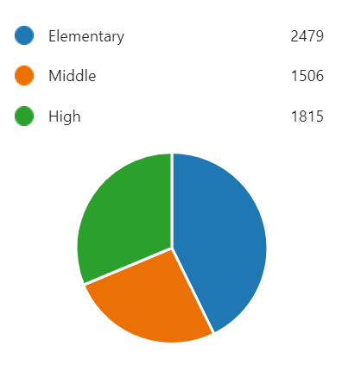
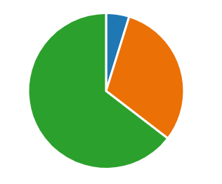
Survey Results
Parents – 4,313 surveys
Staff – 2,327 surveys
Administrators – 112
Support Staff – 715
Teachers – 1507
5%
31%
65%
31%
43%
26%

Slide 14
Parents - Did the Fall Break enhance your child's engagement and preparedness upon returning to school?
36%
64%

Slide 15
Should we continue to have a Fall Break?
Parents
Staff
6%
20%
80%
94%

Slide 16
What is your opinion on the duration of the Fall Break?
Parents
Staff
5%
7%
13%
29%
66%
80%

Slide 17
Well-Being
Parents -Did the Fall Break have a positive impact on your child's well-being?
Staff - Did the Fall Break have a positive impact on your well-being?
8%
21%
92%
79%

Slide 18
Process
Research modified calendars used across the United States
Research modified calendars implemented in SC
Create drafts of potential modified calendars
Held town hall meetings across Aiken County to address questions
Distribute surveys to stakeholders for feedback
Calendar Action Team develops a modified calendar for ACPSD
School Board approves first modified calendar for the 2023-24 school year
Draft of the 2024-25 calendar created, modeled after the 2023-24 calendar
Present draft of the 2024-25 calendar to the Teacher Forum
Superintendent Advisory Groups (parents and students) provide feedback on the initial two-week fall break
Distribute survey to parents and staff to gather additional feedback on the calendar
School Board approves the 2024-25 calendar
Drafts of the 2025-26 and 2026-27 calendars shared with teachers of the year and others
School Board approves 2022-23 school year as a transition year
Present drafts of the 2025-26 and 2026-27 calendars to the School Board

Slide 19
Calendar Framework and Guidelines
School Year Policy IC
School Calendar Policy ICA
State regulations for school calendars
Two-week fall break
Two-week winter break
Two-week spring break
First semester completed by winter break
First day for teachers after the winter break is a workday
School year ends by May 31
Six-week summer break for teachers
Seven-week summer break for students

Slide 20
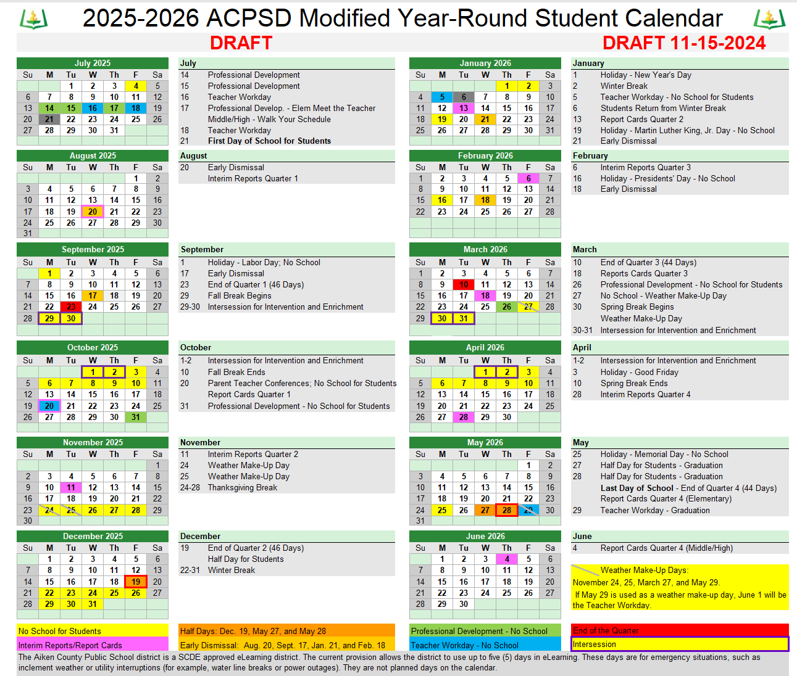

Slide 21
