Slide 1
Strategic Plan Annual Update
March 13, 2012

Slide 2
School Board Policy ADA School District Goals and Objectives
The district will develop and implement five-year comprehensive plans by schools and by the district to meet the requirements of The Early Childhood Development and Academic Assistance Act of 1993 (Act 135), Section 2 and Section 11.
The school district and each school in the district must coordinate in developing a comprehensive five-year plan that will be updated annually to carry out the purposes of the law.
The plans must contain performance goals, interim performance goals and timelines for progress.

Slide 3
Strategic Plan
School Renewal Plans
School Level Title I Plans
Technical Assistance
School Improvement
District Title I
Professional Development
Technology
Facilities
Grants
Notes:
The big picture
Required by state law
Comprehensive five-year
Updated annually
Includes assurances that the district adheres to applicable laws and regulations
Snapshot of the current reality with expectations for the future
Goals
Strategies
Activities

Slide 4
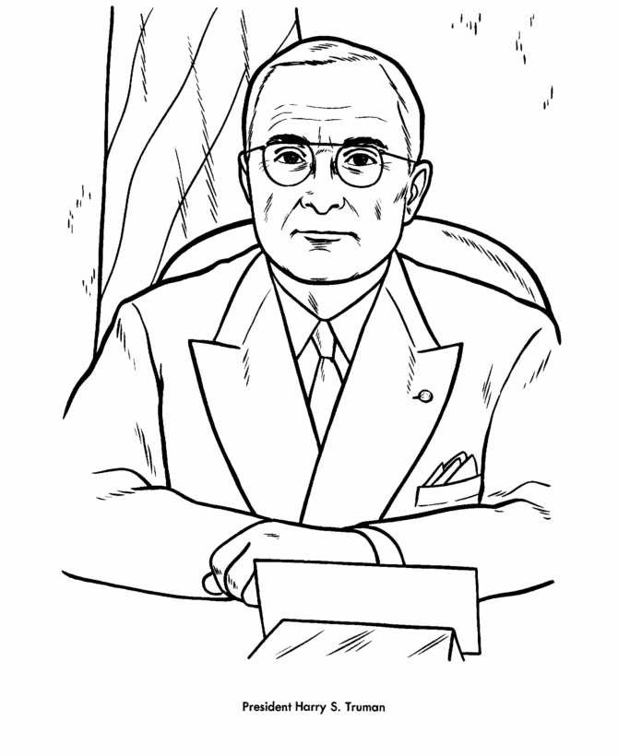
“You can always amend a big plan, but you can never expand a little one.” -Harry Truman (1949)
Notes:
A plan should be a seed, enabling growth, not a container limiting development.

Slide 5
SMART Goals
Specific
Measurable
Attainable
Results-oriented
Time-bound
Notes:
Review of many strategic plans
Most attempted to use SMART Goals – some were not close
Some were as ambitious as ours – some were not

Slide 6
Goals
By spring 2014, Aiken County students will demonstrate academic proficiency by meeting [specific] targets.
By spring of 2014, the on-time graduation rate for our students in each demographic subgroup will be at least 80% and will meet or exceed the state average as indicated on the district report card.
Notes:
We believe our goals are SMART and shoot for a high mark

Slide 7
Goals
By spring of 2014, 100% of our classes will be taught by teachers who maintain highly qualified status as defined by the No Child Left Behind Act.
By spring of 2014, 95% of the district’s stakeholders will indicate satisfaction with the learning environment, social and physical environment, and school-home relations at each of our schools as measured by agree and strongly agree responses on the state report card survey.
Notes:
Charter schools may have up to 25% non-HQ – Figured into district numbers
Personnel shifts may create a lag in teachers becoming HQ

Slide 8
Questions
What is it that we expect students to learn?
How will we know whether or not they have learned it?
How will we respond if they don’t learn it?
How will we respond if they already know it?
Richard DuFour (2004)

Slide 9
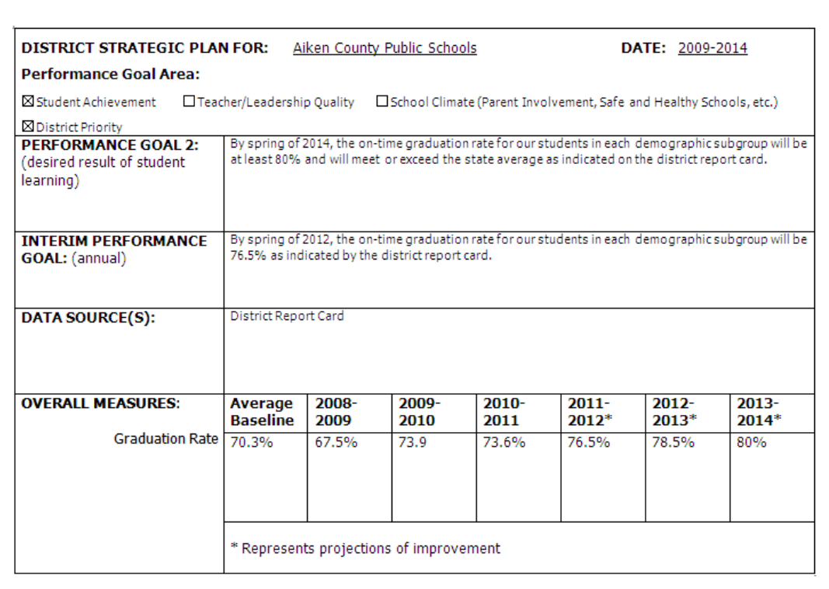
Notes:
What do we expect? – Goal
How will we know? – Data and interim performance
How will we respond? – Update the plan
If the goal is met? – Set a new goal
We are never finished – We are always looking for better ways to meet the needs of students

Slide 10
Revisions
Coincide with recent administration recommendations
School Board focus areas
Curriculum development, alignment, and support
Specific professional development for administrators, teachers, guidance counselors, and support personnel
Alternative learning opportunities

Slide 11
Revisions
Coincide with recent administration recommendations
Community involvement and engagement
Expand adult education diploma opportunities
Technology improvements and expansion
Consolidated redundant activities

Slide 12
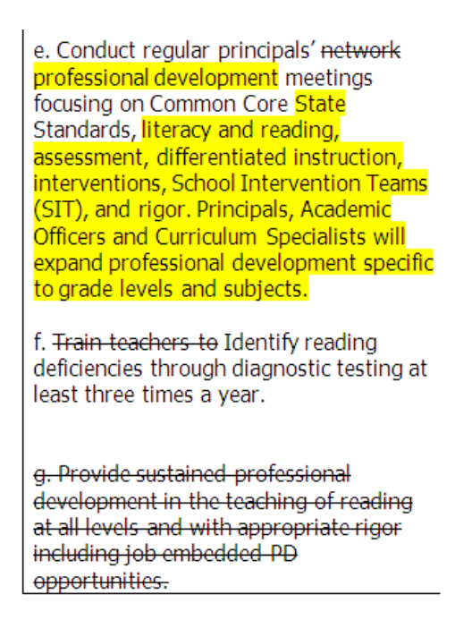
Notes:
Remember, this is an update
We keep the spirit of the original plan, but adjust based on new information or to make it more accessible to the user

Slide 13
Next Steps
Continue to refine current strategic plan
Annual update – Spring 2013
New strategic plan – 2013-2014
Involve all stakeholder categories
Extend targets to 2019
Coordinate with AdvancED accreditation
Continue the cycle of continuous improvement

Slide 14
Questions?

