Slide 1
Legislative Update 2018-2019 Weeks In Review
AIKEN COUNTY PUBLIC SCHOOL DISTRICT
May 28, 2019
AIKEN COUNTY PUBLIC SCHOOL DISTRICT Legislative Update: 5/28/2019
Notes:
**It’s not really this complicated, just erase all but one letter and enter your own info (then erase that first letter). But if you’re curious and want to play around with the presentation, the below is the guide:
TITLE:
font: Calibri Light Headings (all caps); Bold
font size: lg. depending on length 50/60 pt.
color: Black & Gray (Black, Text 1 Lighter 35%)
Subheading:
Part 1 (ACPSD): Font: Calibri Light (Headings) All Caps, Light Green, 24 pt.
Part 2 (DATE): Font: Calibri Light (Headings) Small Caps, Gray (Black, Text 1 Lighter 35%)

Slide 2
It’s a Wrap!
House and the Senate adopted H. 4000 2019-20 Appropriations Act
Summary of education related funding provisions:
1. General Funds (Recurring)
$159 million 4% Teacher Salaries
$49.7 million State Health Plan
$32.4 million for 1% Employer Retirement Contribution
$15 million Base Student Cost
$2.2 million to Department of Mental Health for School Mental Health Services
AIKEN COUNTY PUBLIC SCHOOL DISTRICT Legislative Update: 5/28/2019
Notes:
Title:
Font: Calibri Light (Headings)
Size: about 54+ pt., depending on length
I use “AV” to increase the space between letters to as loose as possible.
Section Content:
Font: Californian 20+ size, black
Color: Light green/black/gray bullets (your preference)
Info Bar at Bottom:
Enter the title of your presentation (Font: Calibri; Size: 18 pt, all lower case; Color: white) and Date (Font: Calibri; Size: 18 pt., small caps; Color: gray)
Copy and paste on each slide, with the exception of slide 1.

Slide 3
H. 4000 2019-20 Appropriations Act
2. EIA Funds (Recurring)
• $4.2 million 1% Employer Retirement Contribution
• $10 million School Resource Officers
• $12.7 million Public Charter School Growth
• $504,313 SDE Grants Committee
• $12 million decrease in Technology Funds (eliminates the line completely)
AIKEN COUNTY PUBLIC SCHOOL DISTRICT Legislative Update: 5/28/2019

Slide 4
H. 4000 2019-20 Appropriations Act (cont’d)
3. Lottery Funds (Non-recurring)
• $20 million Instructional Materials
• $19.3 million School Buses
• Excess Above FY 18-19 Certified Surplus
$2.8 million SCDE Innovation Grants
All remaining unallocated funds to be applied to instructional materials
• Unclaimed Prizes
Unclaimed prizes in Excess of $19 million to be applied to school bus lease/purchase
AIKEN COUNTY PUBLIC SCHOOL DISTRICT Legislative Update: 5/28/2019

Slide 5
H. 4000 2019-20 Appropriations Act (cont’d)
4. Excess Debt Service Funds (Non- recurring)
• $65,000,000 to the Department of Commerce for the Rural School District and Economic Development Closing Fund
• $50,000,000 to the Department of Education for School District Capital Improvements
Notes:
Title:
Font: Calibri Light (Headings)
Size: about 54+ pt., depending on length
I use “AV” to increase the space between letters to as loose as possible.
Section Content:
Font: Californian 20+ size, black
Color: Light green/black/gray bullets (your preference)
Info Bar at Bottom:
Enter the title of your presentation (Font: Calibri; Size: 18 pt, all lower case; Color: white) and Date (Font: Calibri; Size: 18 pt., small caps; Color: gray)
Copy and paste on each slide, with the exception of slide 1.

Slide 6
Notable Education Related Provisos
1.3 State Aid to Classrooms – Adds $15 million to the Base Student Cost
1.25 School Districts and Special Schools Flexibility – Deletes the suspension of the professional staffing ratios
1.57 Full-Day 4K – Increases the per student rate from $4,510 to $4,600
AIKEN COUNTY PUBLIC SCHOOL DISTRICT Legislative Update: 5/28/2019

Slide 7
Notable Education Related Provisos (cont’d)
1.70 Technology Technical Assistance –SDE to withhold $350,000 for statewide technology plan for schools and districts
1.80 Retired Educators Employment - For the current fiscal year school districts may notify retired educators of employment in writing on or before May 1.
1.89 Teacher Salaries/SE Average – Specifies that the projected Southeastern average teacher salary shall be the average of the average teachers' salaries of the southeastern states
AIKEN COUNTY PUBLIC SCHOOL DISTRICT Legislative Update: 5/28/2019
Notes:
Must be in compliance of Section 9-1-1795 of the 1976 Code

Slide 8
Notable Education Related Provisos (cont’d)
3.5 FY 2019-2020 Lottery Funding – Specifies the following:
$20,000,000 -Department of Education- Instructional Materials
$19,363,280 -Department of Education- School Bus Lease/Purchase
$250,000-Department of Education-Reading Partners
AIKEN COUNTY PUBLIC SCHOOL DISTRICT Legislative Update: 5/28/2019

Slide 9
Dates to Remember
November 6-8 SCASBO Fall Conference
January 14, 2020 Legislative Session Begins
AIKEN COUNTY PUBLIC SCHOOL DISTRICT Legislative Update: 5/28/2019

Slide 10
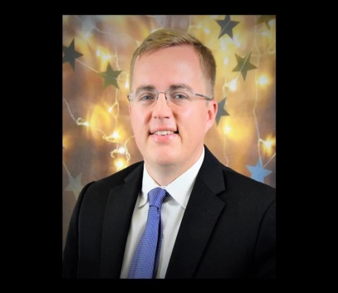
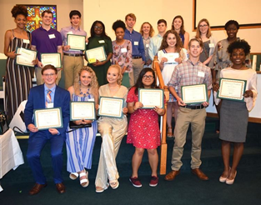
Aiken County Public School District Highlights!
AIKEN COUNTY PUBLIC SCHOOL DISTRICT Legislative Update: 5/28/2019
Notes:
Dr. Jason Holt: Aiken High School , New Principal 2019-2020;
First MVHS Early College Grads;
Dr. Ka’Ron Webb, New Principal at RS-MHS for 2019-2020year;
Seniors Earn Scholarships and Laptops;
Teachers affecting Culture!!!

