Slide 1
Legislative Update
2018-2019 Weeks In Review
AIKEN COUNTY PUBLIC SCHOOL DISTRICT Legislative Update: 5/14//2019
Notes:
**It’s not really this complicated, just erase all but one letter and enter your own info (then erase that first letter). But if you’re curious and want to play around with the presentation, the below is the guide:
TITLE:
font: Calibri Light Headings (all caps); Bold
font size: lg. depending on length 50/60 pt.
color: Black & Gray (Black, Text 1 Lighter 35%)
Subheading:
Part 1 (ACPSD): Font: Calibri Light (Headings) All Caps, Light Green, 24 pt.
Part 2 (DATE): Font: Calibri Light (Headings) Small Caps, Gray (Black, Text 1 Lighter 35%)

Slide 2
The 2019-20 Appropriations Act H.4000
Discussed/Amended/Sent to Senate…5/7/19
Senate… non-concurred with amendments
Both bodies appointed conference committee members.
Conference committee meets Tuesday-5/14
General Assembly returns May 20th to hear the conference committee report
AIKEN COUNTY PUBLIC SCHOOL DISTRICT Legislative Update: 5/14//2019
Notes:
Title:
Font: Calibri Light (Headings)
Size: about 54+ pt., depending on length
I use “AV” to increase the space between letters to as loose as possible.
Section Content:
Font: Californian 20+ size, black
Color: Light green/black/gray bullets (your preference)
Info Bar at Bottom:
Enter the title of your presentation (Font: Calibri; Size: 18 pt, all lower case; Color: white) and Date (Font: Calibri; Size: 18 pt., small caps; Color: gray)
Copy and paste on each slide, with the exception of slide 1.

Slide 3
Education-related Amendments House adopted on May 7th
SDE: Online Accounting or Ledger
50.21 CMRC: Development - Funding for Rural Infrastructure
South Carolina Public Charter School Funding
SDE: Standards-Based Assessments Suspended
SDE-EIA: Formative Assessments
AIKEN COUNTY PUBLIC SCHOOL DISTRICT Legislative Update: 5/14//2019

Slide 4
Bills for Governor’s Consideration
S.735
Abolishes the Clarendon County Board of Education/provides for the election/appointment of members of the Clarendon 1 and Clarendon 2 Boards of Trustees
Vetoed by the Governor on May 1st
The House and the Senate voted to override Governor’s veto.
AIKEN COUNTY PUBLIC SCHOOL DISTRICT Legislative Update: 5/14//2019

Slide 5
Bills Gone For This Session But Not Forgotten
H.3620 Retirees returning to work
H. 3681 Equal Opportunity Education Scholarship Account Act (Private Schools)
H. 4403 Adds to the list of components that local school districts
H. 3199 Instructional topics… high school financial literacy… college and education loans
AIKEN COUNTY PUBLIC SCHOOL DISTRICT Legislative Update: 5/14//2019
Notes:
Title:
Font: Calibri Light (Headings)
Size: about 54+ pt., depending on length
I use “AV” to increase the space between letters to as loose as possible.
Section Content:
Font: Californian 20+ size, black
Color: Light green/black/gray bullets (your preference)
Info Bar at Bottom:
Enter the title of your presentation (Font: Calibri; Size: 18 pt, all lower case; Color: white) and Date (Font: Calibri; Size: 18 pt., small caps; Color: gray)
Copy and paste on each slide, with the exception of slide 1.

Slide 6
Bills Gone For This Session But Not Forgotten
H. 3257 SDE to select/develop instructional units in mental health/wellness
H. 4413 Specifies if the 2019-2020 state fiscal year begins with no annual general appropriations act in effect
H. 3757 Establish the Workforce and Education Data Oversight Committee (WEDOC)
AIKEN COUNTY PUBLIC SCHOOL DISTRICT Legislative Update: 5/14//2019

Slide 7
Bills Gone For This Session But Not Forgotten
S. 203 Any local school district with less than 1,500 (ADA) in Tier IV August 1, 2022 Must Consolidate
S. 276 Unlawful to threaten, solicit another to threaten, or conspire to threaten
S. 293 Church official or governing body may give permission to carry a concealable weapon areas within the school for church services or official church activities, while leasing school for church services
AIKEN COUNTY PUBLIC SCHOOL DISTRICT Legislative Update: 5/14//2019

Slide 8
Bills Gone For This Session But Not Forgotten
H. 3403 State Board of Ed to waive laws/regulations when a district starts a competency-based school program
S. 556 Provide scholarships for students to attend private schools
S. 15 One-half credit in personal finance by 2020-2021 school year
S. 11 Daylight Saving Time: Year-round
H. 3012 Grant school districts E-rate fund flexibility
H. 3136 Exceptional needs children of Active duty members…Fund to increase from $12 million to $20 million
AIKEN COUNTY PUBLIC SCHOOL DISTRICT Legislative Update: 5/14//2019

Slide 9
Dates to Remember
May 7 – 20 Budget Conference Committee & Report
May 20-22 Conference Committee Report Delivered to the Governor
May 20-22 Sine Die – General Assembly Returns for Vetoes
AIKEN COUNTY PUBLIC SCHOOL DISTRICT Legislative Update: 5/14//2019

Slide 10
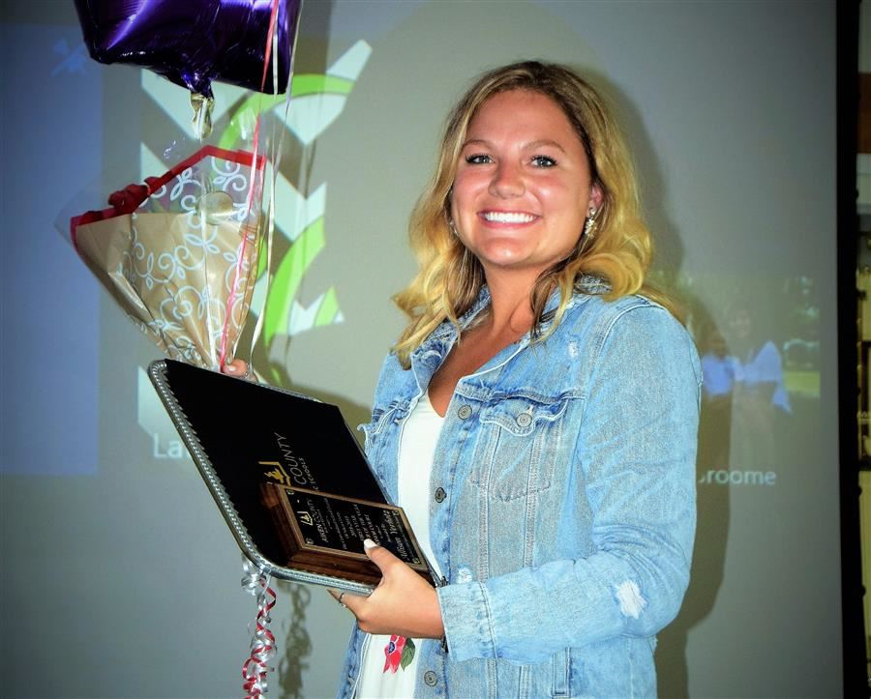
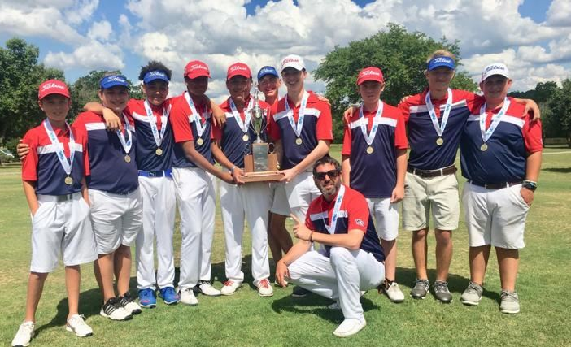
Aiken County Public School District Highlights
AIKEN COUNTY PUBLIC SCHOOL DISTRICT Legislative Update: 5/14//2019

